Slide 1

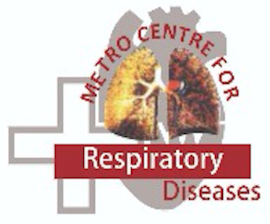
Deepak Talwar
MCRD WASOG SARCOID CLINIC
Pharmacological Management of Interstitial Lung Diseases
MD, DTCD, DNB, DM ( Pulmonary & Critical Medicine ) FISDA, FCCP ( USA ), FNCCP
Director & Chair
Pulmonary, Sleep, Allergy & Critical Care Medicine
Metro Group of Hospitals, INDIA

Slide 2
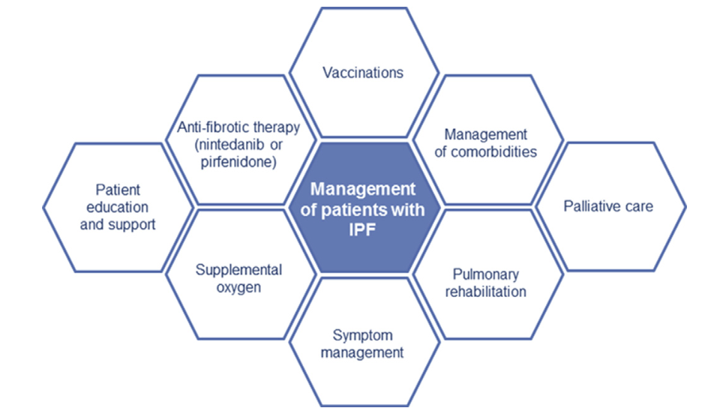
Management of ILD’s : Multidimensional
The goals of patient care are :
Recover Lung damage
To stop / slow the progression of the disease
Preserve QoL
Improve survival
Drug therapy in ILD’s
Management of ILD’s
Continuum of Care, sub-optimal outcomes

Slide 3

Response to Treatment in ILD : Complex & Variable ?
Clinical :
Physiological
Imaging
UIP
Probable UIP
Unclassifiable
Alternate diagnosis
Type
Severity
Exposures
AI features
Drugs
Steroids
Anti-Fibrotics
Immunosuppressives
Inflammatory
Fibrotic
Mixed Inflammatory Fibrotic
Guidelines ?
Algorithms ?
Med J Aust. 2022 Apr 18;216(7):331-333.

Slide 4
Immunosuppressives in ILD’s : Mainstay in Non IPF ILD’s
Corticosteroids
MMF/AZT/ MTX
Cyc / RTx / Toci
MMF
Which & When ?

Slide 5
Corticosteroids : Upfront Anti-inflammatory Drug
Ther Adv Respir Dis 2022, Vol. 16: 1–16
No High-quality Data
Good Response : Non-Fibrotic HP, OP & NSIP – CTD, Sarcoidosis, Eosinophilic Pneumonia
Partial Response : Fibrotic HP and CTD-ILD’s ( Except SSc-ILD ), iNSIP

Slide 6
Dose & Duration of Oral Steroids :
HP : 20-40 mg/day and taper to 10 mg/day
Sarcoidosis : 20-40 mg/day tapered to 10 mg/day in 3 months and maintain for ~1-2 years
iNSIP : 0.5 mg /kg/day taper 10 mg/day in 6 months and continue as per response
CTD ILD’s ( Except SSc ) : Minimum in RA-ILD (10mg/day) & maximum in IM-ILD (80mg/day )
Corticosteroids may improve lung function in patients with non-IPF f-ILD, but impact on mortality is uncertain
Pitre T, et al. BMJ Open Respir Res 2023

Slide 7
Immunosuppressives in F-ILD’s : 1st& 2nd Line
Steroids are ‘Not Recommended for Prolonged Use’ due its side effects
Ther Adv Respir Dis 2022, Vol. 16: 1–16

Slide 8
Mycophenolate Mofetil : MMF
Inhibits inosine monophosphate dehydrogenase
Exerts cytostatic effect on lymphocytes
Currently most widely used 1st line steroid- sparing agent in fibrosing ILD
It is generally effective, well tolerated and less toxic than CYC
SSc-ILD, IPAF, CTD-ILD, IM-ILD and FHP : Positive
1st line to reduce Steroids & Stabilize FVC & DLco
Sarcoidosis : Negative Study
Ther Adv Respir Dis 2022, Vol. 16: 1–16
Notes:
In 2016, a randomized trial compared 2years of MMF therapy with 1 year of oral CYC, followed by 1 year of placebo in SSc-ILD patients. A sig- nificant improvement in FVC and Rodney skin score over 2years was observed with both treat- ments, with no significant differences between drugs, although MMF was associated with less toxicity.11 Both regimens were associated with a significant improvement in the extent of high- resolution computed tomography (HRCT) ILD changes at 2 years38 and improvements in health- related quality of life.39
In chronic HP, patients treated with MMF or AZA had a significant improvement in DLCO12,43 and reduced prednisone requirements.43

Slide 9
Azathioprine
Inhibits purine synthesis and DNA replication in lymphocytes
Widely used as 2nd line therapy in fibrosing ILD’s
Most data in SSc-ILD and other CTD ILD’s
Sarcoidosis AZT is 2nd line, effective as MTX in steroid sparing & Stabilizing FVC & DLco
FHP AZT reduced OCS dose and FVC and DLco as also seen in MMF
2nd line agent to reduce Steroids in CTD / FHP ILD’s
Ther Adv Respir Dis 2022, Vol. 16: 1–16
Notes:
Data are unanimously positive, but largely limited to retrospective series
In SSc-ILD, AZA therapy following intravenous CYC induction has been shown to stabilize or improve lung function in both a 2008 retrospec- tive study and in the randomized Fibrosing Alveolitis in Scleroderma (FAST) trial.

Slide 10
Methotrexate
Folate analogue that interferes with purine and pyrimidine synthesis
Anti-inflammatory and immunosuppressant effects
Pulmonary Toxicity is very rare
RA-ILD : prevents progression to ILD, improve lung functions & survival
Sarcoid –ILD : ↓Steroids requirement and↑ FVC and ↑DLco
2nd line agent to reduce Steroids in RA & Sarcoid ILD’s
Ther Adv Respir Dis 2022, Vol. 16: 1–16

Slide 11
Cyclophosphamide & Rituximab: 3rd Line Therapy
Immunosuppressives but more toxic and used mostly as Salvage Therapy
Ther Adv Respir Dis 2022, Vol. 16: 1–16

Slide 12
Choice of Immunosuppressives in F-ILD’s
FHP
Sarcoidosis
iNSIP
IPAF
Steroids
MMF
AZA
Steroids
MTX
AZA
Steroids
MMF
AZA
CYC
Infliximab
Steroids
MMF
AZA
RTX / CYC

Slide 13
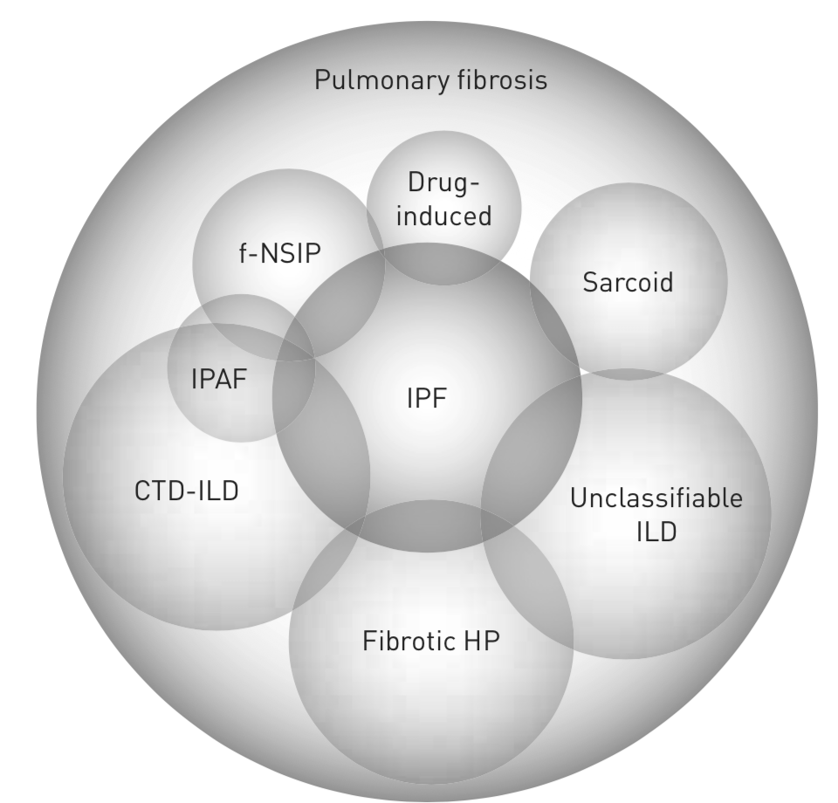
Pharmacological Treatment for Fibrosis
Immunosuppressives
Antifibrotics
Progressive
Fibrosis
Immunosuppressives + Antifibrotics

Slide 14
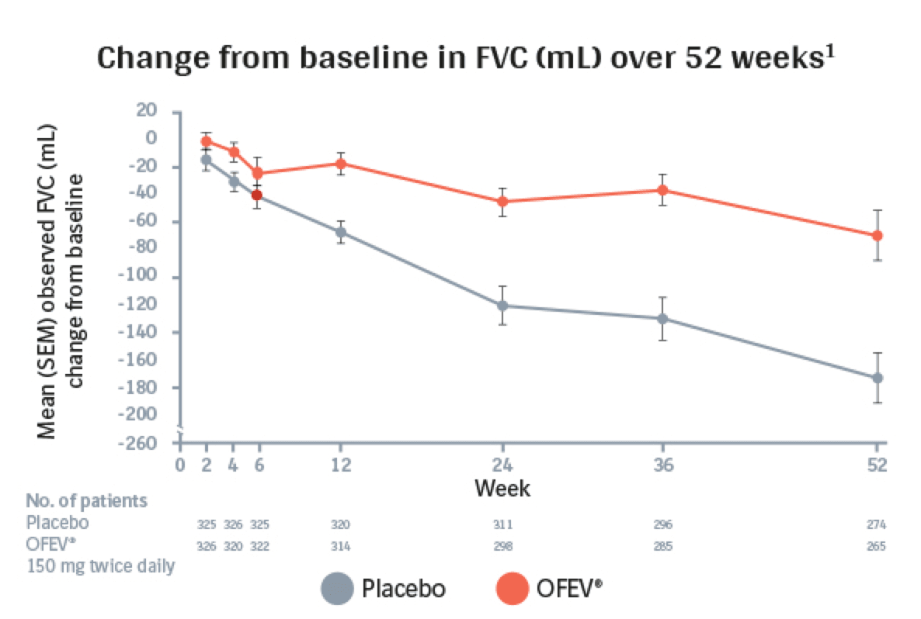
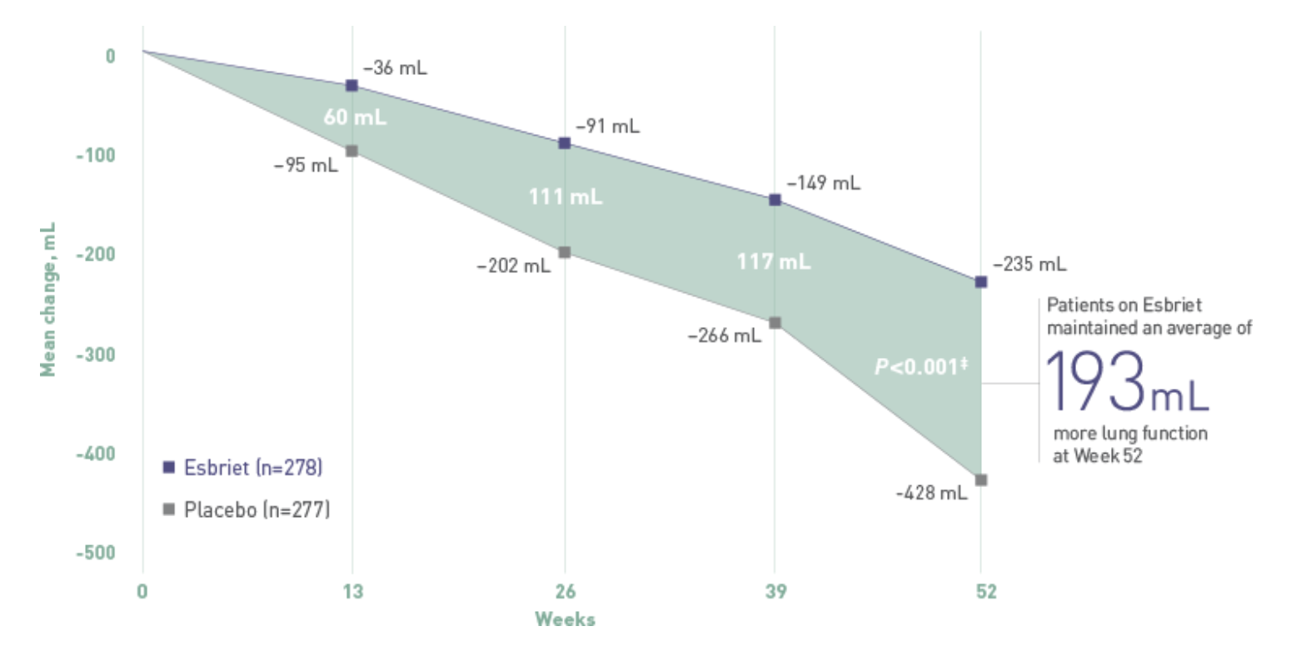
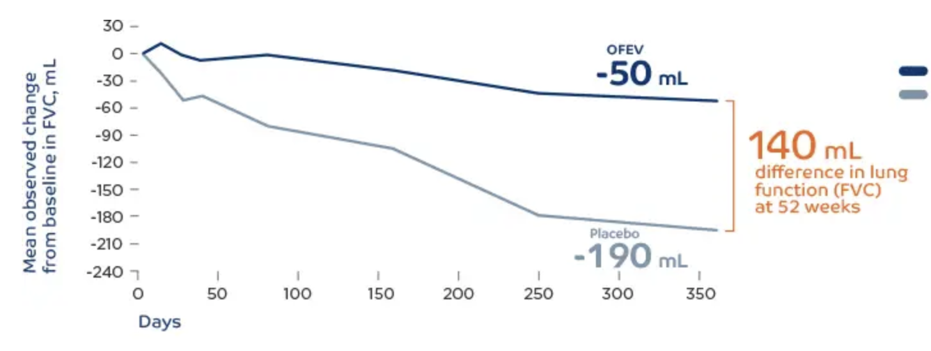
Both Antifibrotics Reduce Decline in FVC
Pirfenidone
Placebo
Nintedanib
King TE Jr, et al. N Engl J Med, 2011.370(22):2083-92.
Richeldi L et al; N Engl J Med. 2014;370(22):2071-2082.
~ 50%

Slide 15
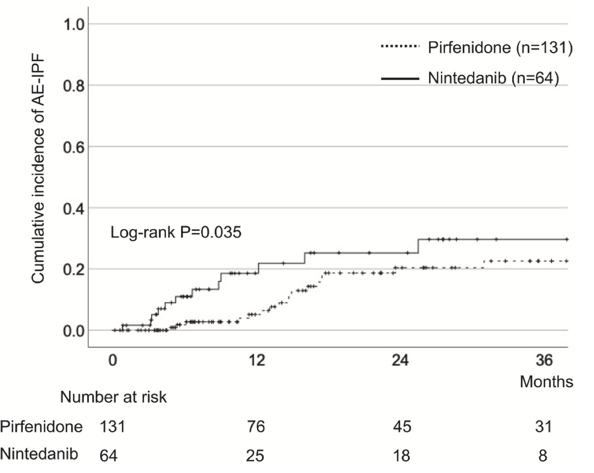
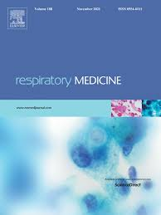
Reducing Risk of IPF-AE : Both Antifibrotics Work!
N = 199 IPF patients
Pirfenidone
Retrospective study 2010-2018
Respiratory Medicine 2021; 187: 106551

Slide 16
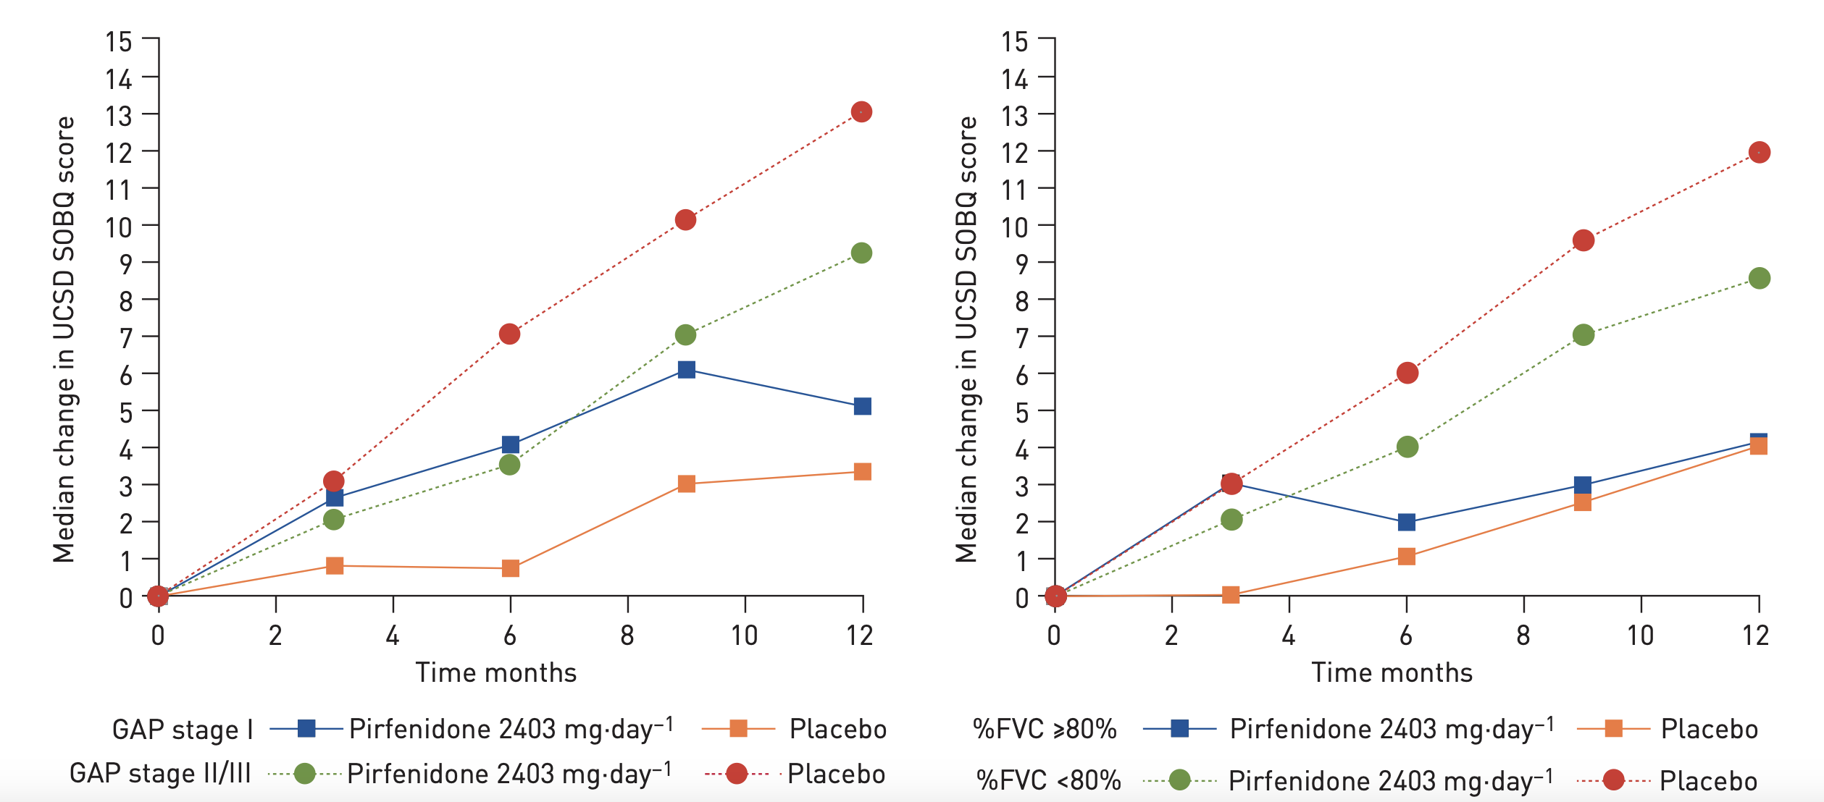



QoL in IPF ?
Pirfenidone Improved cough in 74% @ 12 weeks
24-h cough decreased by 34%
Cough reduction starts within 4 weeks in 70%
Improved cough related QoL
Eur Respir J. 2017 Oct 19;50(4):1701157.
Patients with IPF on Nintedanib in the FIBRONET study, patients with cough decreased
Dyspnoea
Decreased mobility
Cough
Pirfenidone Improved SOBQ @ 12 months
Effective in GAP II & III and FVC < 80%
RWE also improved dysnea scores
Respiration (2022) 101 (6): 577–584
Eur Rrespir J 2019;54:1900399

Slide 17
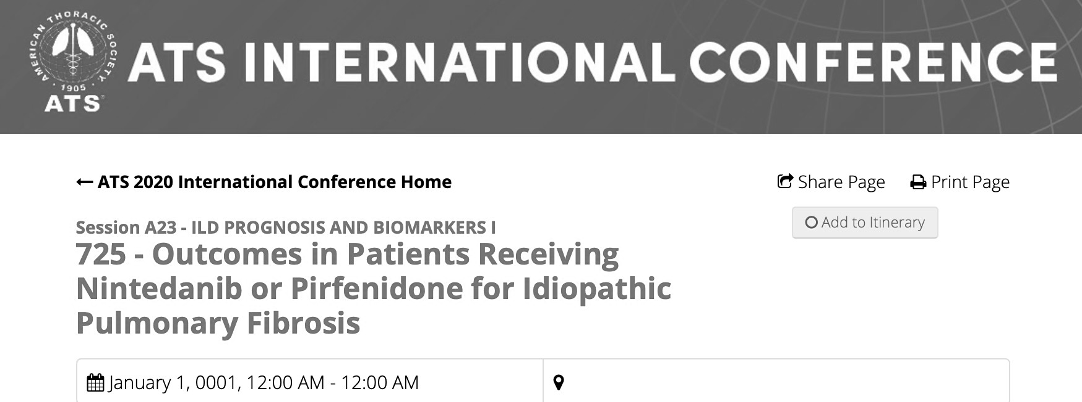
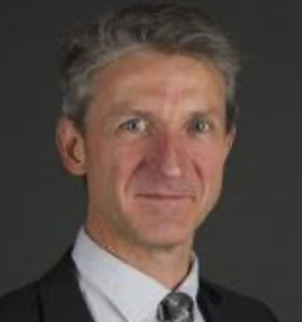

Headlines … Anti Fibrotics in IPF Improve Survival !
The cumulative all-cause mortality @ 3 years:
50.23% (95% CI=[48.34%-52.09%]) in untreated
25.5% (95% CI=[19.6%-31.7%]) in Pirfenidone
31.1% (95% CI=[21.2%-41.6%] in Nintedanib

Slide 18
ANTI-FIBROTICS : Pirfenidone OR Nintedanib : ?
 | Pirfenidone | Nintedanib
Dose Escalation | Required | X
Number of Tablets | 3 -12 | 2
Adverse Effects | UGI Toxicity | Lowe GI Toxicity
Low BMI |  | X
CAD | +
Oral Anti-coagulants | +
Elective Major Surgery | +
QoL | + | +
Prevention of AE / Respiratory Hospitalization | + | +

Slide 19




Progressive Pulmonary Fibrosis in Non IPF ILD’s
Worsening respiratory symptoms;
Physiological evidence of disease progression
Radiological evidence of disease progression
18–32% of patients with non-IPF ILDs develop “PPF (despite management)” within 61–80 months from the onset of symptoms
Eur Respir J 2023; 61: 2103187

Slide 20

Q? Antifibrotics : Add or Alone in PF- ILD’s ?
INBUILD showed decrease progression in PF-ILD’s with add on Nintedanib as add on immunosuppression
Clinical dilemma :
Intensify immunosuppressive
OR introduce antifibrotic
OR use as combination
Recommended 3-6 months on standard therapy before adding antifibrotic
Adverse effects need to monitored more closely, especially Infections, Liver/ Kidney toxicity

Slide 21
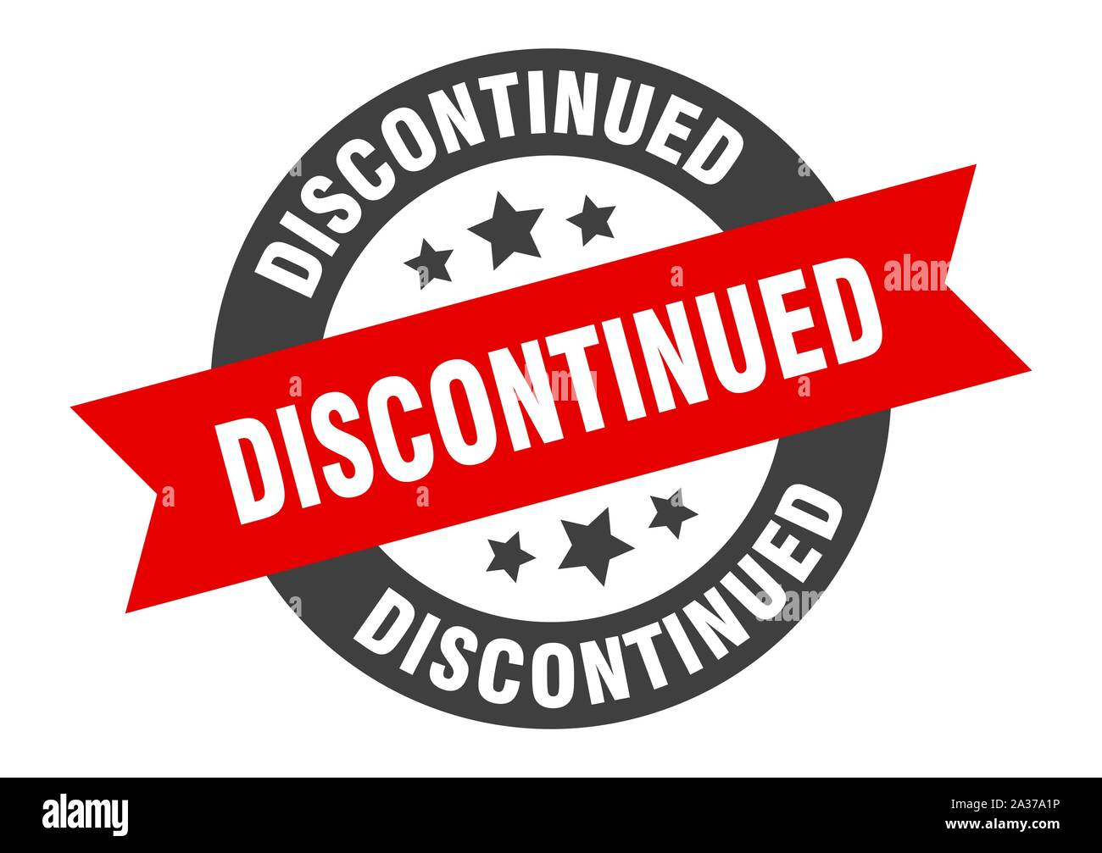
How Long to Continue OCS & Immunosuppressives
ILD Pattern
OP
Myositis- ILD
Young Age & Pathology
Previous OCS Responsive
Sarcoidosis
Non-Pulmonary Flare on OCS Stoppage
NSIP
Adrenal
UIP
Old Age
Reoccurring Infections
No clinical / physiological improvement with ↑ risk of OCS side effects
In specific PPF such as CTD-ILD and F-HP, the group is generally in favour of immunosuppressants (non-corticosteroid) being continued
European Respiratory Journal 2023 61: 2103187

Slide 22


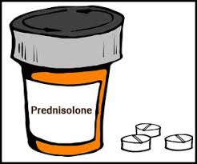
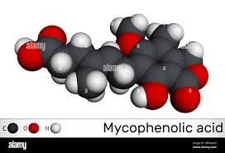
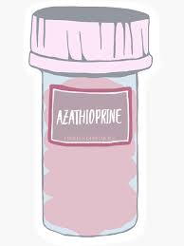
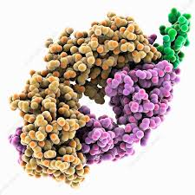
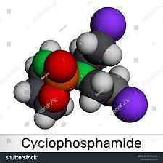
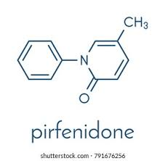

Conclusions:
HP, CTD and Sarcoidosis ILD’s, iNSIP, IPAF are suitable for IS
Steroids are 1st Choice in most ( Except SSc-ILD ), but not indefinitely
MMF is 1st line immunosuppressive for most Non IPF ILD’s ( Except Sarcoidosis ( MTx) )
AZA Is 2nd option in HP / iNSIP
Newer drugs : RTx, Toci / Tofacitinib gaining recognition in CTD-ILD’s
Cyclophosphamide: 3rd line / Rescue in most ( not in HP/Sarcoidosis)
Stopping IS is possible in few cases but need to be individualized
Antifibrotics are 1st linE in IPF but after IS in Non IPF ILD's when its PPF
Combined IS + Antifibrotics in some non IPF ILD's but IS should be non Steroids
immunosuppressives + Antifibrotics
MMF

Slide 23
Thank you

