Slide 1

Medical Management of IPF in Present Times
15 June 2020 Webinar on NEW Normal in IPF
Dr Deepak Talwar
Director & Chair
Pulmonary, Sleep & Critical Care
Metro Centre for Respiratory Diseases
Metro Hospitals & Heart Institutes, NCR India

Slide 2
Various Touch Points in IPF … In Present Times
Pharmacotherapy
Pulmonary Rehabilitation
Oxygen Therapy
Palliative Therapy
‘ touchpoint ’ :
A time, condition, or circumstance that is vulnerable or unstable enough to precipitate a highly unfavorable, possibly devastating outcome
– English Oxford Dictionary
Lung Transplantation
Lung Tx
Post
Tx

Slide 3
Issues in Medical Management of IPF During COVID Times :
Pharmacotherapy & Non-Pharmacological Therapies

Slide 4
Q 1 What do you think is Not Achievable by use of Antifibrotics in IPF ?
Improvement in symptoms
Better survival
Less decline in lung functions
Lesser exacerbations
More transplant free survival

Slide 5
Issues with Pharmacotherapy in Present Times : Antifibrotics
Safety & Efficacy of Antifibrotics
Monitoring with lung functions may be sub optimal
Targeting optimal dose of antifibrotic drugs to achieve best clinical response is the aim
Drug related adverse events needs to be minimized
Long term maintenance and adherence to antifibrotics to be ascertained
Choosing an antifibrotic drug in new cases

Slide 6
Q 2 What do you think is main Plus Point of Nintedanib over Pirfenidone in IPF ?
Better drug tolerability
Better survival
Better in cardiac comorbidities
More effective in Severe disease

Slide 7
Pharmacotherapy : Antifibrotics
European IPF Network: Over time antifibrotics have replaced other therapies
N= 525 IPF
83% on Pirfenidone
Respiratory Research 2018; 19:141

Slide 8
Antifibrotics Improve Survival too …
N= 525 IPF
European IPF Network: Antifibrotics* improved survival in IPF patients
vs. those receiving prednisolone or other treatments
*83% on pirfenidone
N= 525 IPF
* 83% of patients received pirfenidone and 17% received nintedanib
Respiratory Research 2018; 19:141

Slide 9
Which Anti-fibrotic to Choose in IPF…
Drug B
Nintedanib
2016 - 2019
Pirfenidone
Drug A
2/2 phase III trials positive
2/3 phase III trials positive
Efficacious in broad range of IPF patients
Efficacious in patients with strict inclusion criteria
Safety
Efficacy
Cost
Reduces the risk of acute exacerbations
Does not decrease the risk of acute exacerbations
One capsule twice a day
4 tablets 3 times a day
Lower GI side effects
Upper GI side effects
Avoid in unstable CAD /AC
Avoid if eGFR < 30ml
Notes:
VEGF receptor inhibition has been associated with both thrombosis and haemorrhage [25], therefore patients with a recent history of unstable ischaemic heart disease or those receiving full-dose anticoagulation or high-dose antiplatelets were excluded.
Pirfenidone is contraindicated in patients with a crea- tinine clearance (CrCl) of\30 mL/min. It is metabolised by cytochrome P450 (CYP) 1A2 and interacts with drugs that use this pathway. Cigarette smoke can potentiate the meta- bolism of pirfenidone through CYP1A2, making it less effective; therefore, it is recommended that patients stop smoking prior to or on initiation of treatment

Slide 10
Real World Experience with Antifibrotics in IPF
Patients with total drug exposure as high as 9.9 years still appeared to tolerate pirfenidone therapy
Pirfenidone
Nintedanib
2018
Acceptable long-term safety and efficacy
@> 3 years of treatment.
AE led to discontinuation in 22.5%
Skin-related adverse events (25%)
Liver toxicity in 5%
FVC improved in 20%, stable in 65% @ 2 years
Mortality at 3 years 32.5%
Safety and efficacy @ 1 year 21% discontinued due to severe AE
18% mortality
20% had pre-existing CAD
2 % had MI
Efficacy irrespective of IPF severity : mild to severe ( FVC >80% < 50%
Jury’s Still Out
2018

Slide 11
IPF in 2020 is Different !
V. Cottin¹, P. Spagnolo², P. Bonniaud³, M. Nolin⁴, F. Dalon⁴, K. Kirchgässler⁵, J. Chia⁶, T. V. Kamath⁶, E. Van Ganse⁷, M. Belhassen⁴;
The cumulative all-cause mortality @ 3 years:
50.23% (95% CI=[48.34%-52.09%]) in untreated
25.5% (95% CI=[19.6%-31.7%]) in Pirfenidone
31.1% (95% CI=[21.2%-41.6%] in Nintedanib

Slide 12
IPF : Pirfenidone
IPF is the result of ‘fibroblast dysfunction’ rather than dysregulated inflammation
Anti-inflammatory therapy does not improve disease outcome (PANTHER Trial)
Pirfenidone inhibits TGF-β stimulated collagen synthesis
Slows the decline in lung function
30% improvement in progression-free survival
1.ID Drugs 2004; 7: 166-172
2.Cochrane Database of Systematic Reviews 2010, Issue 9. Art. No.: CD003134
3.A 389, ERS 2010, Barcelona
4.Am J Respir Crit Care Med 1999; 159: 1061-69
PFD
X 3

Slide 13
Slower Decline in FVC :
High-dose (2403 mg/d) vs Low Dose (1197mg/d) Pirfenidone
Preclinical and clinical studies on pirfenidone have indicated that pirfenidone acts in a dose-dependent manner; hence IPF patients should be maintained on high dose (ie 1800-2400mg/d) pirfenidone
BMJ Open Resp Res 2018;5: e000323. doi:10.1136/ bmjresp-2018-000323
CAPACITY trials; Lancet 2011; 377: 1760–69

Slide 14
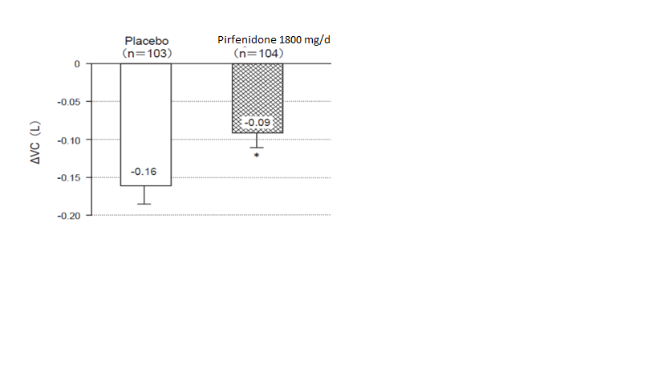
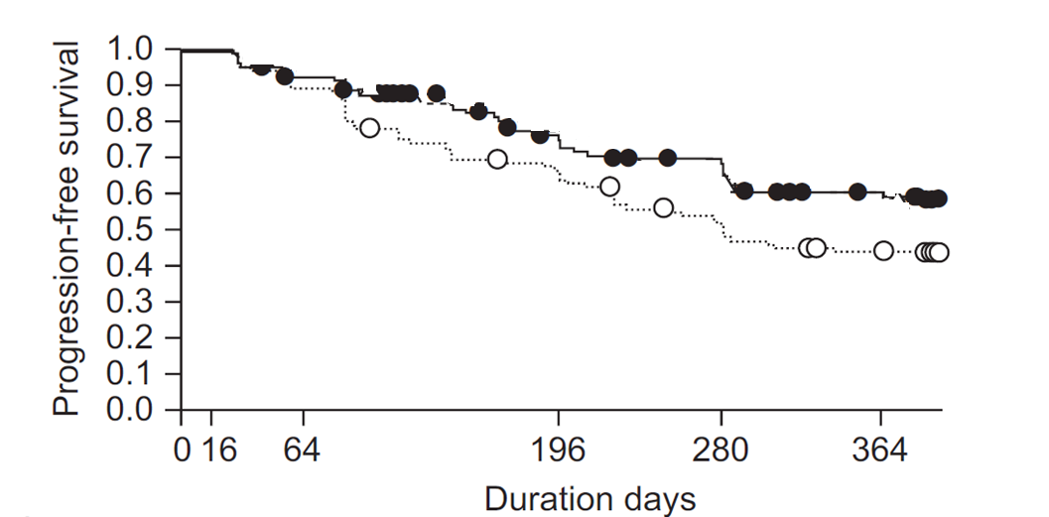
Better Progression-free Survival with high-dose Pirfenidone
* p=0.0416
Multicenter, double-blind, placebo-controlled, randomized phase III clinical trial
N= 275; Total Study Duration : 52 weeks
Solid circle: Pirfenidone (1800mg/d)
Blank circle: Placebo
Eur Respir J 2010; 35: 821–829

Slide 15
High dose Pirfenidone Reduces the Risk of Respiratory Related Hospitalization (RRH)
77% of hospitalizations in IPF patients are due to RRH¹
Significant risk reduction in RRH by 48%²
Fewer deaths in those with RRH²
40%
50%
N= 1274 IPF patients (623 pirfenidone 2403 mg vs 624 placebo)
Duration of Study: 52 weeks
1. Chest 2015; 147(1): 173 - 179
2. Am J Respir Crit Care Med 196 (6): 756–761
Notes:
There were a total of 139 events, of which 7% of patients in pirfenidone arm experienced at least one RRH vs 12% in placebo arm.
Total deaths due to RRH was 27% in pirfenidone arm vs 46% in placebo arm.
Thus pirfenidone treated patients were 48% less likely to experience respiratory Related Hospitalization at the end of 52 weeks.

Slide 16
Long term Pirfenidone : 2.5 years free of the 1st Acute Exacerbation and Improved Survival Rate
46 patients with IPF who received PFD
Group Long term : PFD for over 1 year (n=30)
Group Short term : PFD for less than 1 year (n =16)
Median age : 70.5 years
Median baseline % predicted forced vital capacity (%FVC): 70.0%
Intern Med 2018; 57: 2813-2818
Notes:
In this study, a total of 46 patients were treated with pirfenidone. Of 46, 30 IPF received pirfenidone for more than a year (Long-Term Group) while 16 patients received pirfenidone for less than a year (Short-Term Group).
As shown in the graph, patients who continued and adhered to Long term treatment, the 1st episode of AE occurred at 2.5 years (947 days); resulting in an improved survival observed in 86% in Long-term group compared to 18% in Short Term Group.
Thus, long term treatment with 2403mg pirfenidone results in 2.5 years free of 1st AE and improved survival.

Slide 17
Pirfenidone in Severe IPF : It Still Works !
72% reduced risk for all cause mortality
Fewer patients with advanced disease receiving pirfenidone reported >10% decline in FVC or death compared to placebo
Respiratory Medicine 153 (2019) 44–51

Slide 18
Pirfenidone : Symptomatic Relief in Cough in IPF
After 12 weeks of pirfenidone treatment, objective 24-h cough decreased by 34%
43 treatment-naïve IPF patients aged 40–85 years, who had daily IPF-related cough for ≥8 weeks with a cough score of ≥40 mm on a 0–100 mm visual analogue scale (VAS). FVC ≥50% and TLCOc) ≥30%
Eur Respir J 2017; 50: 1701157

Slide 19
High Dose Pirfenidone: Significantly reduces the worsening of patient-reported breathlessness *
IPF of various severities
* measured by change in the UCSD SOBQ score (University of California, San Diego Shortness of Breath Questionnaire) from the baseline to month 12
Eur Respir J 2019; 54: 1900399

Slide 20
Pirfenidone : Transplant Free Survival
24% patients received Pirfenidone as pre transplant therapy for 45.2 months.
During the treatment period, the pirfenidone group achieved a significant reduction in the decline rate of the forced vital capacity (-6.2%vs.-0.3%,p =0.04) and a lower lung allocation score (31 vs.41,p=0.013) compared with the non- Pirfenidone group.
The pirfenidone group exhibited 100% waitlist survival three years after registration that was comparable to other indications, and 66% of the patients were still alive at the time of organ availability.

Slide 21
High Dose Pirfenidone (2403mg/d ) Lowers the Risk of Disease Progression
83 less events
102 less events
Superior Efficacy
33 less events
20 less events
CHEST 2019; 155(4):712-719
Notes:
In a patient diagnosed with IPF, he/she may suffer from any of the below events at any given point of time.
Decline in FVC >10%
Decline in 6MWD>50m
Respiratory related hospitalization
Death
Hence, all the above events are considered as indicators of disease progression resulting in early death. Some of the events can occur multiple times in the same patient over 12 months, however its incidence is unknown.
As seen in the graph; patients treated with 2403mg of pirfenidone had 102 lesser events of decline in FVC>10%, 83 less events of decline in 6MWD >50m, 33 less events of respiratory related hospitalization and 20 lesser events of death compared to placebo.
Fewer patients who received pirfenidone had more than one progression event compared with placebo (17.0% vs 30.1%; P < .0001).
The study, thus concluded that continued treatment with 2403mg of pirfenidone can overall reduce the risk of disease progression.
Dark shaded “caps” (> 1 event) on each column depict the percentage of patients who had a second progression event of the same type.

Slide 22
Pirfenidone : Low discontinuation in Phase III & Real-World Studies
 | RECAP¹ N= 603 | CAPACITY¹ N= 345
Nausea | 30.0 | 36.2
Discontinuation | 1.3 | 1.4
Diarrhea | 22 | 28.7
Discontinuation | 0.5 | 0
Photosensitivity | 8.8 | 12.2
Discontinuation | 0.3 | 0.9
Rash | 13.3 | 32.2
Discontinuation | 1.2 | 1.4
PASSPORT (REAL WORLD STUDY) ² N= 1009
20.6
4.1
9.5
2.5
5.8
1.5
12.2
3.2
S/E due to pirfenidone was rarely associated with discontinuation
Data presented as %
Dose in all 3 studies: 2403mg/d
Passport study duration: 2 years
1.Eur Respir Rev 2015;24:58-64; 2.ERJ Open Res 2018; 4: 00084-2018
Notes:
In the RECAP study, the median time on treatment was 163.3 weeks. The mean daily dose of pirfenidone for all subjects during this time was 2070 mg/day, with the maximum possible daily dose being 2403 mg/day.
As shown in the table the most frequent, treatment-emergent adverse events were similar to those recorded in CAPACITY and were rarely associated with treatment discontinuation .

Slide 23
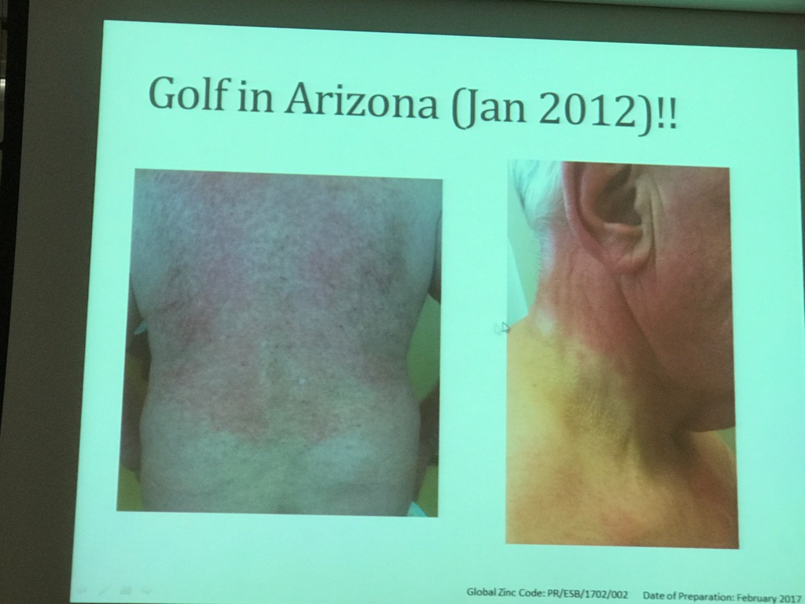
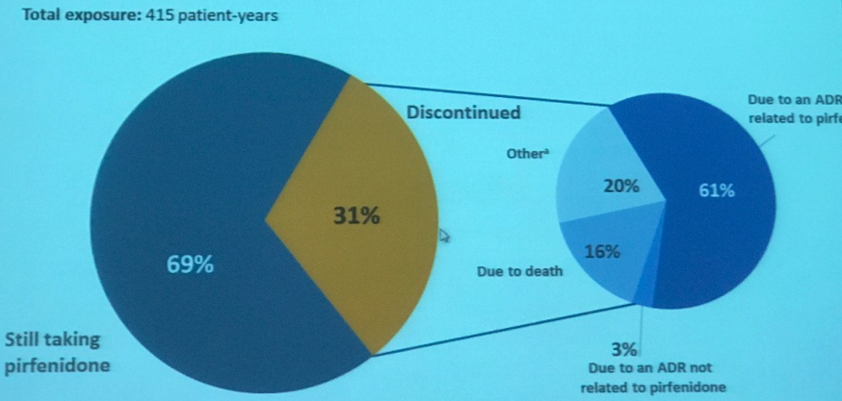
Managing Side Effects of Pirfenidone
67, Male Physician, IPF
Pirfenidone 2400 mg /day ( ramped - 2 months )
Developed rash
Stopped for 4 weeks and now being ramped to same dose ( 3 months )
Rash
Drug discontinuation due to adverse drug reactions was lower in patients who had a dose adjustment compared with those who did not (20% vs 33%)
PASSPORT Study Cottin et al Chest 2015

Slide 24
Dose modification in First 6 months Doesn’t Effect Outcomes of Pirfenidone in IPF ?
Dose interruptions, required to manage Treatment Emergent AEs, mostly occurred during the first 6 months of treatment
Despite dose reductions and interruptions, most patients with IPF maintained relatively high dose intensity on pirfenidone, without compromising its treatment effect
Notes:
It is also unknown if a minimum dose may be needed to maintain the efficacy of pirfenidone through a modification period; further division into dose subgroups (eg, <80%or <70%dose) was not possible in this analysis due to small sample sizes
higher proportion of men remained on >90% dose intensity than did women.

Slide 25
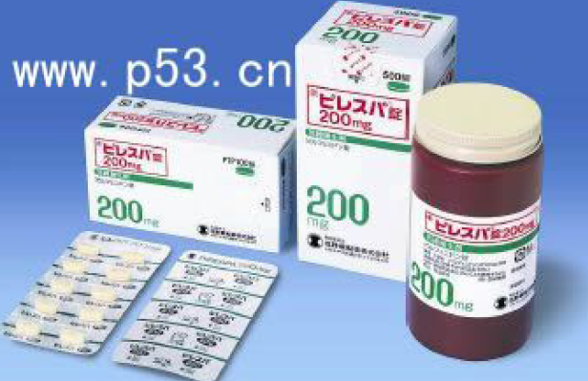
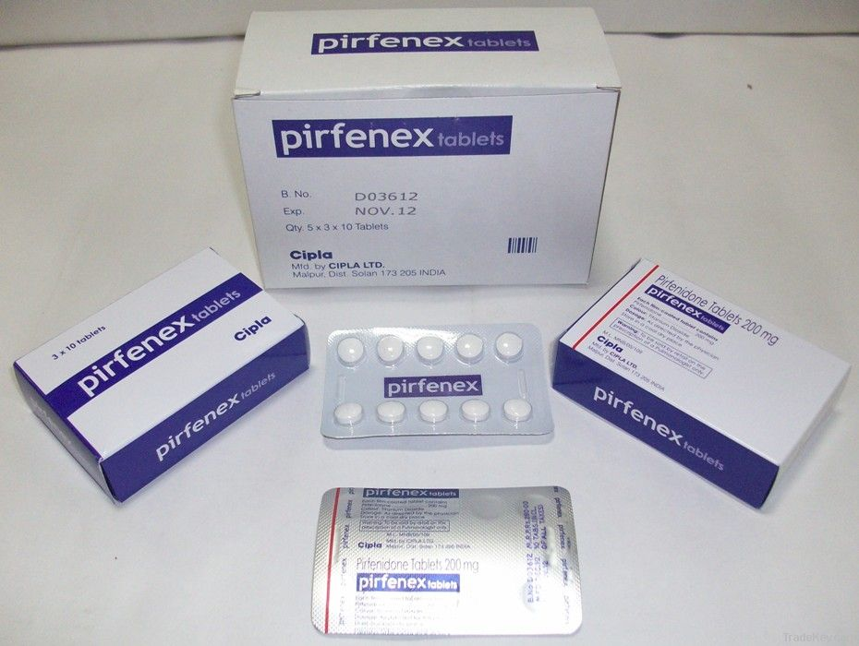
Pirfenidone – Pill Burden in India & World
Country | Approval Year | Drug name | Strengths approved | Approved Target Daily Dose
Japan | 2008 | Pirespa | 200mg | 1800 mg
India | 2010 | Pirfenex | 200mg 400mg 600 mg 801 mg | 1800 mg to 2400 mg
EU (Italy, Germany, France, UK) | 2011 | Esbriet | 267mg, 534mg, 801mg | 2400 mg
USA | 2014 | Esbriet | 267mg, 534mg, 801mg | 2400 mg
Canada | 2017 | PrESBRIT | 267mg, 801mg | 2400 mg
No Longer an issue

Slide 26
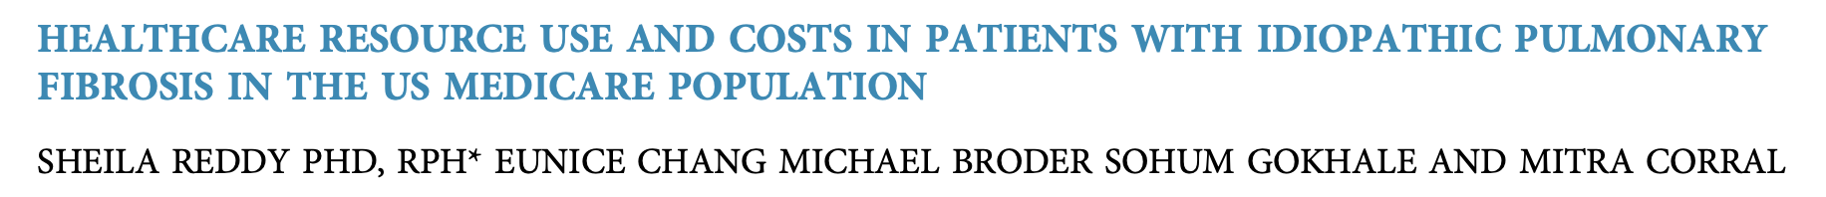
Costs : Better with Pirfenidone Worldwide
CLINICAL IMPLICATIONS: Patients receiving Pirfenidone vs Nintedanib may have overall lower all-cause inpatient costs and fewer respiratory-related hospital days.

Slide 27
Q 3 Which antifibrotic would be Safe & Better during COVID times ?
Pirfenidone
Nintedanib
None

Slide 28

To Summarize …
Pirfenidone bettered Nintedanib in mortality risk and respiratory-related hospitalizations among treated patients with IPF over a 12-month assessment.
Vincent Cottin ATS 2020

Slide 29
Issues with Non-Pharmacological Treatment in IPF
The current exercise training data in IPF provide ‘sufficient evidence of clinical benefit’ for consideration to be given to recommending exercise-based pulmonary rehabilitation as standard of care for IPF
Breathe 2016; 12: 130–138.

Slide 30
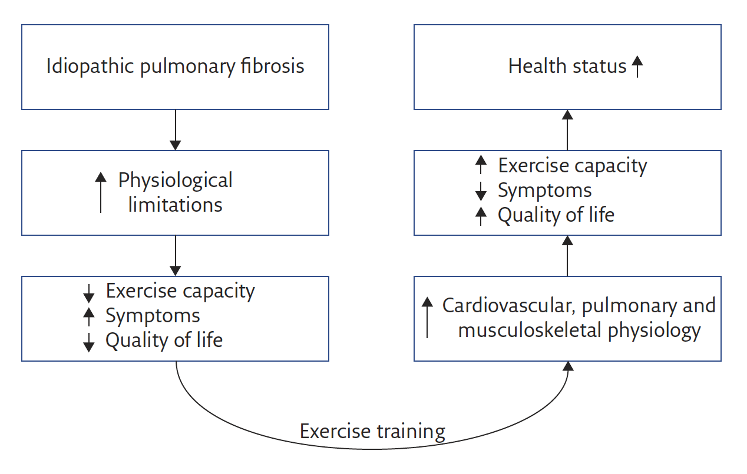
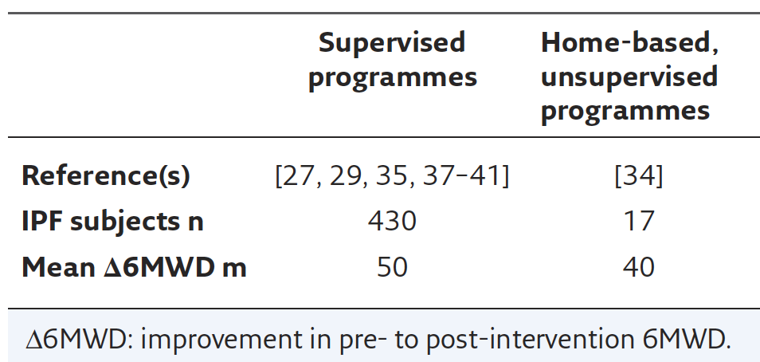
Home Based PR Programs

Slide 31

Issues with Non-Pharmacological Treatment in IPF
Home Exercises & Tele-Rehabilitation

Slide 32
Tele Rehabilitation Services : ‘An Opportunity Amidst Despair’

Slide 33
Conclusions: IPF management in Present Times
Choose antifibrotics Early and Appropriately:
Efficacy : Survival, RRH, Time to 1st exacerbation, Symptomatic improvement
Safety : Adverse events, discontinuations, availability, cost, serious side effects
Tolerability : Long-term, less monitoring
Drug- Drug / Drug- COVID 19 interactions: Thrombosis & AC
Avoid drugs of ? Role in IPF; steroids and immunosupressives
Virtual Consultations and Pulmonary Rehabilitation

Slide 34
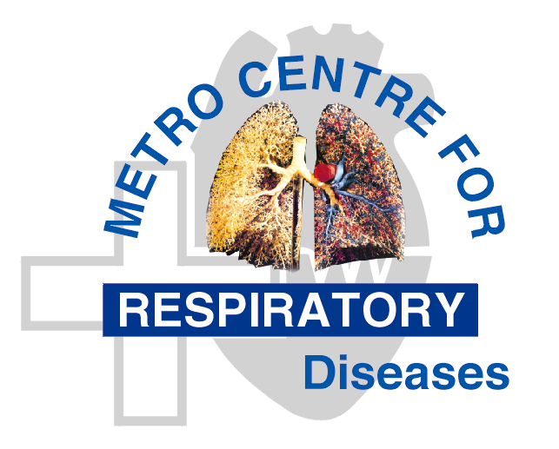
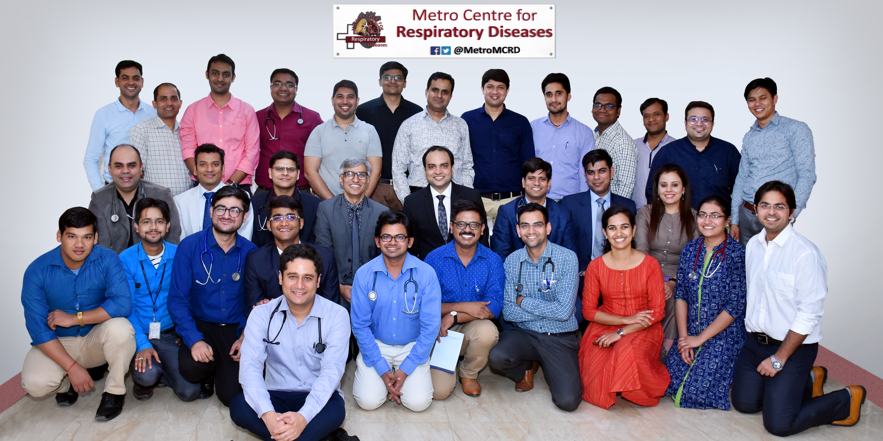
Thank You
“For it happens…that in the beginning of the malady it is easy to cure but difficult to detect, but in the course of time, it becomes easy to detect but difficult to cure.”
-N. Machiavelli, The Prince

