Slide 1
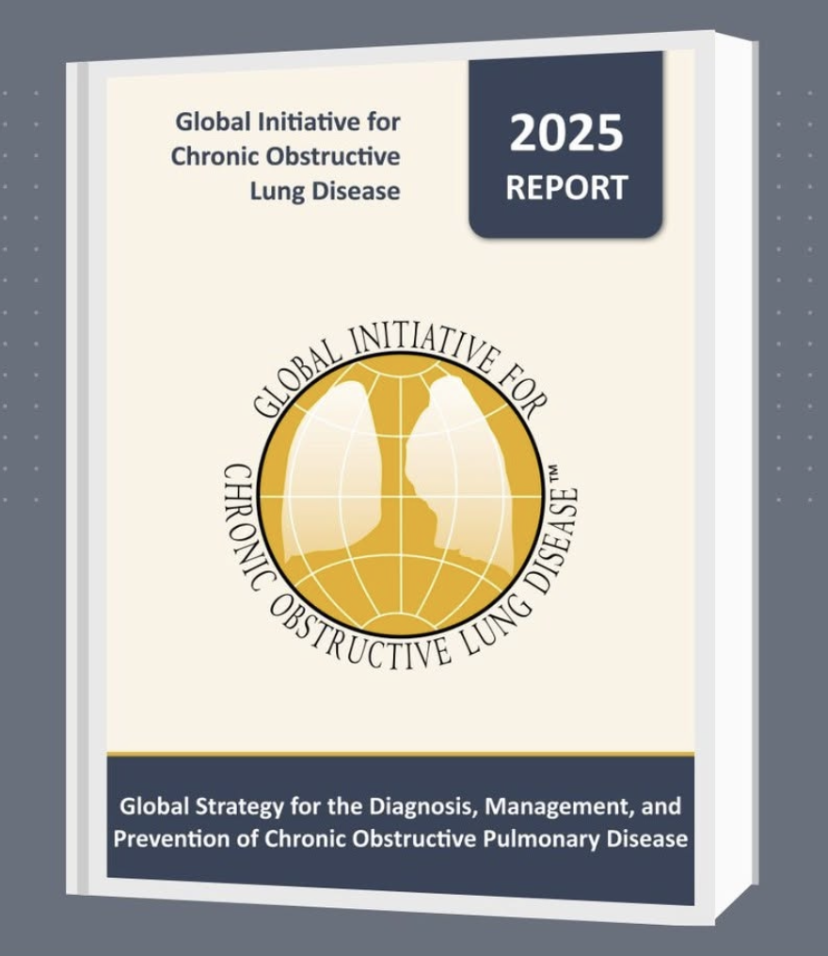
What is new in GOLD 2025 Guidelines?
Dr Dhruv Talwar

Slide 2
Introduction
Global initiative for Chronic Obstructive Lung Disease (GOLD) program initiated in 1998.
First report of Global Strategy for Diagnosis,Management and Prevention of COPD published in 2001.
GOLD Science committee established in 2002 to review research published on COPD.
The GOLD Science committee meets twice yearly to discuss each publication that was considered by at least one member to have an impact on management of COPD.

Slide 3
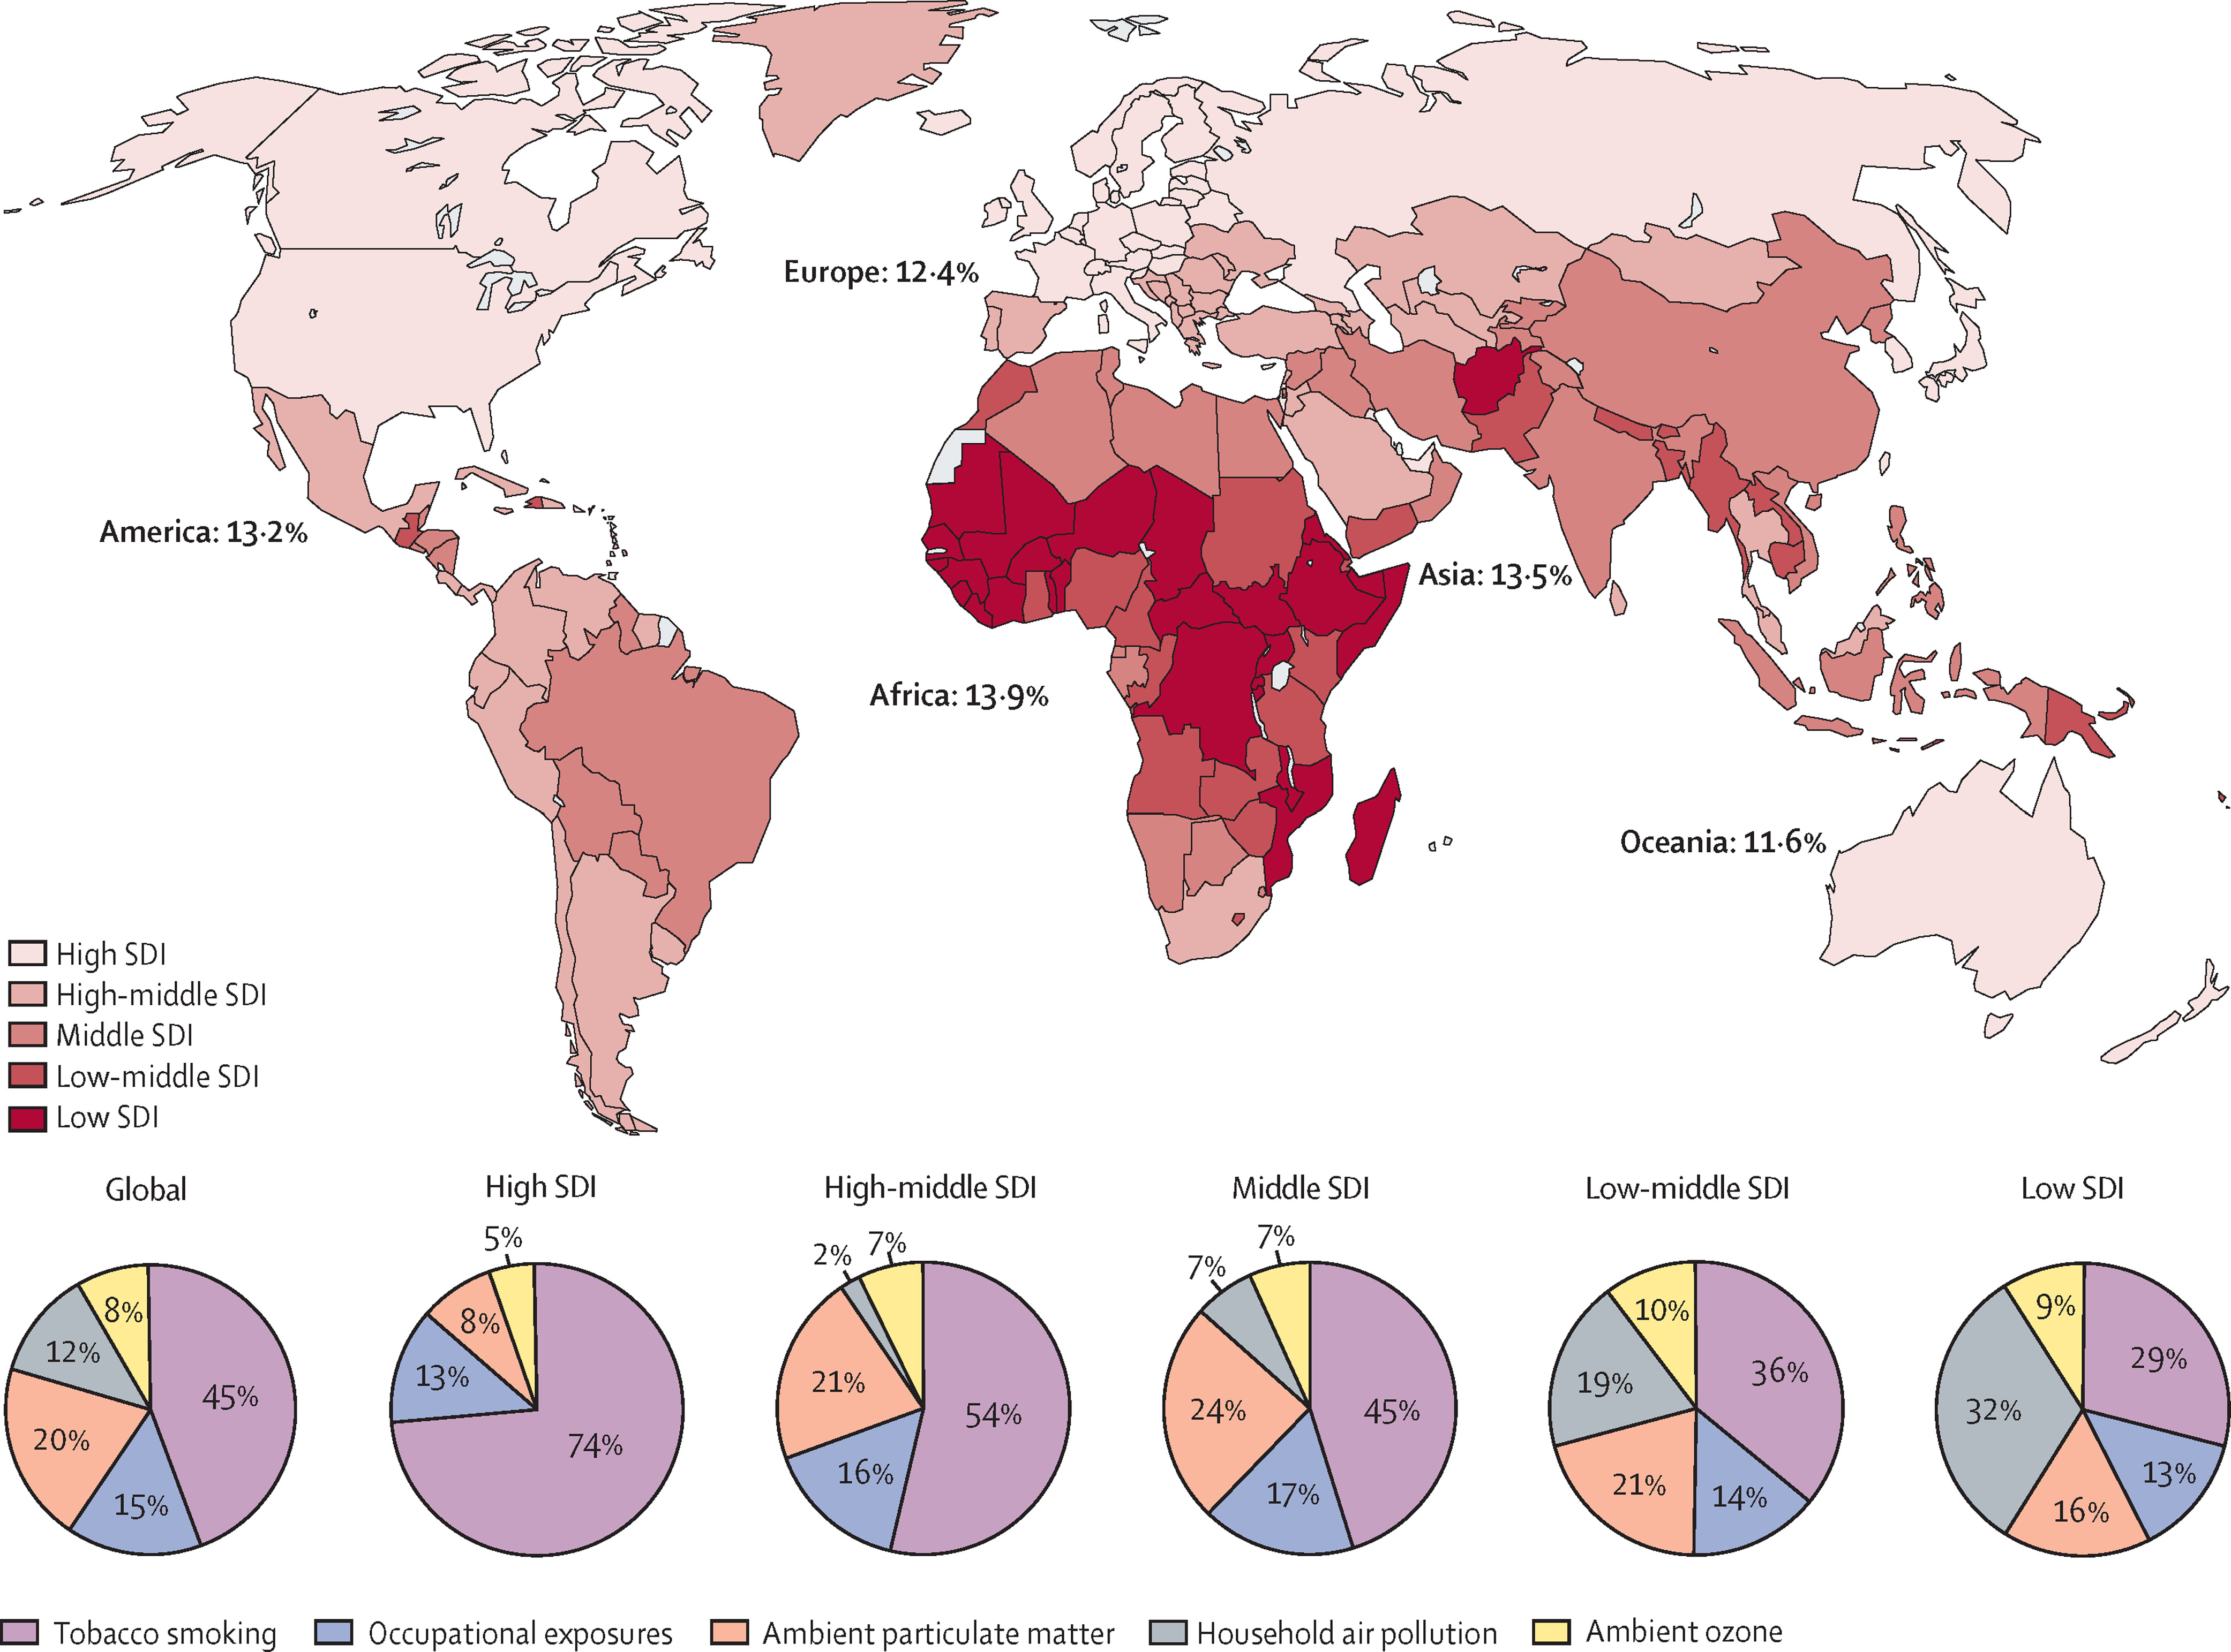
COPD-A Global Health Crisis
Urban areas having heavy pollution and rural areas relying on biomass fuels are most affected.
Over 500,000 hospitalisations and ¼ readmitted within 30 days
One tenth of population
3rd leading cause of mortality
20-40% COPD worldwide are never smokers
Ian A Yang et al 2022 LANCET

Slide 4
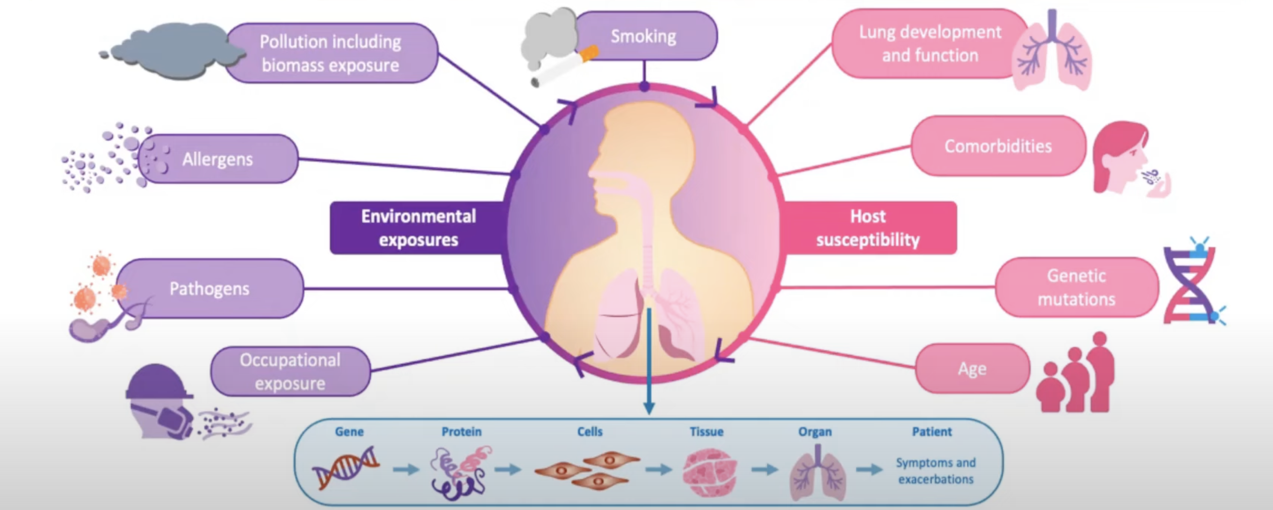
Contributors to disease phenotypes in COPD
Brighting C,Greening N,Eur Respir J 2019

Slide 5
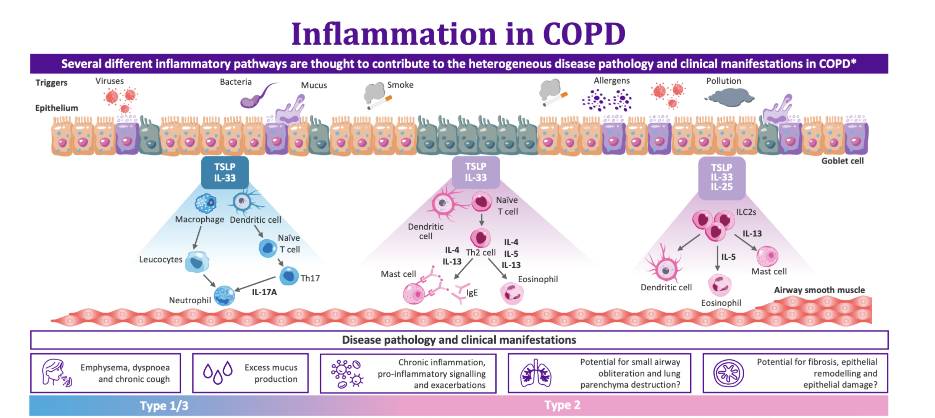
Role of epithelial cytokines in the inflammatory cascade
Calderon AA et al Eur Respir Rev 2023

Slide 6
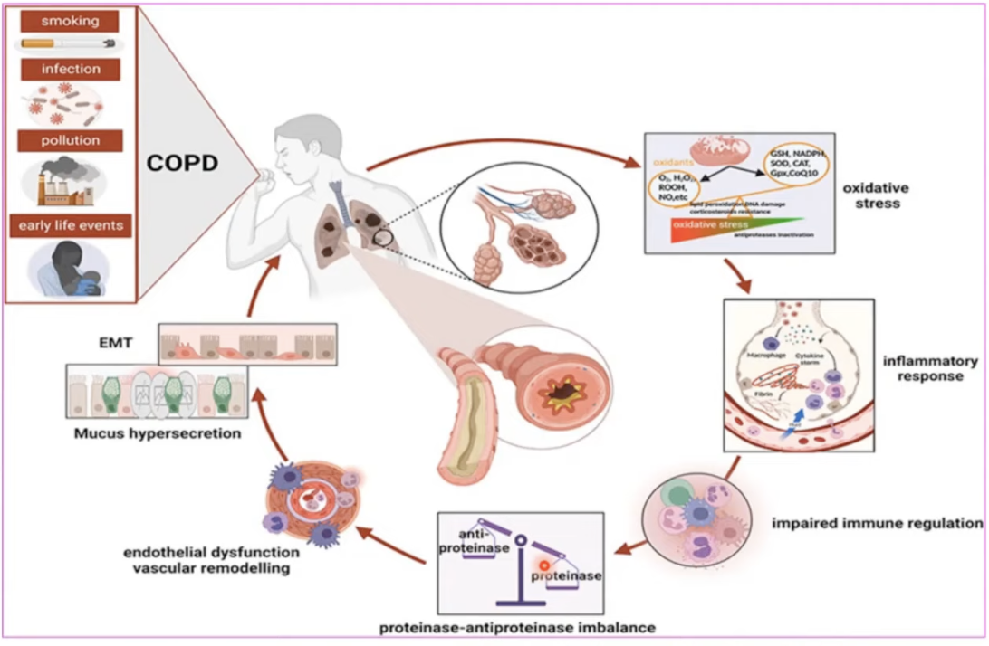
Arezina et al,Mechanic insights into therapeutic landscape of Chronic obstructive pulmonary disease,International journal of COPD,447-457.10.2147/COPD.S393540

Slide 7
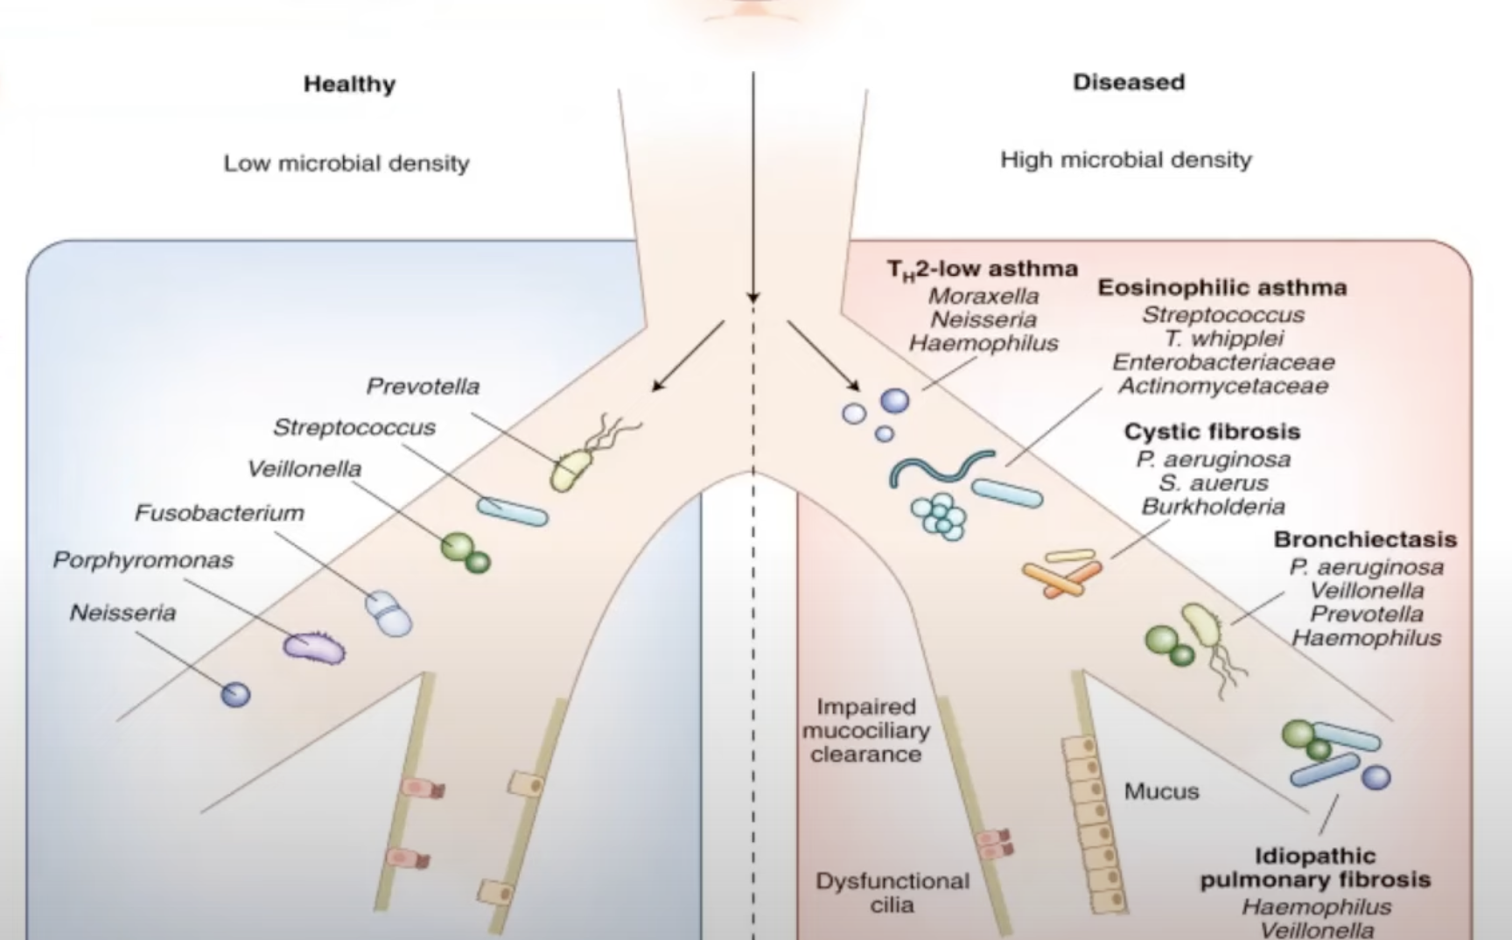
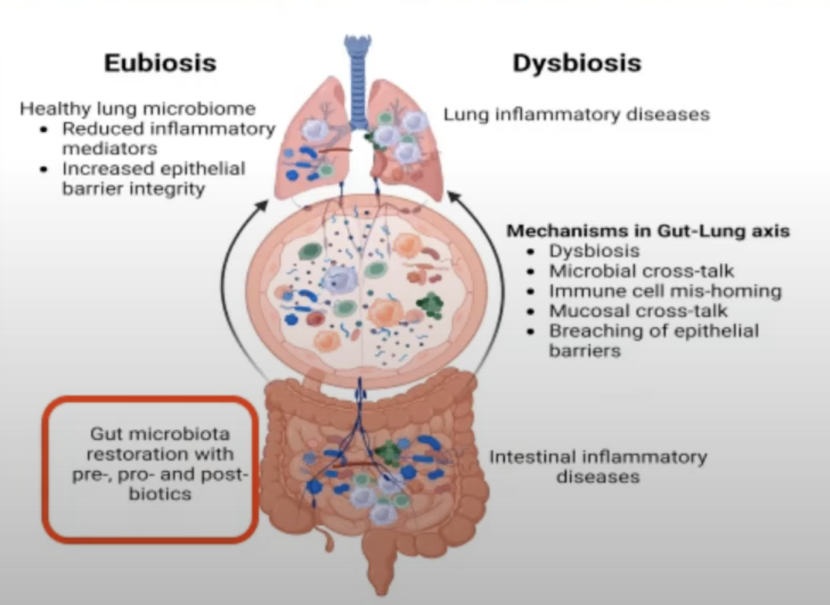
Dysbiosis-Role of Probiotics?
New-2025 Report
Notes:
Dysbiosis refers to disruption of the microbiome
Dysbiosis is cross sectionally associated with copd and frequency of exacerbations-likely due to alteration of mucosal defense and stimulation of inflammation
Possible prognostic,diagnostic and therapeutic applications

Slide 8
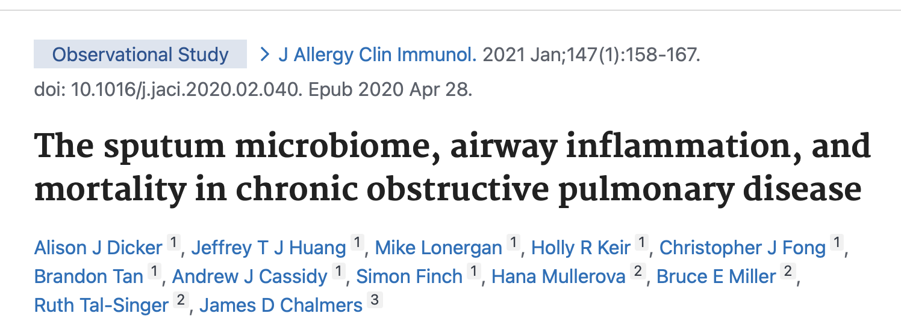
\
Number of patients | Method | Result | Conclusion
253 clinically stable COPD patients | 16S ribosomal RNA gene sequencing was performed on sputum from 253 clinically stable COPD patients (4-year median follow-up). Samples were classified as Proteobacteria or Firmicutes (phylum level) and Haemophilus or Streptococcus (genus level) dominant | Proteobacteria dominance and lower diversity was associated with more severe COPD according to the Global Initiative for Chronic Obstructive Lung Disease classification system (P = .0015), more frequent exacerbations (P = .0042), blood eosinophil level less than or equal to 100 cells/μL (P < .0001), and lower FEV₁ (P = .026). Proteobacteria dominance was associated with increased mortality compared with Firmicutes-dominated or balanced microbiome profiles (hazard ratio = 2.58; 95% CI = 1.43-4.66; P = .0017 and hazard ratio = 7.47; 95% CI = 1.02-54.86; P = .048, respectively). | Reduced microbiome diversity, associated with Proteobacteria (predominantly Haemophilus) dominance, is associated with neutrophil-associated protein profiles and an increased risk of mortality.

Slide 9
Taxonomy for COPD
Same as 2024
Classification | Description
Genetically determined COPD (COPD-G) | Alpha-1-antitrypsin deficiency (AATD)
COPD due to abnormal lung development (COPD-D) | early life events, premature birth, low birth weight
Cigarette smoking COPD (COPD-C) | Exposure to tobacco smoke, including in utero or passive smoking Vaping or e-cigarette Cannabis
Biomass and pollution exposure (COPD-P) | Exposure to household pollution, ambient air pollution, wildfire smoke, occupational hazards
COPD due to infections (COPD-I) | Childhood infections, tuberculosis-associated COPD,HIV-associated COPD
COPD & Asthma (COPD-A) | Particularly childhood asthma
COPD of unknown cause (COPD-U)

Slide 10
GOLD COPD Definition
COPD as a heterogenous lung condition characterized by :-
Symptoms
Abnormal Structure
Impaired Function
Chronic Respiratory Symptoms (dyspnea, cough, expectoration and/or exacerbations)
Due to abnormalities of the airway (bronchiolitis, bronchitis) and/or alveoli (emphysema)
That cause persistent, often progressive airflow obstruction

Slide 11
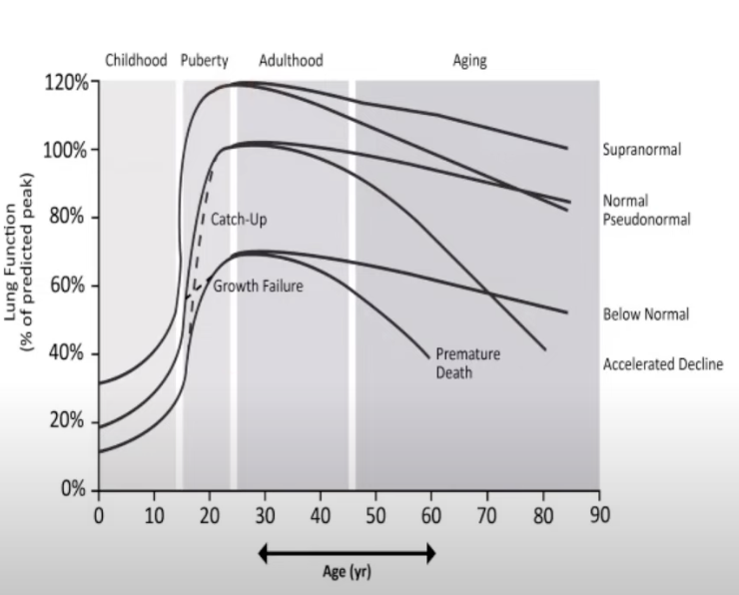
FEV1 Trajectories over life course
Early COPD: only research
Mild COPD: airflow obstruction severity
Young COPD: < 50 years
PRISm: Preserved ratio + FEV1 <80% ref
Agusti A,Hogg JC ,update on pathogenesis of COPD,N Eng J Med.2019
Notes:
Fletcher and Peto Model
Childhood disadvantage factors key determenent of lung function in adulthood
Birthweight associated with fev1 in adulthood

Slide 12
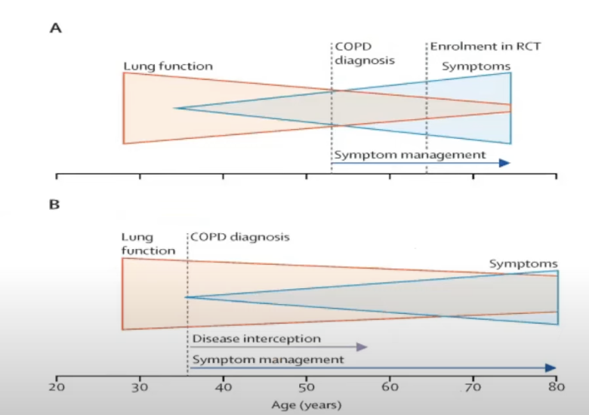
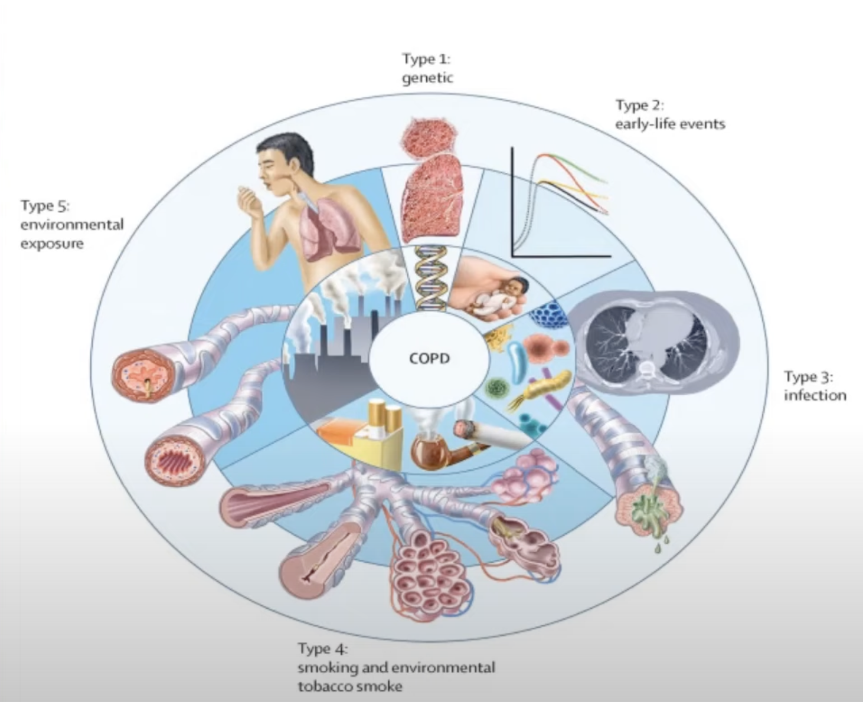
Early Diagnosis
Concept from GOLD 2023
Stolz et al Lancet 2022

Slide 13
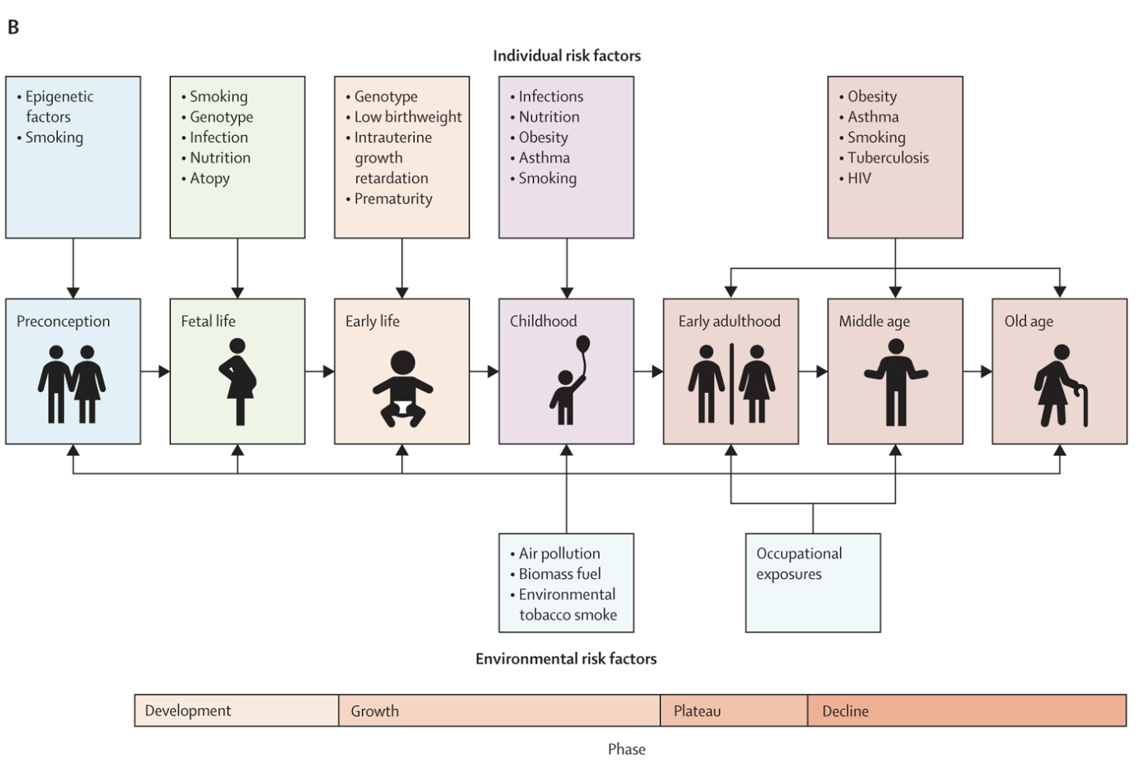
GETomics
Gene (G)-Serpina 1 Gene
Environment (E) interactions occurring over tobacco,Pollution
Lifetime (T) of individual
Damage lung/Alter normal development/Aging process

Slide 14
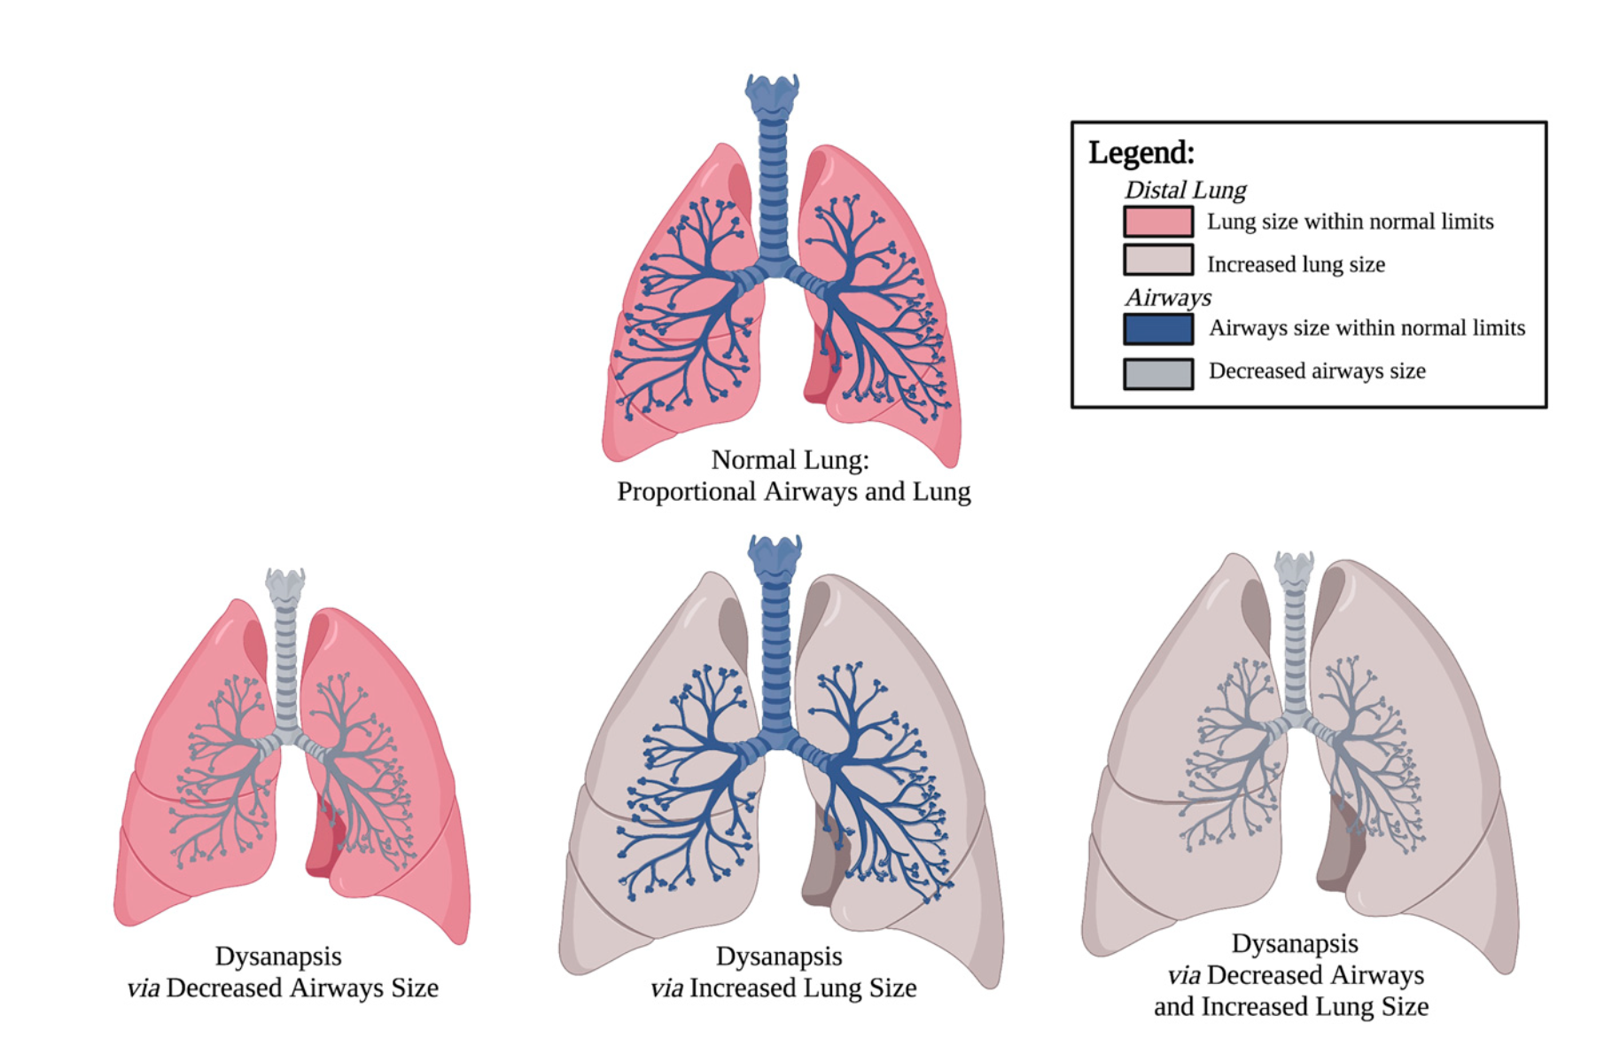
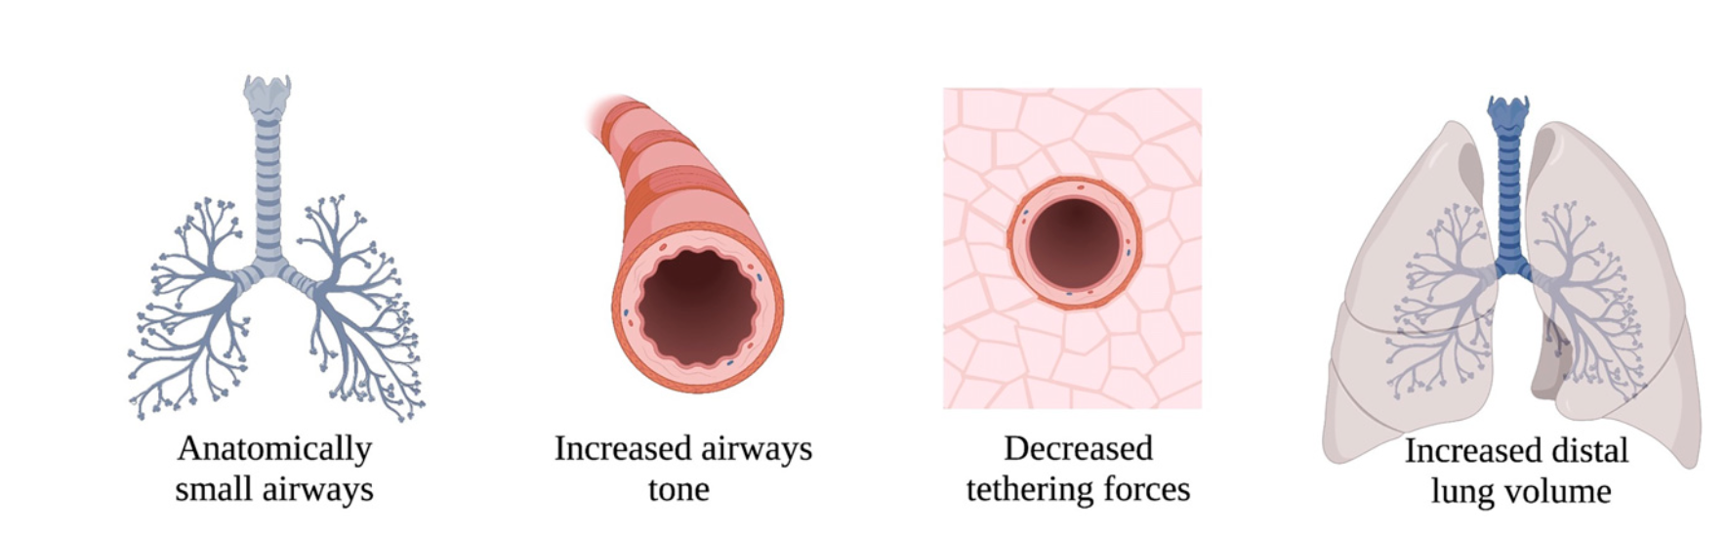
Dysnapsis
Anthropometric mismatch of airway tree calibre relative to lung volume
Common in general population
Associated with FEV1/FVC from early childhood
Associated with baseline airflow obstruction and risk of incident COPD independent of age,sex ,height ,race and ethnicity

Slide 15
Early COPD
Starting early in life
Difficult to diagnose early
Use to discuss the biological first steps of disease in experimental setting

Slide 16
Young COPD
Relates to chronological age of the patient
20-50 years of age
May be associated with structural and functional abnormalities
Family history, early life events (Hospitalisation <5yrs age)

Slide 17
PRE COPD
Any age
Respiratory symptoms +/- structural lung lesions (eg emphysema)
Without airflow obstruction on forced spirometry
May/may not develop COPD over time (Persistent airflow obstruction)
FEV1/FVC >0.7 POST BRONCHODILATION

Slide 18
PRISm-Preserved Ratio >0.7
Impaired spirometry
Post BD FEV1 and/or FVC <80% (earlier classification)
Identify those with normal ratio but abnormal spirometry
High in active/former smokers ,both high and low BMI,female gender ,obesity ,multimorbidity
Increased risk of Cardiovascular mortality
20-30% transitioned over time to obstructive spirometry
May transition to normal or obstructive spirometry over time

Slide 19
Q.Which of the following is not a predictor of transition of PRISm to COPD?
A.Current Smoker
B.Male
C.Higher Age
D.Lower FEV1

Slide 20
PRISm-Preserved Ratio >0.7
Same as 2024
Prevalence – 7.1 to 11% in population
Predictors of Transition:
1.Lower baseline FEV1%,FEV1/FVC
2.Higher Age
3.Current Smoking
4.Females
5.Longer FET on second assessment

Slide 21
Asthma
Adults with asthma-12 fold higher risk of COPD over time compared to non asthma (Tuscon cohort) after smoking adjustment
European community respiratory health survey – 2nd to cigarette smoking as leading risk factor for COPD (15% risk,smoking-39%)

Slide 22
Diagnosis of COPD
Symptoms
Shortness of breath
Chronic Cough
Sputum
Recurrent Wheeze
Recurrent LRTI
Risk Factors
Host Factors
Tobacco
Occupation
Indoor/Outdoor Pollution
Spirometry
Post Bronchodilator FEV1/FVC <0.7

Slide 23
Pre and Post Bronchodilator Spirometry
NEW
2025
Pre-Bronchodilator
FEV1/FVC
FEV1/FVC
>0.7
FEV1/FVC
<0.7
NO COPD
Measure Post Bronchodilator FEV1/FVC
Measure Post-Bronchodilator FEV1/FVC if volume responder suspected e.g low FEV1 Or high symptoms
FEV1/FVC
>0.7
FEV1/FVC
<0.7
COPD

Slide 24
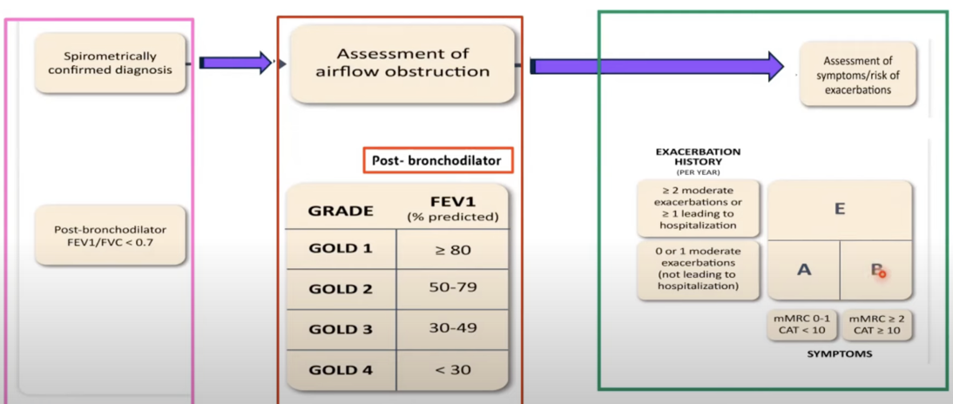
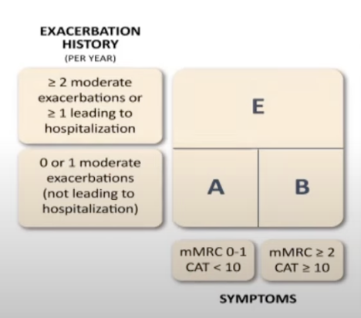
GOLD ABE ASSESMENT TOOL

Slide 25
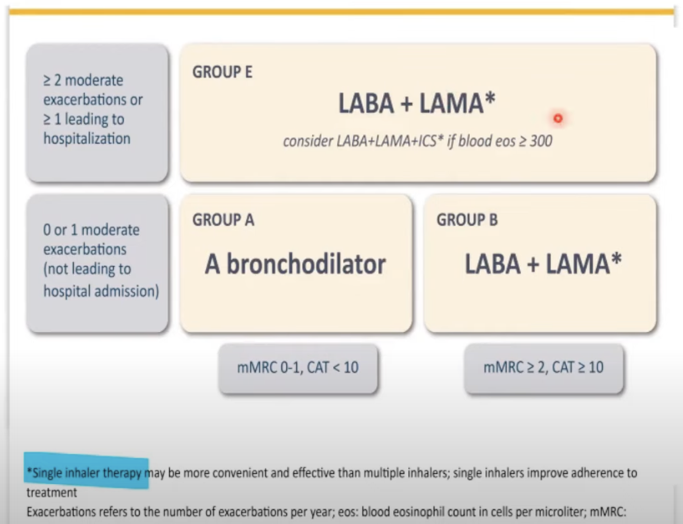
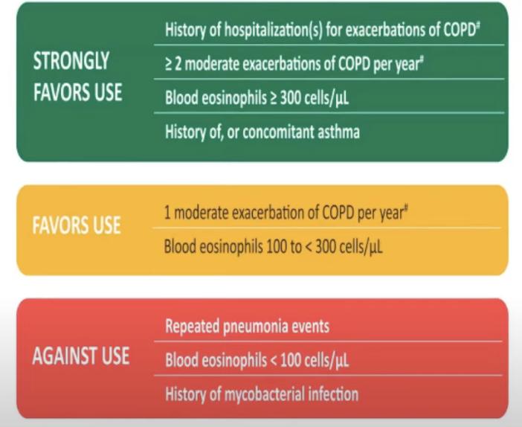
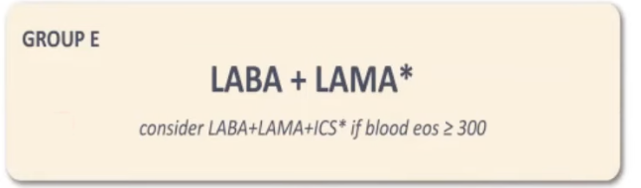
Initial Pharmacological Treatment-Stable COPD

Slide 26
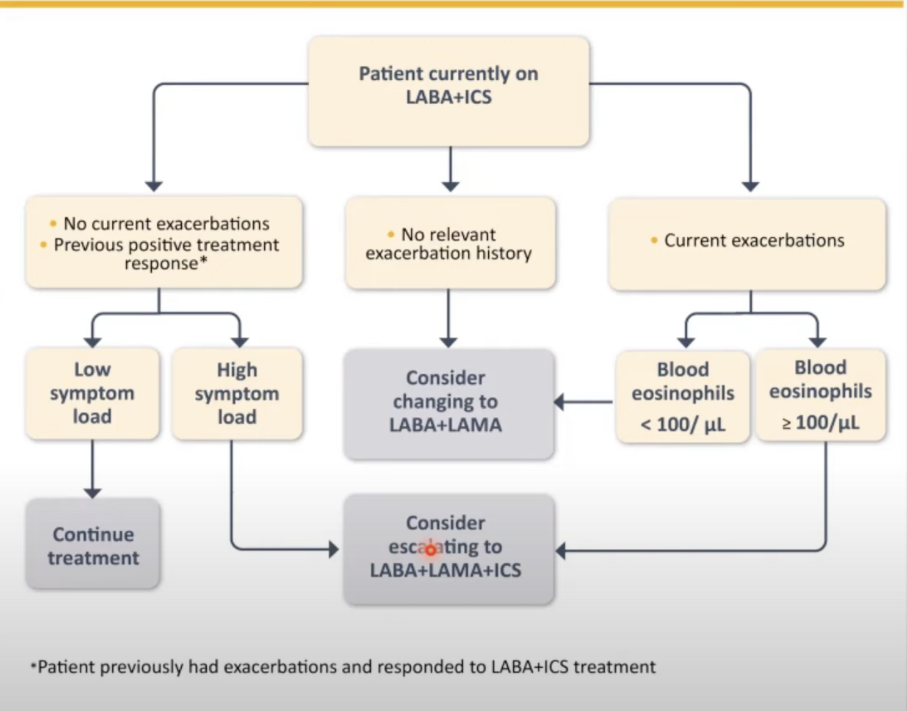
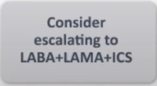
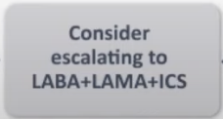
Patient currently on LABA ICS
NEW
2025

Slide 27
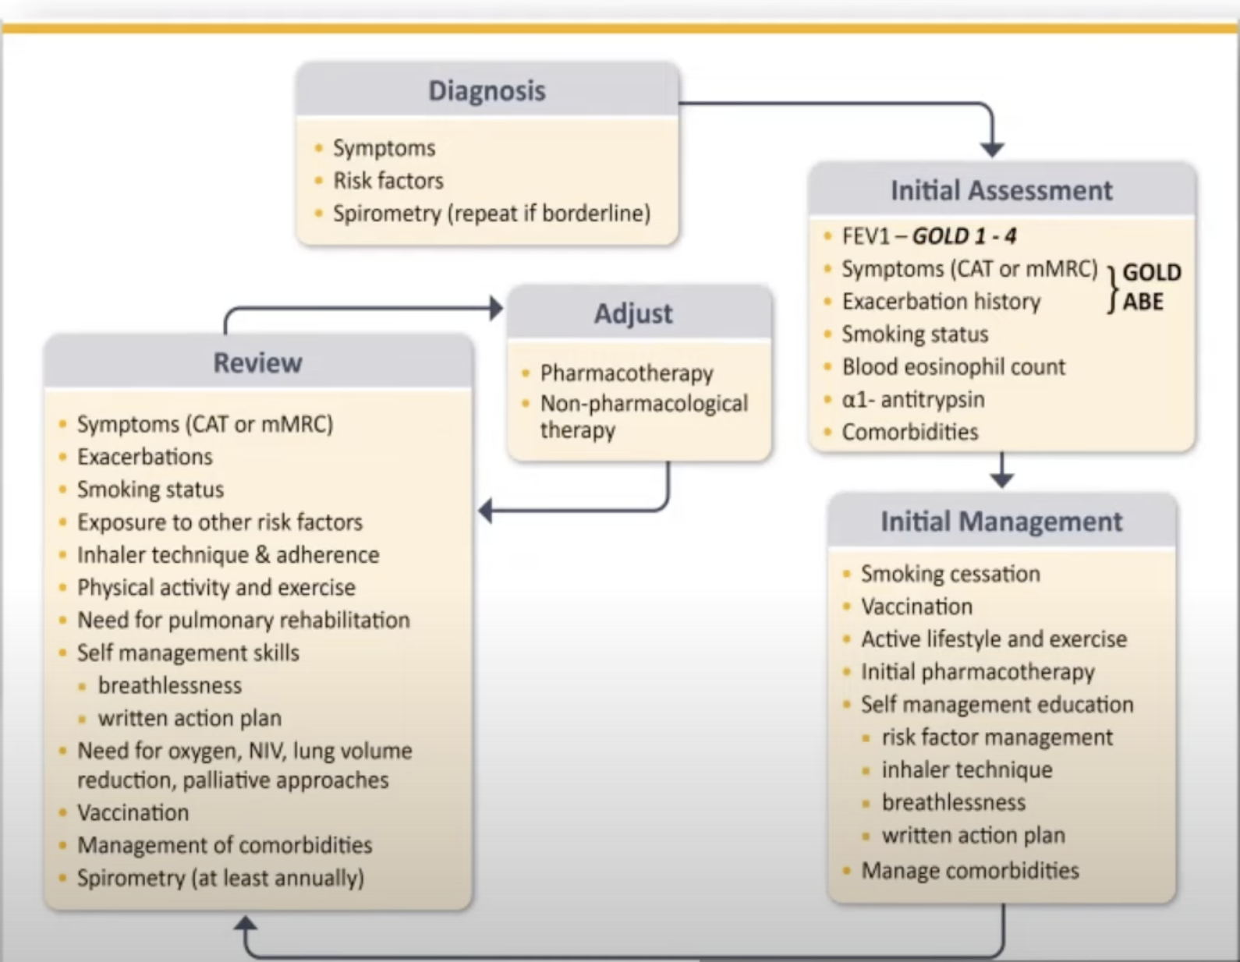
What next?

Slide 28
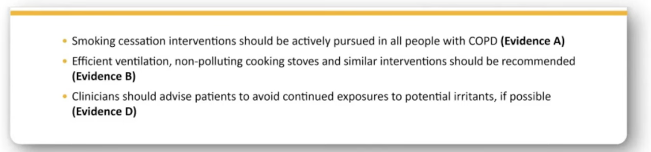


Identify and reduce risk factor exposure

Slide 29
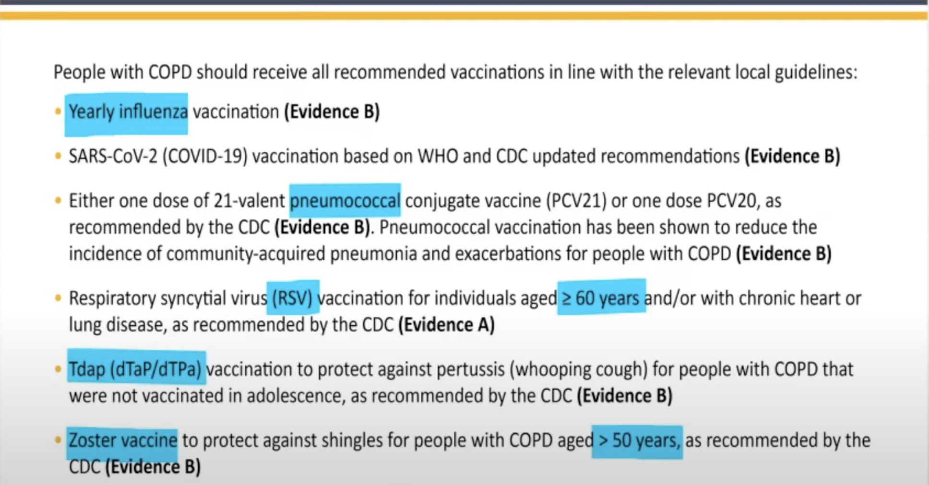
Vaccinations for Stable COPD

Slide 30
What helps reduce mortality?
Therapy | RCT | Treatment effect on mortality | Patient characteristics
LABA + LAMA + ICS | YES | Single inhaler triple therapy compared to dual LABD therapy relative risk reduction: IMPACT :HR 0.72 (95% CI: 0.53,0.99) ETHOS: HR 0.51 (95% CI: 0.33,0.80) | Symptomatic patients with a history of frequent and/or severe exacerbations
Smoking cessation | YES | HR for usual care group compared to intervention group (smoking cessation) HR 1.18 (95% CI:1.02,1.37) | Asymptomatic or mildly symptomatic
Pulmonary Rehabilitation | YES | Old Trials :RR 0.28 (95% CI: 0.10,0.84) New Trials: RR 0.68 (95% CI 0.28,1.67) | Hospitalized for exacerbations of COPD (during <4 weeks after discharge)
Long Term Oxygen Therapy | YES | NOTT >19 hours of continuous oxygen vs <13 hours-50% reduction MRC >15hours oxygen vs no oxygen :50% reduction | PaO2 <55 mm Hg or <60 mm Hg with cor pulmonale or secondary polycythemia
Noninvasive positive pressure ventilation | YES | 12% in NPPV (High IPAP level) and 33% in control HR 0.24 ((95% CI 0.11,0.49) | Stable COPD with marked hypercapnia
Lung Volume reduction surgery | YES | 0.07 deaths/person-year (LVRS) vs 0.15 deaths/person-year (UC) RR for death 0.47 (p=0.005) | Upper lobe emphysema and low exercise capacity

Slide 31
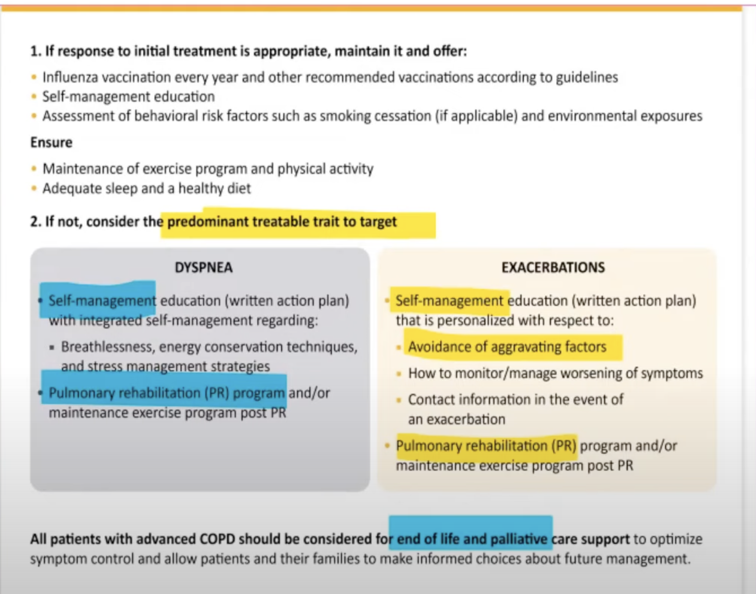
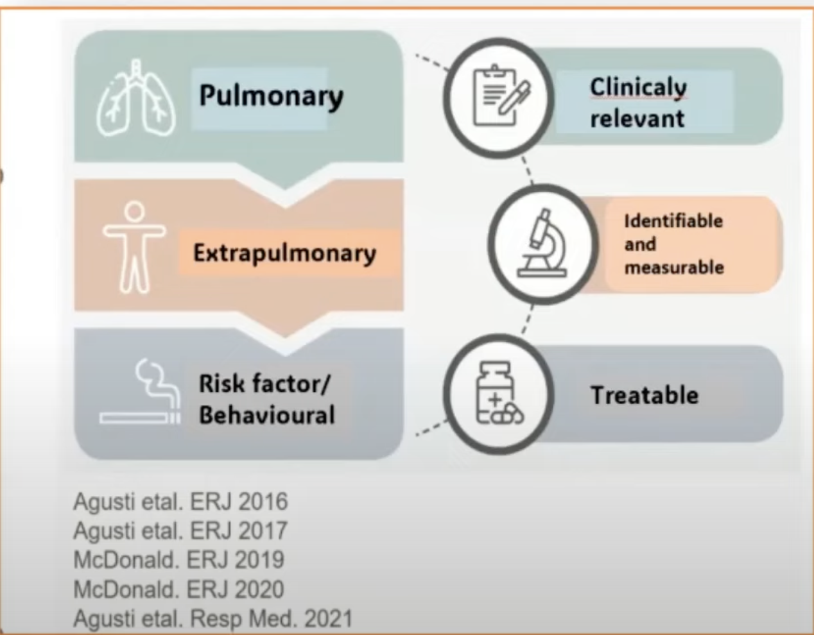
Follow up of non pharmacological treatment

Slide 32
Q.Which of the following Biologicals have been recommended in GOLD 2025?
A.Meopolizumab
B.Benralizumab
C.Dupilumab
D.Omalizumab

Slide 33
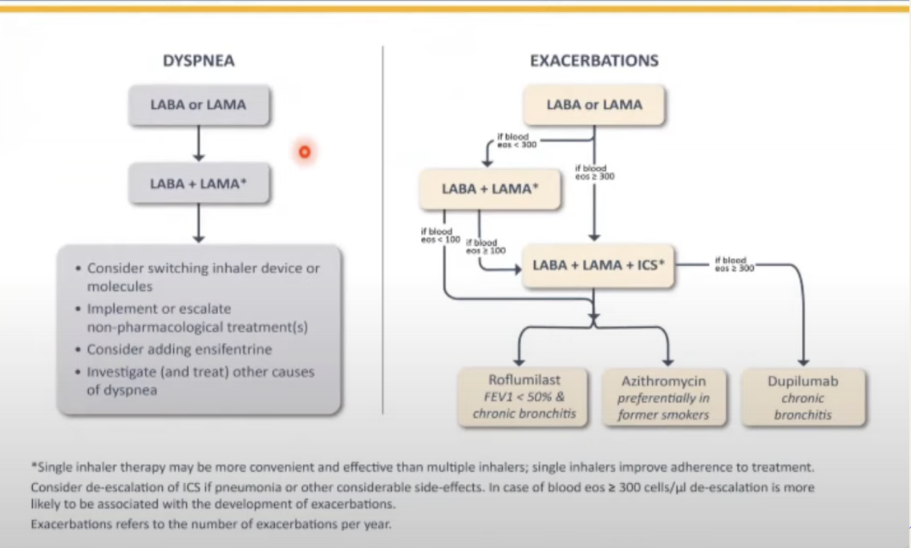

Follow up of pharmacological treatment
NEW
2025

Slide 34
Q.Mechanism of action of ensifentrine?
A.PDE 5 Inhibitor
B.PDE 4 Inhibitor
C.PDE 3 inhibitor

Slide 35
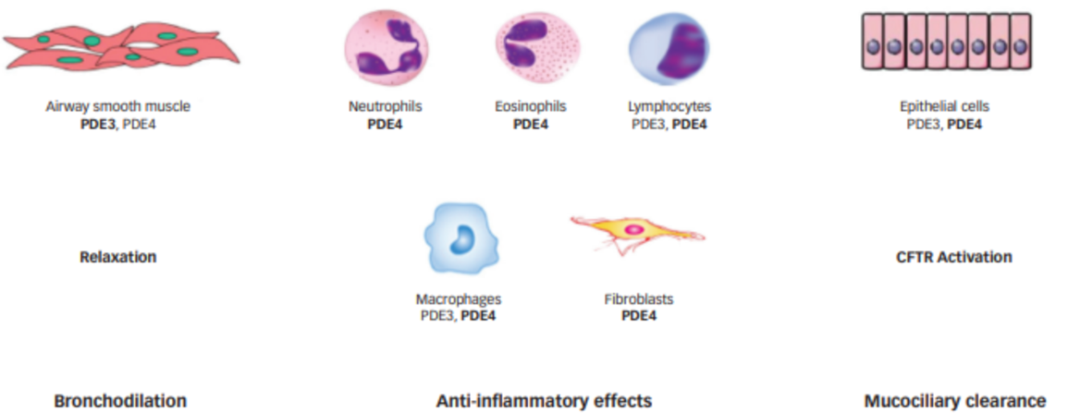
Ensifentrine – dual PDE3/4 inhibitor
Mechanisms of action
C Page & M Cazzola Curr Opin Pharmacol 2017;56:197
Notes:
35

Slide 36
Ensifentrine, a novel phosphodiesterase 3 and 4 inhibitor for the treatment of COPD: ENHANCE-1 and ENHANCE-2
Study design
COPD - FEV₁ 30-70%, 40 to 80 years, mMRC≥2
ENHANCE-1 (n=760), ENHANCE-2 (n=789)
69% LAMA, 55% LABA
Nebulized ensifentrine 3 mg bid
Placebo
24 weeks
Primary - average FEV₁ AUC (0-12h) at week 12
Secondaries - peak FEV1, E-RS, SGRQ, morning trough FEV1
Safety
Anzueto A et al AJRCCM 2023; 208:406–16
Notes:
36
Transition Dyspnea Index (TDI), Evaluating Respiratory Symptoms (E-RS)

Slide 37
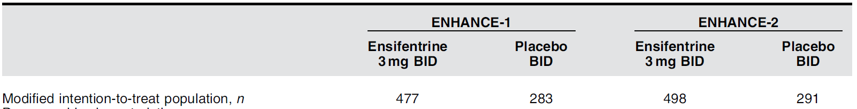
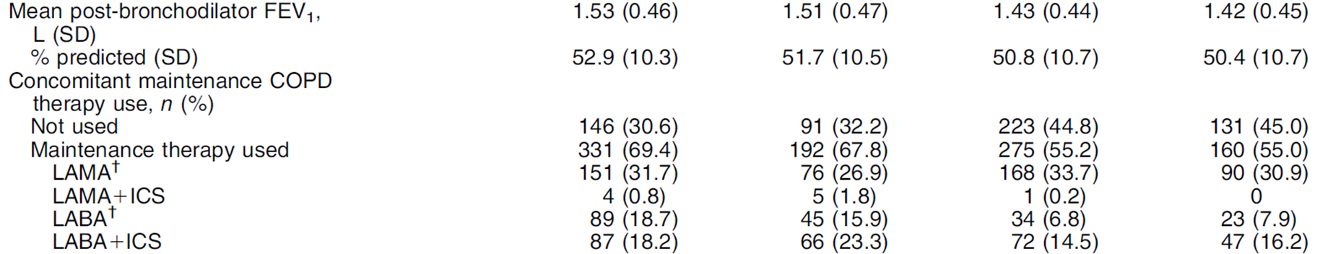
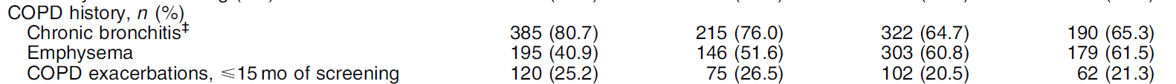
Ensifentrine, a novel phosphodiesterase 3 and 4 inhibitor for the treatment of COPD: ENHANCE-1 and ENHANCE-2
Baseline characteristics
Anzueto A. et al AJRCCM 2023; 208:406–16
Notes:
37

Slide 38
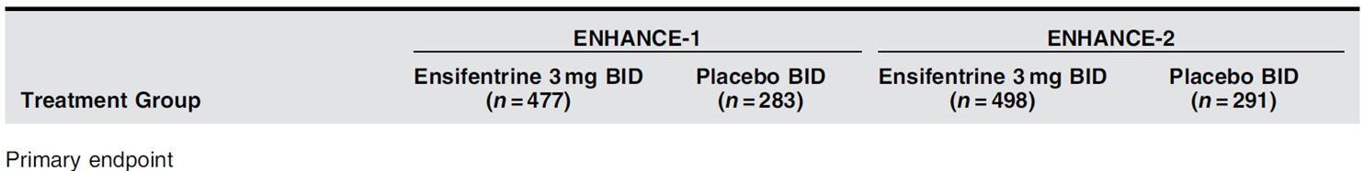

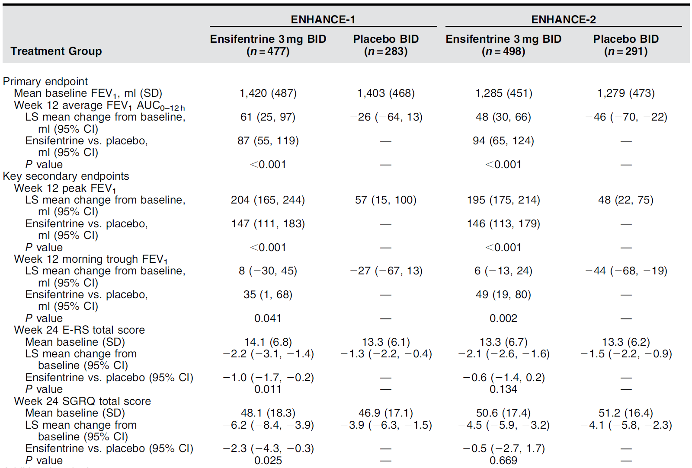
Ensifentrine, a novel phosphodiesterase 3 and 4 inhibitor for the treatment of COPD: ENHANCE-1 and ENHANCE-2
Primary and secondary outcomes
Anzueto A. et al AJRCCM 2023; 208:406–16
Notes:
38

Slide 39
Ensifentrine, a novel phosphodiesterase 3 and 4 inhibitor for the treatment of COPD: ENHANCE-1 and ENHANCE-2
Primary and secondary outcomes
Anzueto A. et al AJRCCM 2023; 208:406–16
Notes:
39

Slide 40
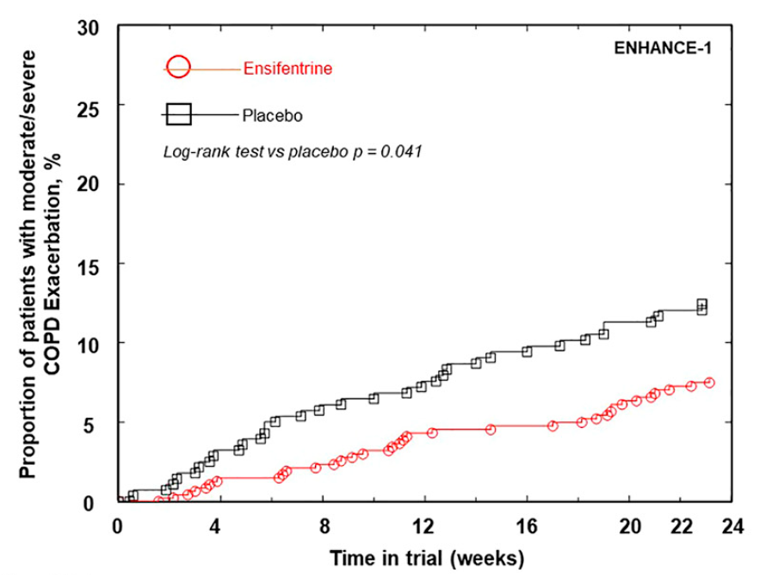
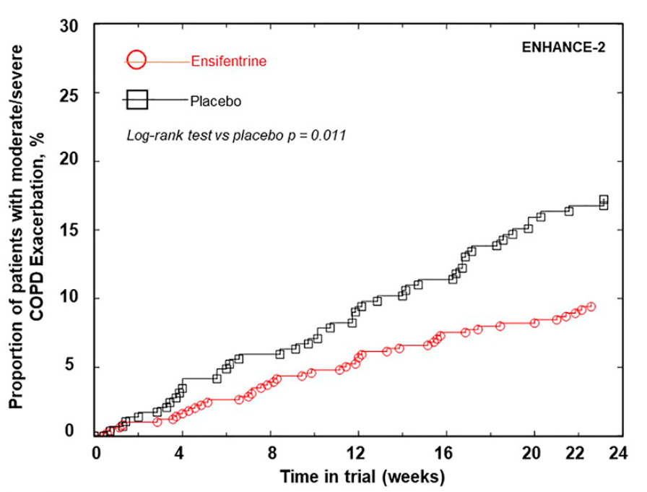
Ensifentrine, a novel phosphodiesterase 3 and 4 inhibitor for the treatment of COPD: ENHANCE-1 and ENHANCE-2
Time to first exacerbations @ 24 weeks
Anzueto A. et al AJRCCM 2023; 208:406–16
Notes:
40

Slide 41
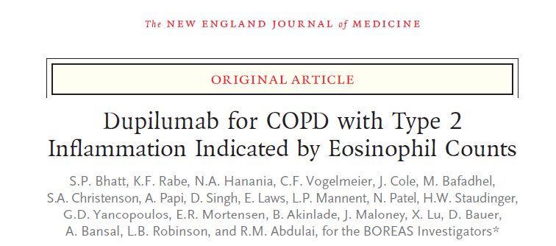

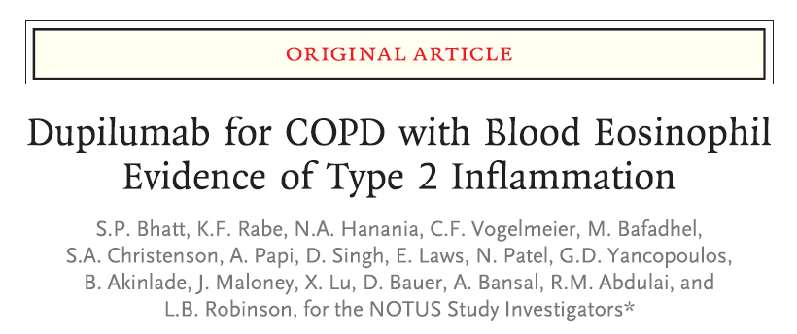
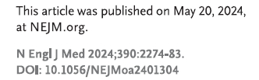
BOREAS
NOTUS

Slide 42
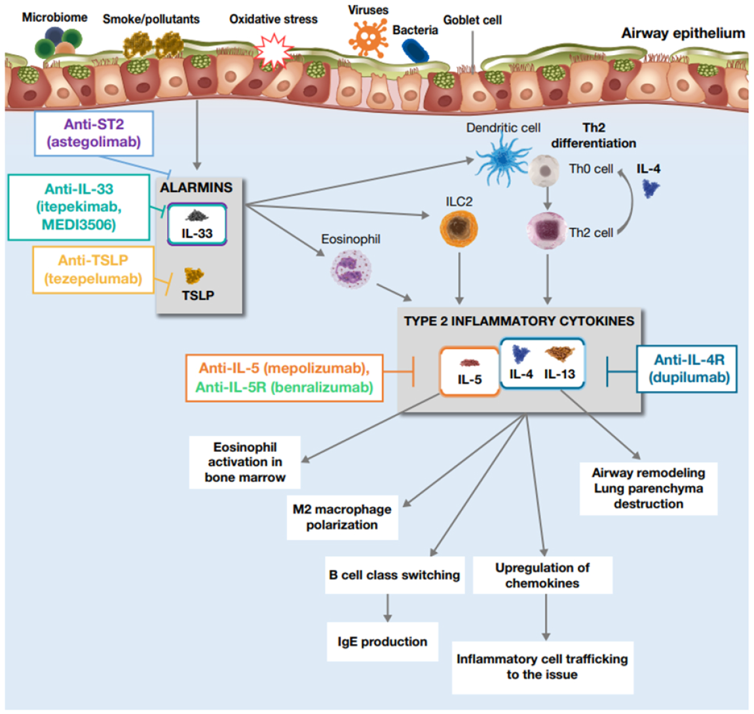
KF Rabe et al AJRCCM 2024

Slide 43
BOREAS and NOTUS Clinical Trials: Inclusion and Exclusion Criteria
Key Inclusion Criteria^{1,2}
Physician-diagnosed COPD for ≥12 months prior to randomisation
Current or former smoker with a smoking history of ≥10 pack-years
Signs or symptoms of chronic bronchitis (chronic productive cough) for ≥3 months
≥1 exacerbation while the patient was on SOC
mMRC dyspnoea scale grade ≥2
Blood EOS ≥300 cells/μL
≥2 moderate or ≥1 severe exacerbations within the year prior to screening
Background optimised therapy (ICS+LAMA+LABA) for 3 months prior to randomisation with a stable dose of medication for ≥1 month prior to Visit 1; double therapy (LAMA+LABA) allowed if ICS was not appropriate
Key Exclusion Criteria^{1,2}
Physician-diagnosed COPD for <12 months prior to randomisation
Diagnosis or history of asthma according to the 2018 GINA guidelines
1. Bhatt SP, et al. N Engl J Med. 2023;389(3):205-214. 2. Bhatt SP, et al. N Engl J Med. Published online 20 May 2024. doi:10.1056/NEJMoa2401304
Notes:
Key points
Key inclusion criteria for the BORAS and NOTUS trials include^{1,2}:
Physician-diagnosed COPD for ≥12 months prior to randomisation
Current or former smoker with a smoking history of ≥10 pack-years
Signs or symptoms of chronic bronchitis (chronic productive cough) for ≥3 months
≥1 exacerbation while the patient was on SOC
mMRC dyspnoea scale grade ≥2
Blood EOS ≥300 cells/μL
≥2 moderate or ≥1 severe exacerbations within the year prior to screening
Background optimised therapy (ICS+LAMA+LABA) for 3 months prior to randomisation with a stable dose of medication for ≥1 month prior to Visit 1; double therapy (LAMA+LABA) allowed if ICS was not appropriate
Patients were excluded if they had physician-diagnosed COPD for <12 months prior to randomisation or diagnosis or history of asthma according to the 2018 GINA guidelines^{1,2}
References
Bhatt SP, Rabe KF, Hanania NA, et al. Dupilumab for COPD with type 2 inflammation indicated by eosinophil counts. N Engl J Med. 2023;389(3):205-214
Bhatt SP, Rabe KF, Hanania NA, et al. Dupilumab for COPD with blood eosinophil evidence of type 2 inflammation. N Engl J Med. Published online 20 May 2024. doi:10.1056/NEJMoa2401304
BOREAS:
Bhatt 2023 suppl/p8/ bullets1,2,4 (including subbullets and * footnote); p9/ **footnote; p9/ bullets1-2
NOTUS:
Bhatt 2024 suppl/ p10-12
BOREAS: Bhatt 2023 suppl/p8/ bullets1,2,4 (including subbullets and * footnote); p9/ **footnote; p9/ bullets1-2
NOTUS:
Bhatt 2024 suppl/ p10-12/inclusion criteria & exclusion criteria

Slide 44
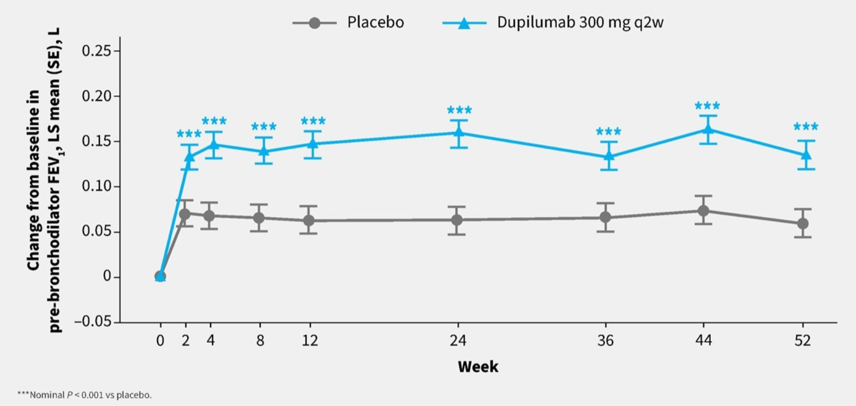
Dupilumab efficacy and safety in patients with moderate-to-severe COPD with type 2 inflammation: pooled analysis of BOREAS and NOTUS
Pre BD FEV₁
S Bhatt et al. ERS 2024 Poster-ID 4787

Slide 45
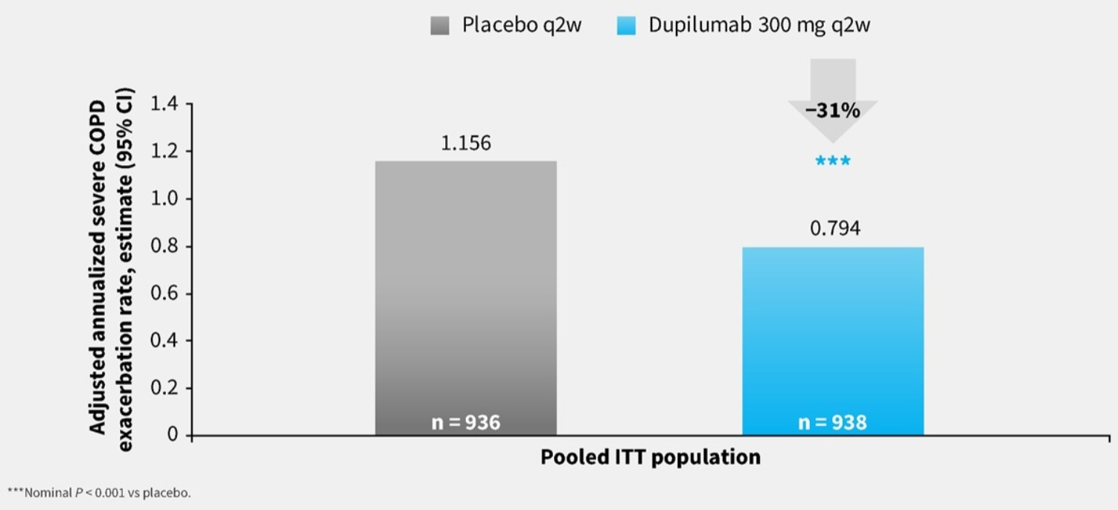
Dupilumab efficacy and safety in patients with moderate-to-severe COPD with type 2 inflammation: pooled analysis of BOREAS and NOTUS
Exacerbation rate
S Bhatt et al. ERS 2024 Poster-ID 4787

Slide 46
Definition of exacerbation
GOLD 2022
An exacerbation of COPD is defined as an acute worsening of respiratory symptoms that results in additional therapy
GOLD 2023/2024/2025
Increased dyspnea and or cough and sputum
<14 days
May be accompanied by increased tachypnoea and or tachycardia
Often associated with increased systemic and local inflammation caused by infection,pollution or other insults to the airways

Slide 47
Exacerbations of COPD
ECOPD
AECOPD
Urgent medical contact: Patient with suspected ECOPD
Severity | Criteria for judging severity
Mild | Dyspnea VAS <5 RR <24 breaths/min HR <95 Resting SPO2 >92% breathing ambient air AND Change <3% (where known) CRP <10mg/L (if obtained)
Moderate (meets at least three of five) | Dyspnea VAS >5 RR >24 breaths/min HR >95 Resting SPO2 <92% breathing ambient air AND Change >3% (where known) CRP >10mg/L (if obtained) If obtained ABG may sow hypoxemia PaO2 <60 mm of hg and/or hypercapnia PaCO2 >45 mm of hg but no acidosis (pH >7.315)
Severe | ABG shows hypercapnia and acidosis (PaCO2 >45mm of hg and pH <7.315)
Confirm ECOPD diagnosis and determine severity
Consider differential diagnosis
Severity as per Rome Proposal
Heart Failure
Pneumonia
Pulmonary embolism

Slide 48
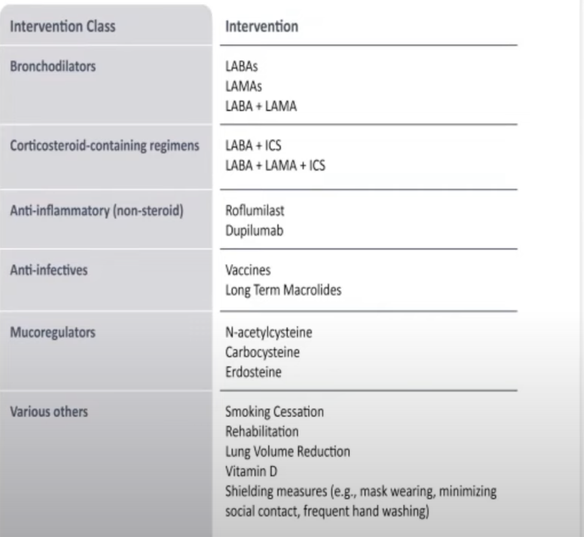
Interventions that reduce exacerbation frequency

Slide 49
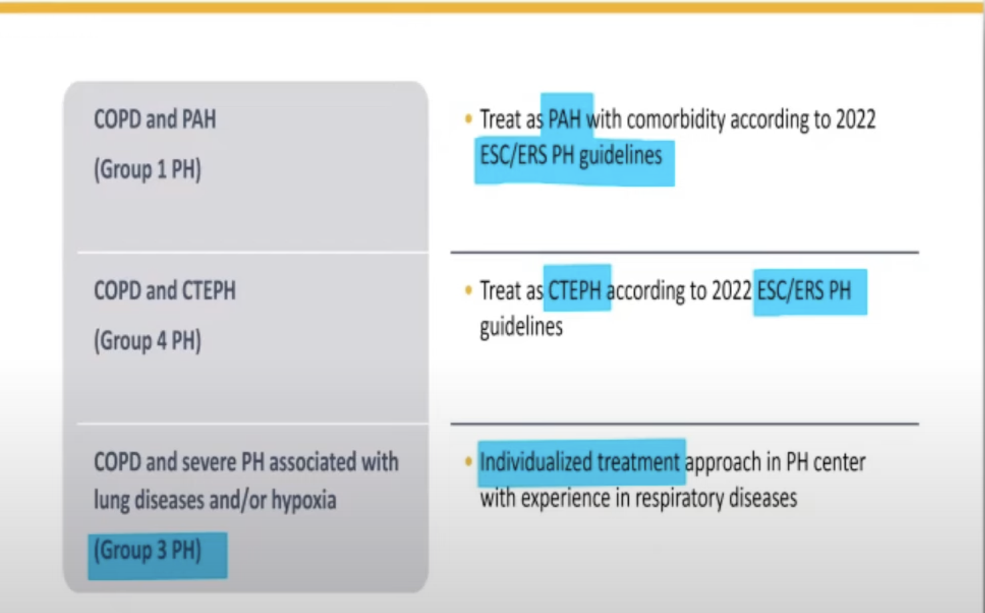
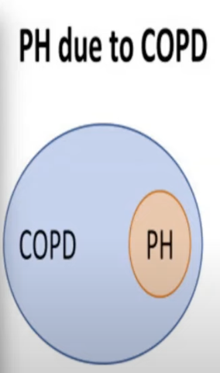
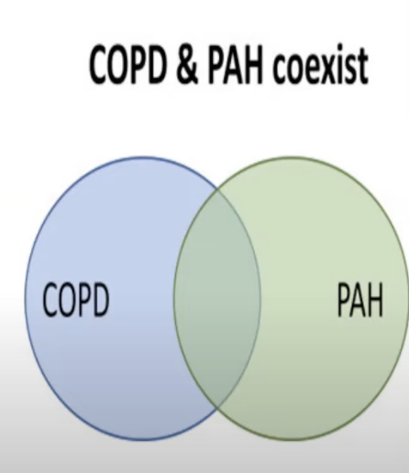
Treatable Traits in Pulmonary Hypertension-COPD
NEW
2025
Notes:
Perfect study=Treprostinil had to stop

Slide 50
Cardiovascular Risk in COPD
Patients with COPD often suffer cardiovascular diseases and vice versa
Clinically stable COPD
High prevalence of cardiovascular diseases, including arterial hypertension,coronary artery disease ,heart failure and arrhythmias
Acute exacerbation of COPD
Cardiovascular risk increases during and after exacerbation

Slide 51

High prevalence of CVD in stable patients with COPD
Coronary
artery disease
(40.0%)
Peripheral
artery
disease
(8.8%)
COPD
Arrhythmias
(12.5%)
Hypertension
(46.6%)
Myocardial
infarction
(13.5%)
Heart failure
(20.3%)
Atrial
fibrillation
(9.9%)
Stroke†
(<10.0%)
Rogliani P, et al. Expert Rev Respir Med 2021;15:59–70

Slide 53
Q. What is the probable mechanism of Cardio Vascular Disease in COPD?
A. Inflammation
B. Hypoxia
C. Hyperinflation

Slide 54
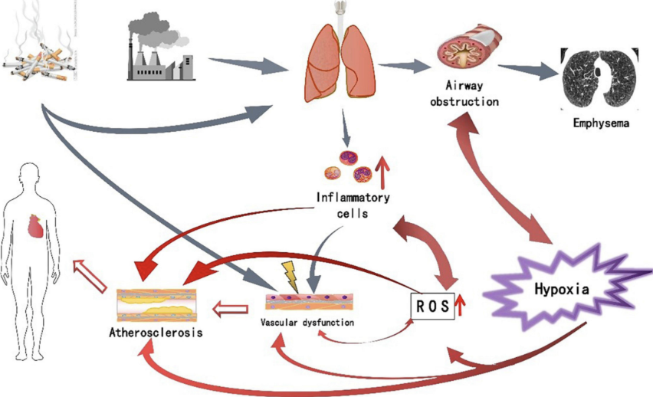
Potential Mechanism
  Inflammation – COPD and CVD are both inflammatory conditions. COPD is associated with increased systemic inflammation, and airway inflammation is amplified during acute exacerbations
  Hyperinflation – hyperinflation is a hallmark of COPD and a mechanical event, which can impair venous return to the heart and cardiac systolic function
  Hypoxia – in more severe COPD disease, hypoxic vasoconstriction can lead to pulmonary hypertension
These mechanisms can be amplified during an exacerbation, which is why exacerbations can be important drivers of cardiopulmonary risk in COPD
The heart and lungs are fundamentally linked, and patients with COPD at increased cardiopulmonary risk should be proactively identified and their management optimised

Slide 55
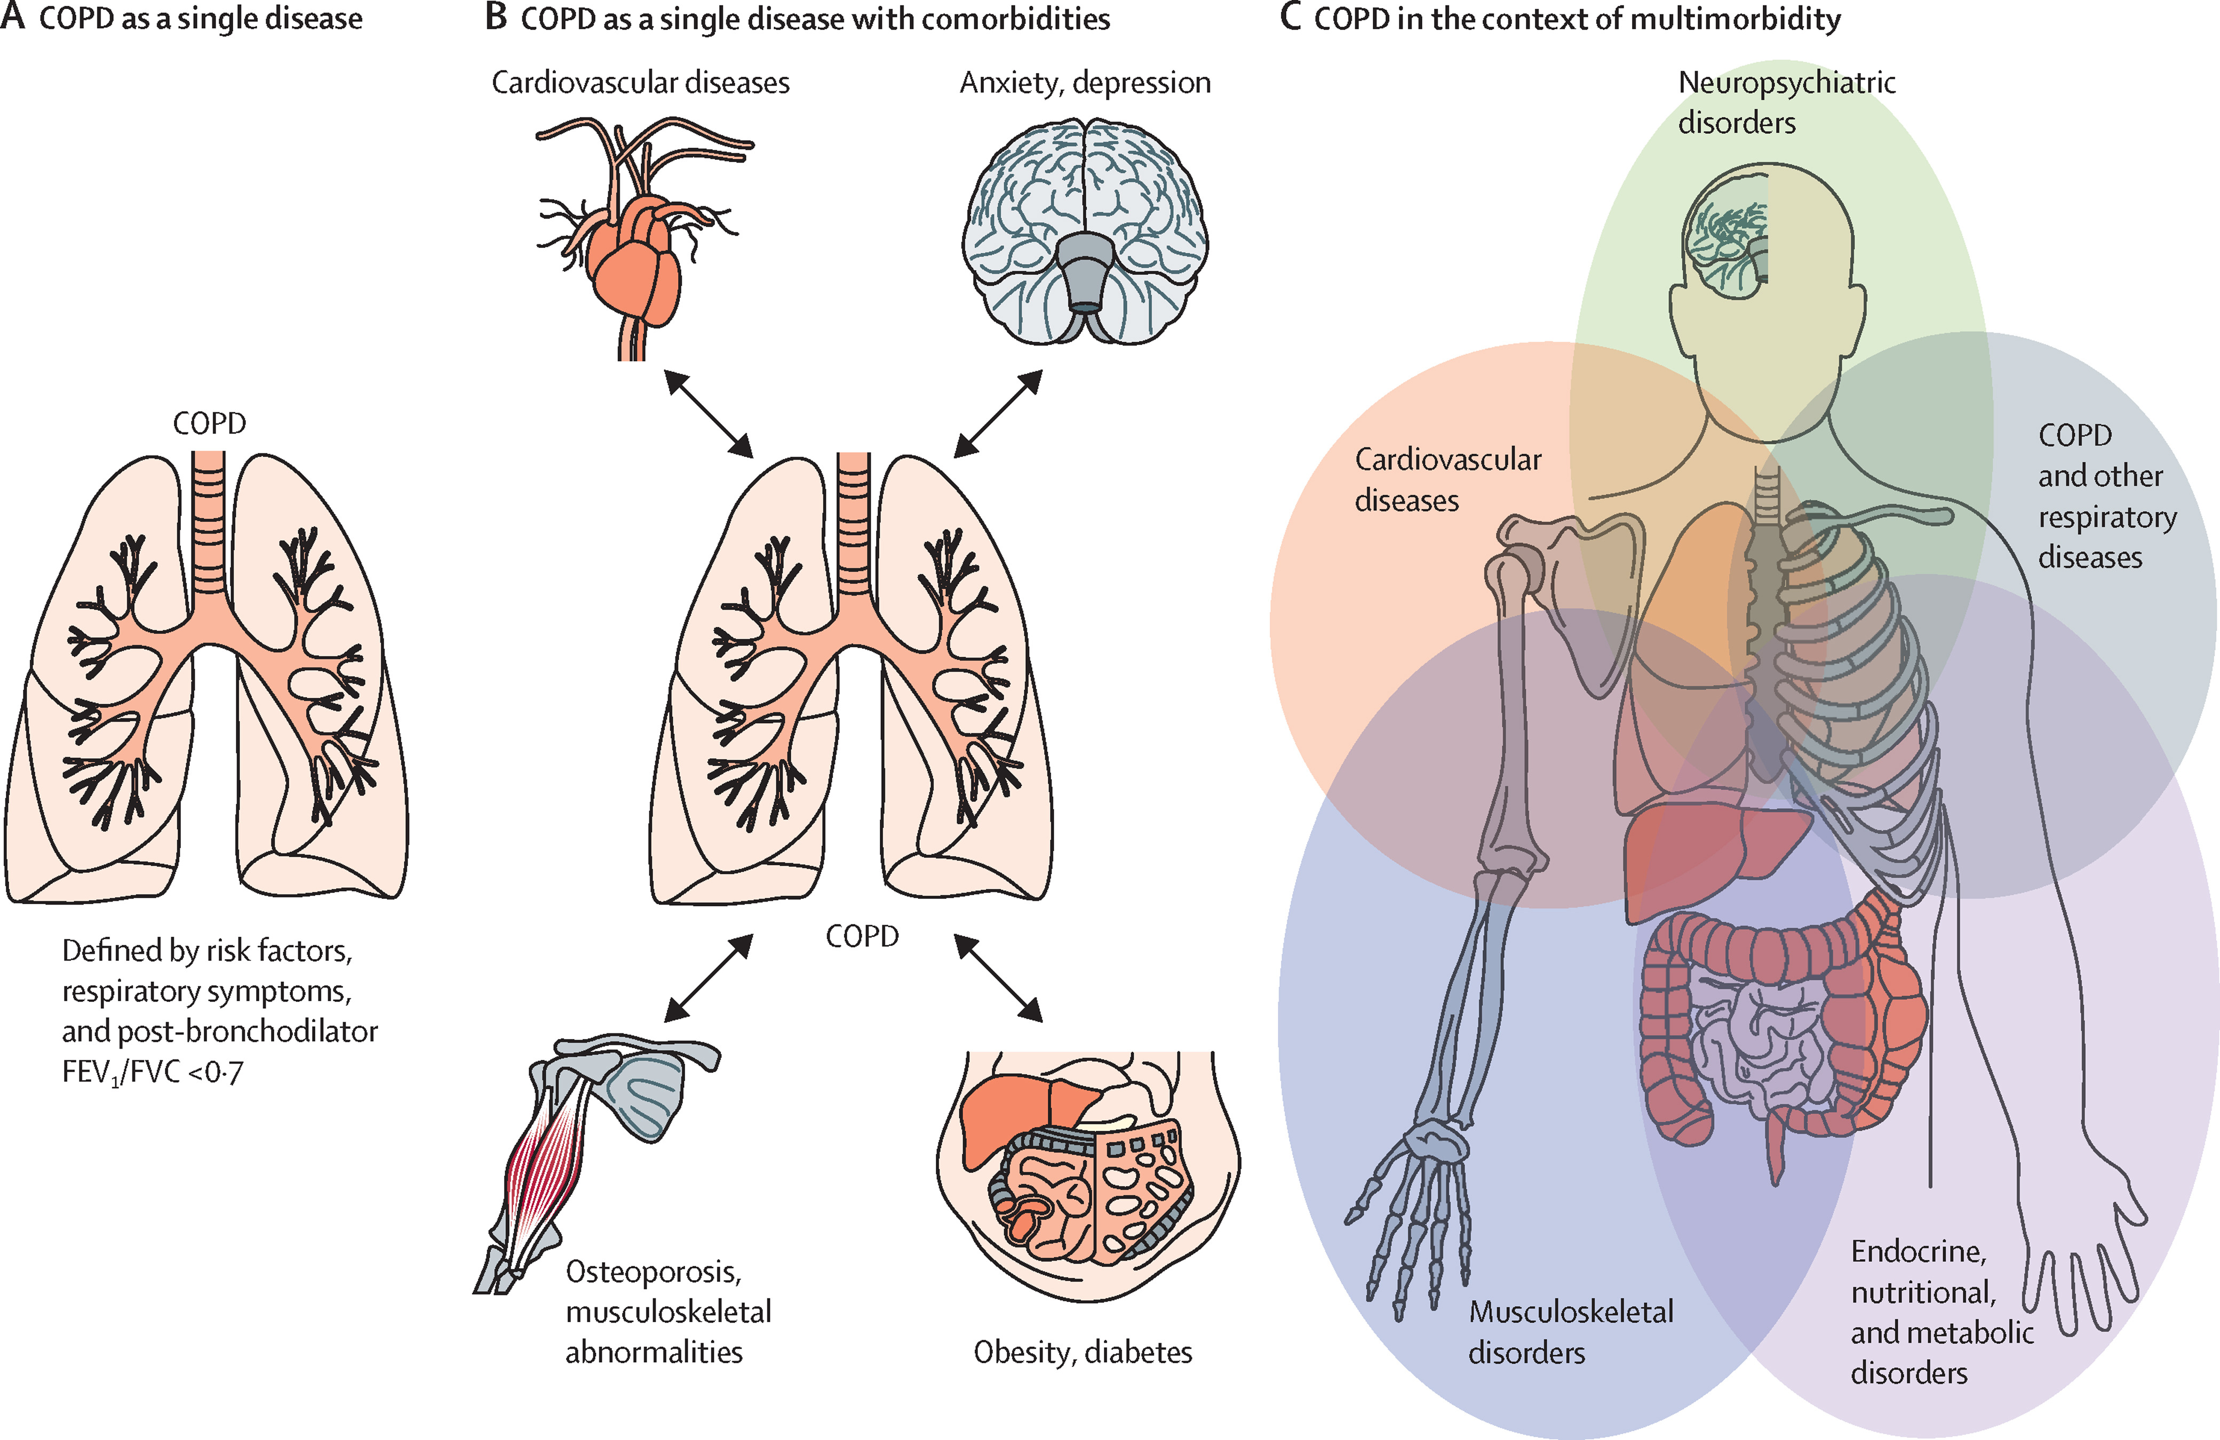
Syndemic Approach to COPD-A Novel Concept
Syndemic refers to co-occurrence of diseases with shared mechanisms and risk factors a novel concept that helps to explain the clustering of certain morbidities in patients diagnosed with COPD

Slide 56
Q.Which of the following is a false indication for lung cancer screening?
A.Smoking pack years >20 years
B.Quit smoking 10 years ago
C.Age 50-80 years
D.None of the above

Slide 57
NEW
2025
Role of CT Scan in COPD
Emphysema
Distribution and severity can be assessed
Can help in decision making for lung volume reduction syregry or endobronchial valve placement
Lung nodules
American cancer society suggests individuals aged 50-80 years with 20 pack year smoking history, regardless of years since quitting should be considered for lung cancer screening
Airways
Bronchiectasis visible in roughly 30% patients
Mucus plugs associated with mortality
COPD related morbidities
CT scan provides information about coronary artery calcification ,bone density ,muscle mass

Slide 58
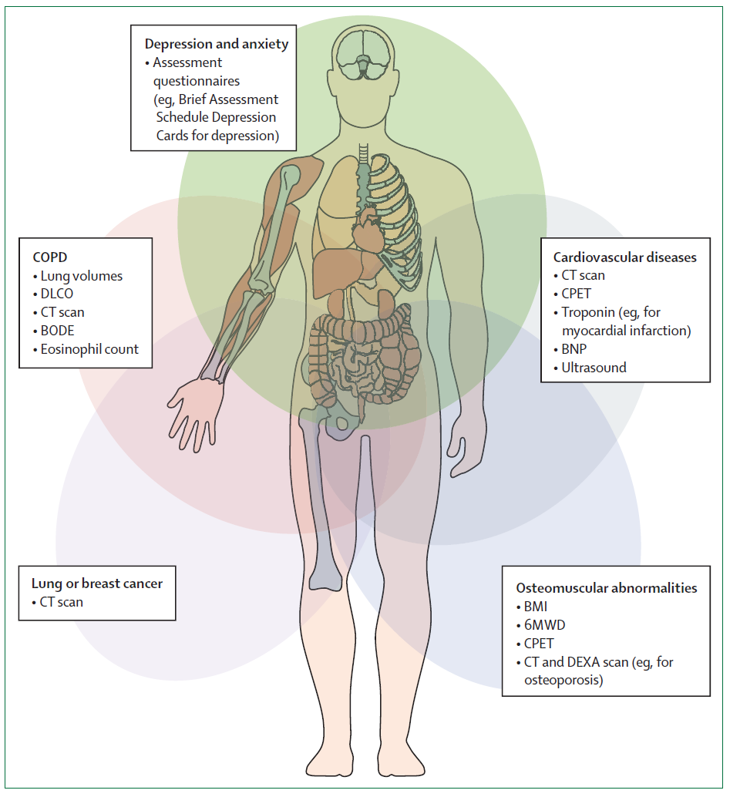

Identifying multimorbidity in patients with COPD
LM Fabbri et al Lancet Respir Med 2023
Notes:
58

Slide 59
COPD – comorbidities detected by CT vs clinical diagnoses
p<0.05 for all comorbid comparisons
N=379 clinically stable COPD patients BODE cohort
Ezponda et al, Respirology 2022;27:286-293
Notes:
The proportion of radiologically detected diseases using computerized chest tomography compared to the proportion of diagnoses clinically known by the time of the testing in 379 COPD patients. The proportion differences were statistically different (p<0.05) in all comorbidities. Modified from reference #110
PAE-pulmonary artery enargement
CAC-coronary artery calcification

Slide 60
Climate change & COPD
NEW
2025
Higher outdoor temperature were shown to be linked with an increased risk of hospitalization
Lower outdoor temperatures were linked with a risk increase for exacerbations

Slide 61
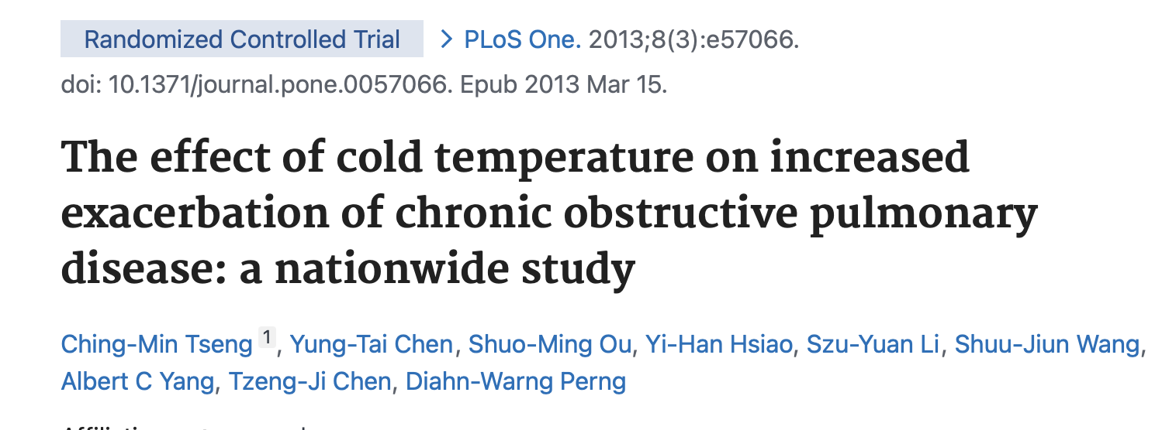
Type of study | Number of Patients | Result | Conclusion
Randomized controlled trial | 16,254 | It was found that a 1°C decrease in air temperature was associated with a 0.8% increase in the exacerbation rate on event-days (95% confidence interval (CI), 1.015-1.138, p = 0.015). With a 5°C decrease in mean temperature, the cold temperature (28-day average temperature) had a long-term effect on the exacerbation of COPD (odds ratio (OR), 1.106, 95% CI 1.063-1.152, p<0.001). In addition, elderly patients and those who did not receive inhaled medication tended to suffer an exacerbation when the mean temperature dropped 5°C. | Elderly patients and those without inhaled medicine before the exacerbation event were affected significantly by lower mean temperatures. A more comprehensive program to prevent cold stress in COPD patients may lead to a reduction in the exacerbations rate of COPD.

Slide 62

Type of study | Patients | Result | Conclusion
Observational Study | 12.5 million Medicare beneficiaries in 213 United States counties | obtained daily county-level rates of Medicare emergency respiratory hospitalizations in 213 U.S. counties from 1999 through 2008. Overall, each 10°F increase in daily temperature was associated with a 4.3% increase in same-day emergency hospitalizations for respiratory diseases (95% posterior interval, 3.8, 4.8%). | Found strong evidence of an association between outdoor heat and respiratory hospitalizations in the largest population
Notes:
some thermoregulatory responses to heat (39), a few minutes of heat exposure can trigger direct human airway responses to inhaling hot air. This rapid response has been demonstrated in studies of asthma (40, 41), and it likely operates through the cholinergic reflex pathway

Slide 63
Thank You

