Slide 1


ALFA : NIMS HYDRABAD 2025
Cardio-Pulmonary Exercise Test : CPET
Deepak Talwar
MD, DTCD, DNB, DM ( Pulmonary & Critical Medicine ) FISDA, FCCP ( USA ), FNCCP
Director & Chair
Pulmonary, Sleep, Allergy & Critical Care Medicine
Metro Group of Hospitals, INDIA

Slide 2


Exercise Test to Find Out Cause of Exercise Limitation
Heart
Respiratory
Motor force
Ventilation
Circulation
Circulation
Muscles

Slide 3
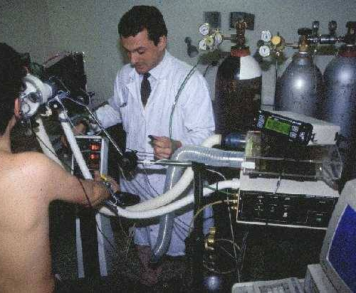
CPET : . Why not Used Often
Need to have very good knowledge of the integrative mechanisms of physiologic
adaptations to exercise for data interpretation (“art”)

Slide 4
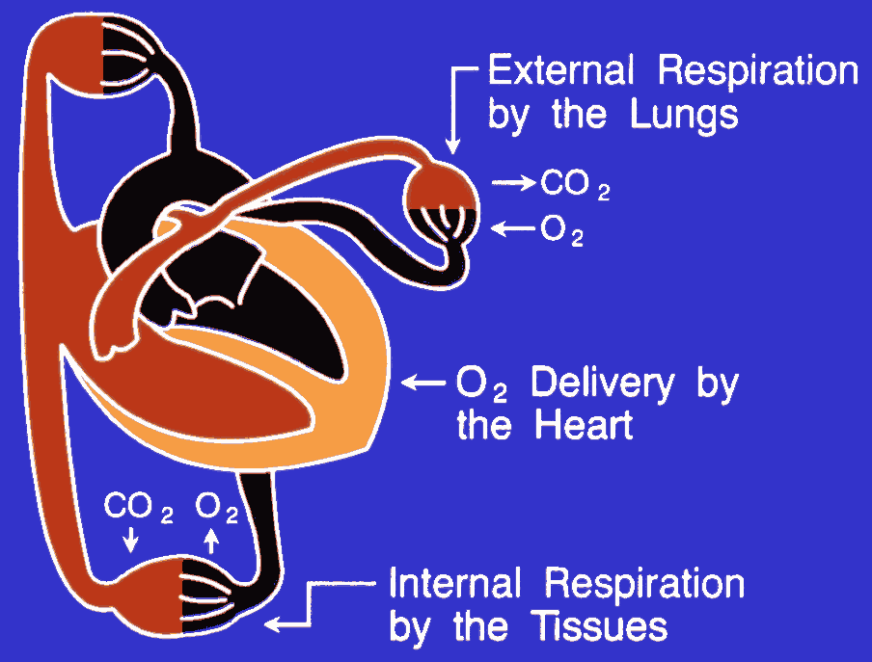
Exercise Test: CPET
Non-Invasive Estimating Internal Respiration by VO₂ & VCO₂
V_{E}

Slide 5
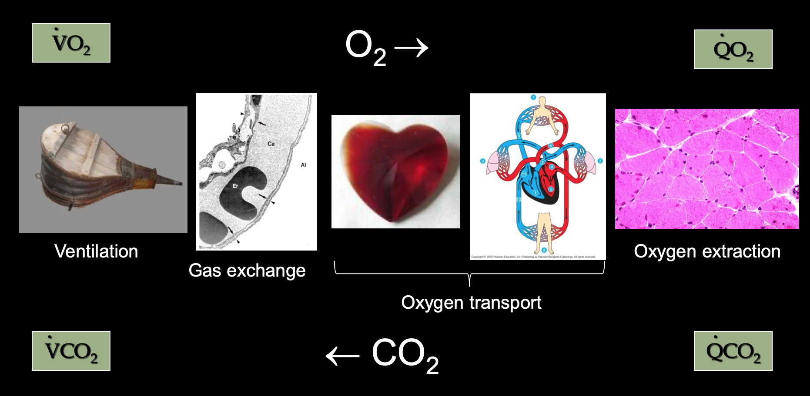
Exercise - Lungs / Heart / Circulation / Muscle

Slide 6
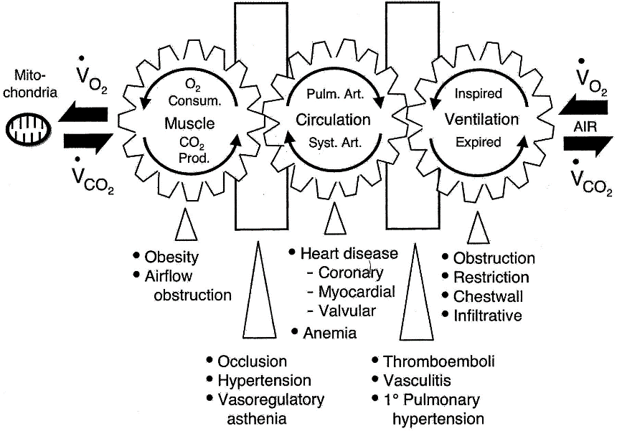



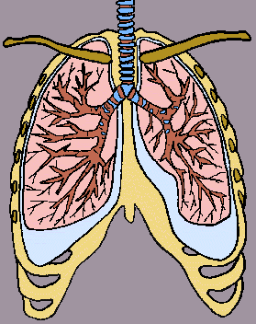
Limitations to Exercise…
Systemic
Pulmonary
Muscle
Heart
Lungs
O2
VO₂ max
O2
Glycogen
CO2
CO2
Muscle Disorders:
Myopathies
Storage Disorders
Deconditioning

Slide 7
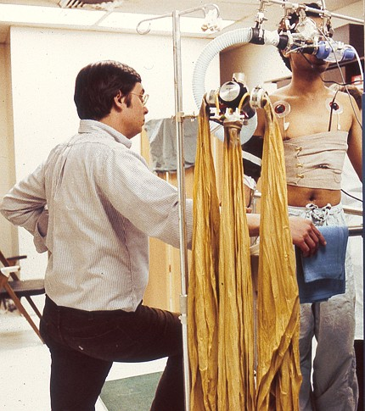
Why CPET Test ???
Cardiopulmonary measurements obtained at rest may not estimate functional capacity reliably
Aim to stress the cardio-respiratory system until factor limiting exercise capacity is identified
By primarily evaluating peak VO₂ and AT

Slide 8
Indications for CPET
Evaluation of dyspnea
Distinguish cardiac vs pulmonary vs peripheral limitation vs other
Detection of exercise-induced bronchoconstriction
Detection of exertional desaturation
Pulmonary rehabilitation
Exercise intensity/prescription
Response to participation
Pre-op evaluation and risk stratification
Prognostication of life expectancy
Disability determination
Fitness evaluation
Diagnosis
Assess response to therapy
Notes:
Malingering/misrepresentation

Slide 10
Exercise : . Load to be Given
*( M -0 , F -1 )
(3.05 x FEV₁) – (0.09 x Age*) + 2.44 x Gender) + 6.18
Gulati M, N Engl J Med 2005

Slide 11
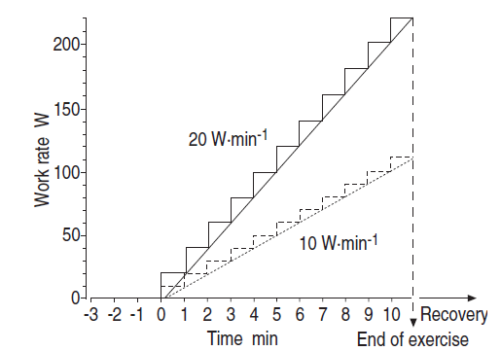

Exercise Protocol : To Reach Limit … till Exhaustion
Work : To do Maximum - Incremental !

Slide 12
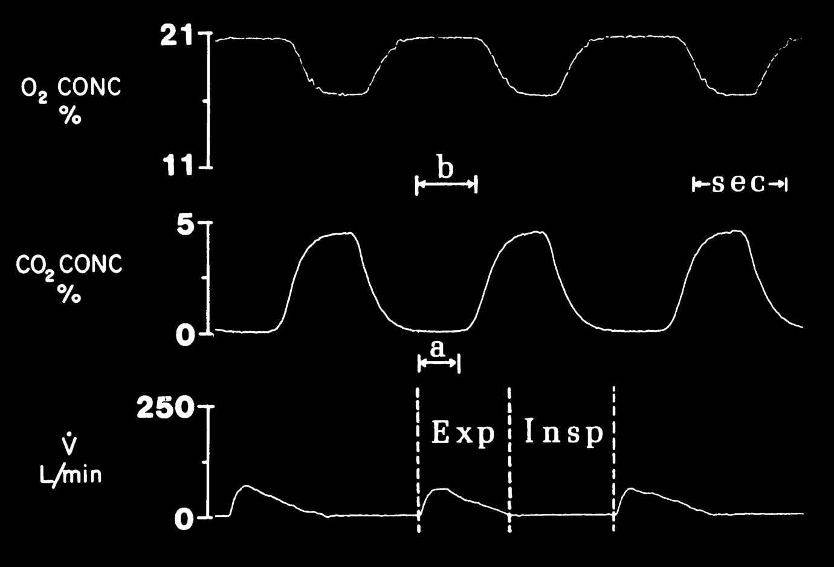
CPET : Breath-by-Breath Respiratory Gas Exchange
Weber KT & Janicki JS. In: Cardiopulmonary Exercise Testing. Philadelphia: Saunders. 1986

Slide 13
Optimal Exercise Test
Typically, > 2 or of the following criteria to be met :
RER > 1.1
± 10 beats / min predicted maximum HR
RPE > 17 ( 6-20 rating scale )

Slide 14
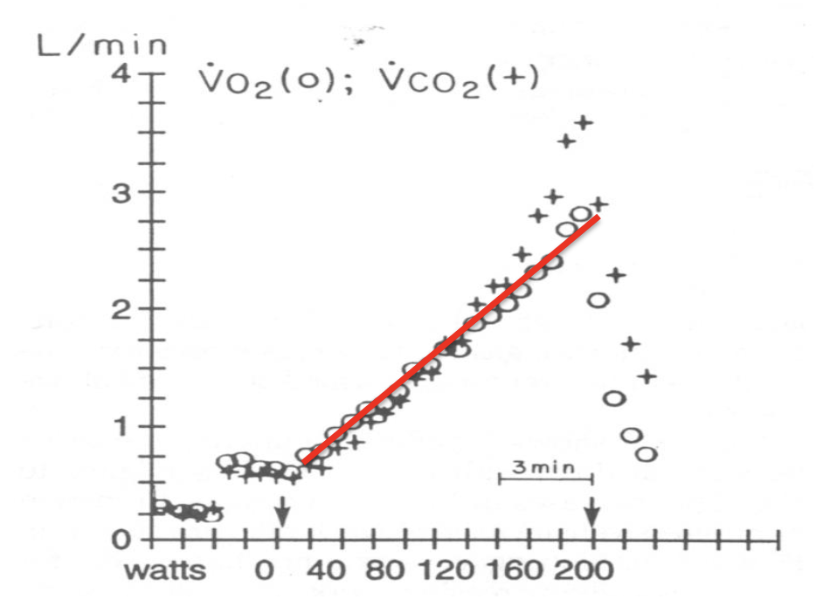
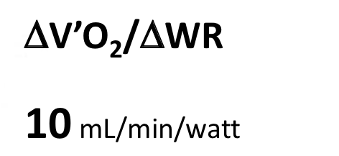
VO2max
Slope that maintains linearity
Gender
Age
Activity
Vco2 Reference
Vo2 Reference
VO₂ max = 15 x (HR max / HR rest )
CPET is the MOST Direct test to determine Vo₂ max

Slide 15
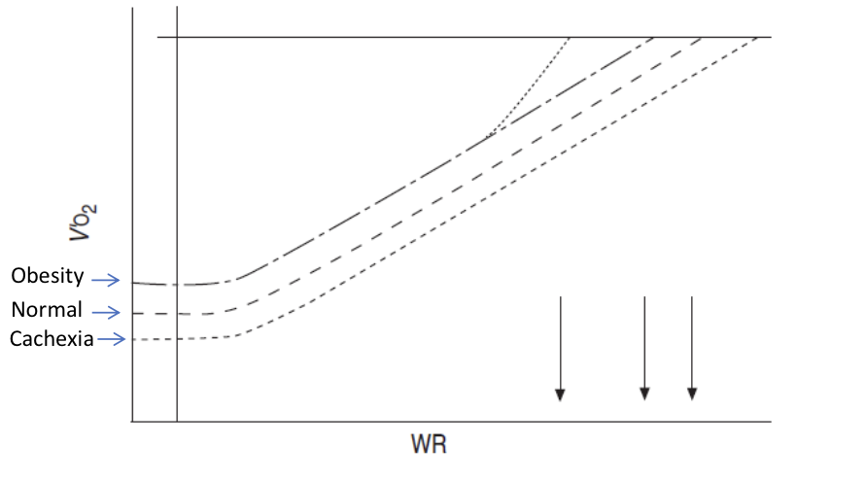
Metabolic Response VO₂ – WR Slopes
Reduced Exercise Capacity

Slide 16
VECO₂
Anaerobic
Threshold

Slide 17
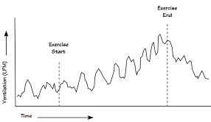
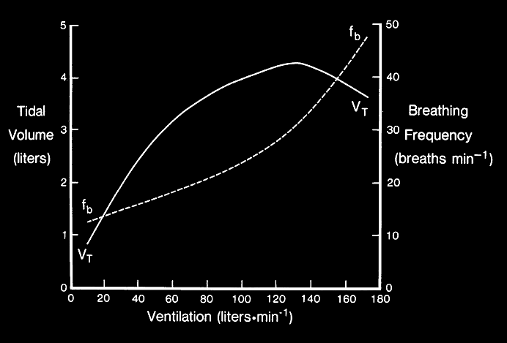
Ventilatory Response VE – T and VT/RR Slopes
Exercise End
Exercise Start
Ventilation =
Tidal Volume x Respiratory Rate

Slide 18
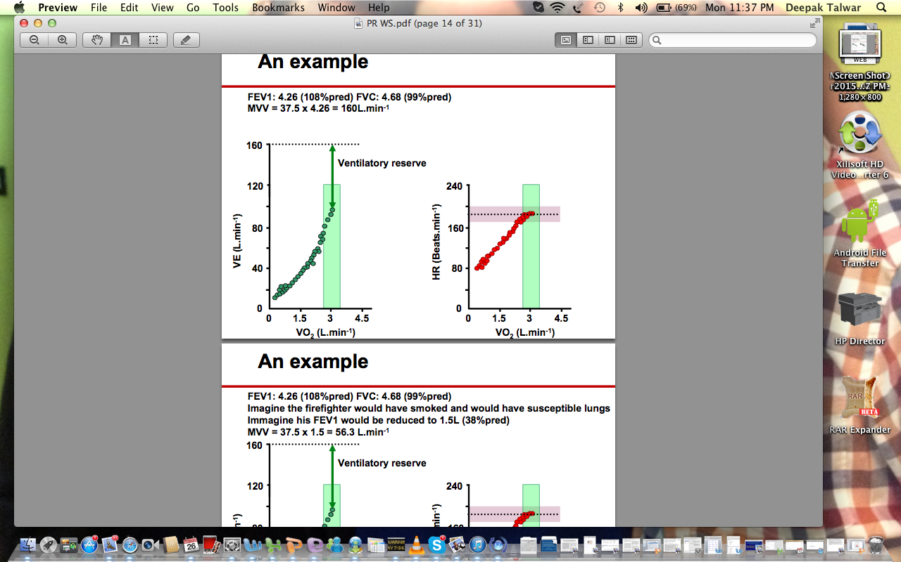
Concept of Breathing Reserve : BR MVV – VE max
BR = (MVV-VE max / MVV ) × 100
Normal - 20-30 %
Typically < 15% considered low

Slide 19
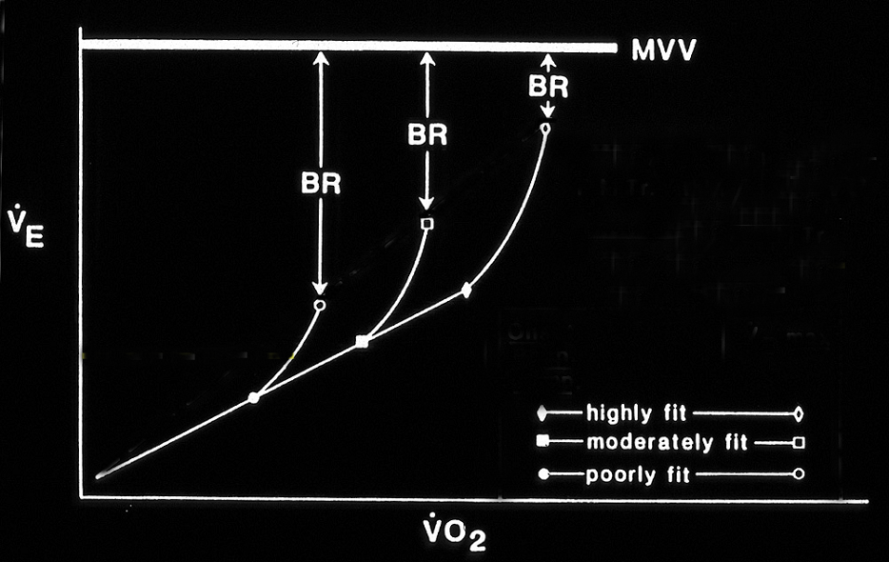
COPD
MVV = Max voluntary ventilation
BR = Breathing reserve
Modified from Whipp BJ, Pardy R. In: Hbk Physiol, Resp (Pulmonary Mechanics).
Eds: Macklem P, Mead J. Washington DC: Amer Physiol Soc, pp 605-629, 1986.
bfe
Notes:
19
19

Slide 20
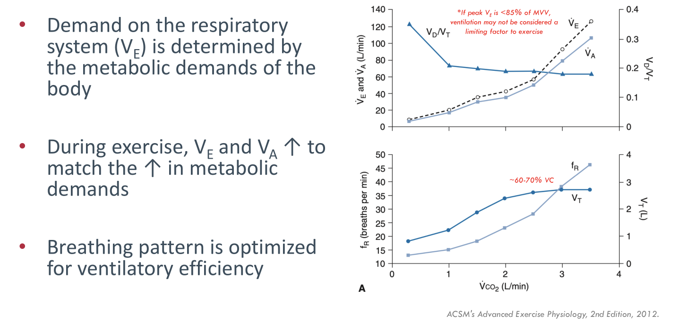
Ventilatory Response Dead Space VD / VT vs VE and VA
VA = VE - VD
Increase or does not decrease with exercise : Poor gas exchange

Slide 21
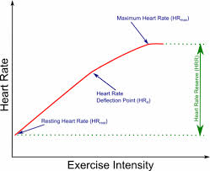
Cardiovascular Response . Heart Rate
Maximum HR ( HR @max )
HR max predicted
HR Reserve
Heart Rate Reserve < 15 beats/min is ~ Normal
Resting HR ( HR@ rest )
Predicted max HR = 220- Age

Slide 22
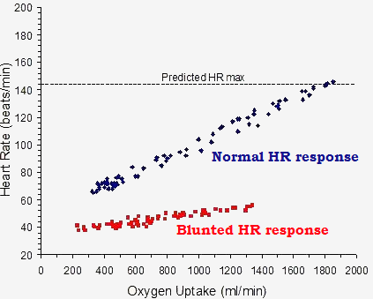
Abnormal HR Response : Sharp vs Blunt
Anxiety
Deconditioning
Sharp HR Response
Drugs : Ca channel or Beta blockers
Heart Failure & LVH
CAD
Autonomic dysfunction
SA Node disease
Elderly : Atherosclerosis

Slide 23
Cardiovascular Response . Oxygen Pulse
Amount of oxygen consumed by the body with each heartbeat and is often used as a surrogate for stroke volume and peripheral oxygen extraction
VO₂ / HR = O₂ Pulse
Surrogate
for Stroke Volume
VO₂ = HR SV(CaO₂ - CvO₂)
VO₂/HR = SV(CaO₂ - CvO₂)
(Henderson and Prince, 1914)

Slide 24
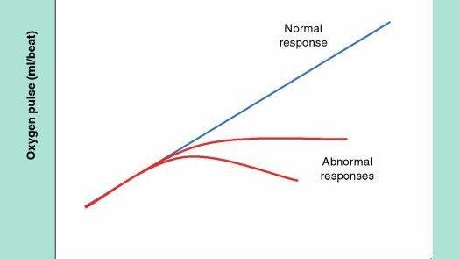
↑ Oxygen Extraction
O₂ pulse normally increases with incremental exercise due to increases in both SV and O₂ extraction
↑ Stroke Volume
Early Plateau or late decrease seen in Diastolic dysfunction

Slide 25
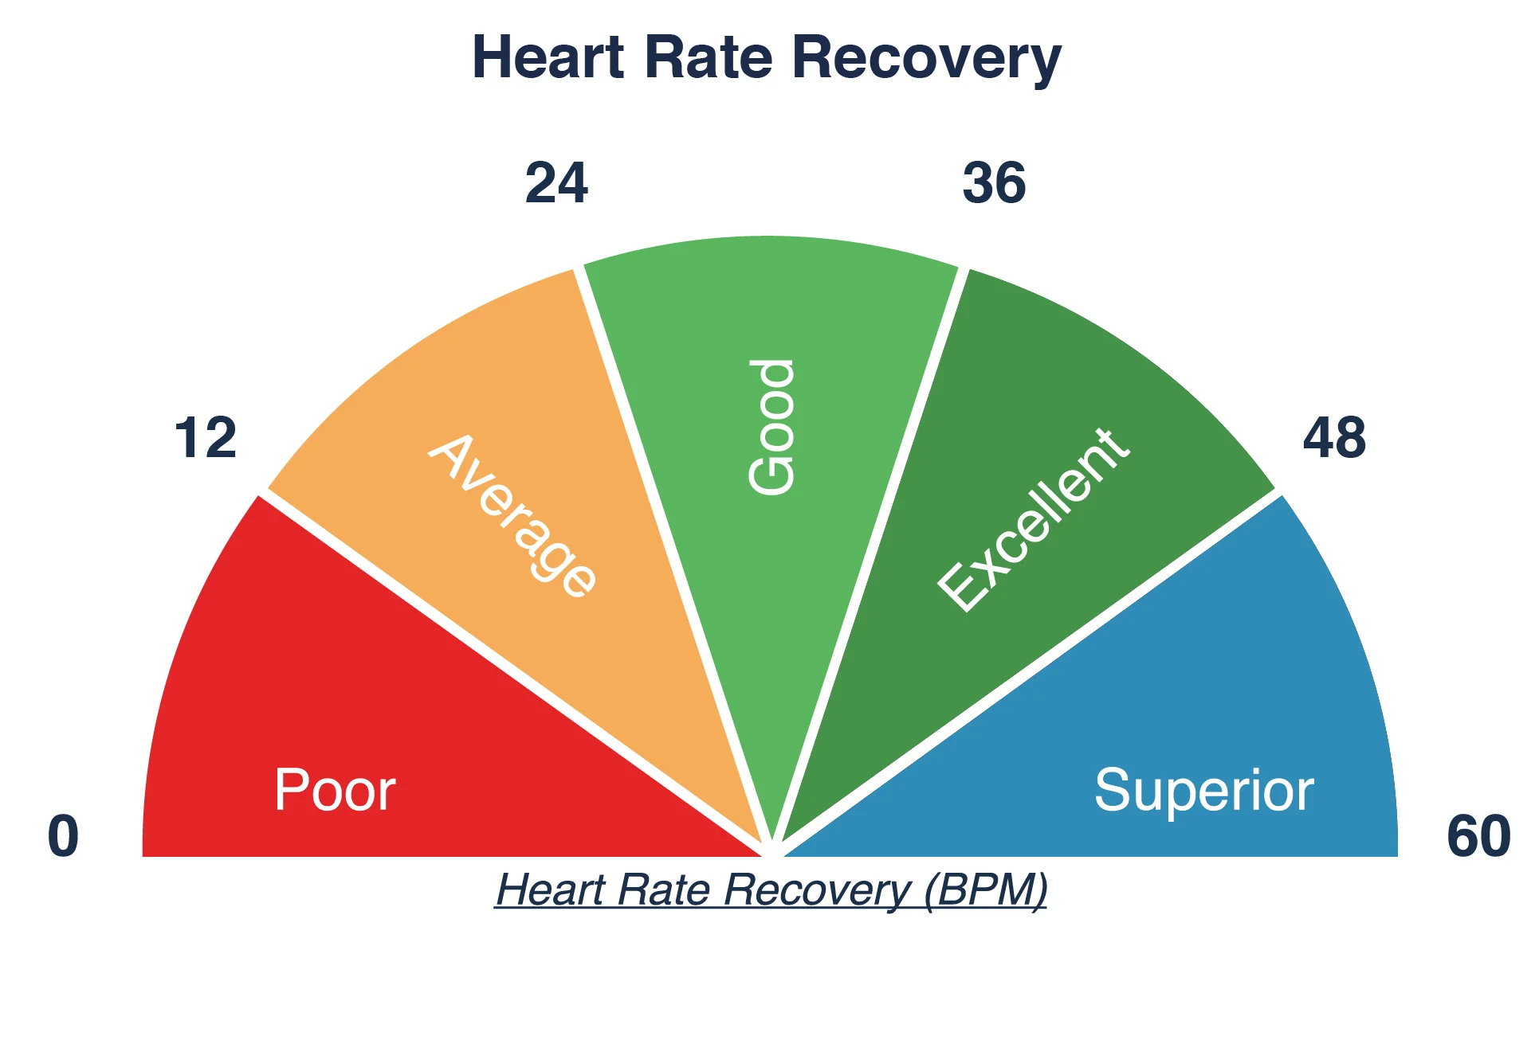
Heart Rate Recovery : HRR
Time to recover HR to baseline after peak exercise
Impaired LV systolic dysfunction, myocardial ischemia and predicts mortality
Normal =15-20 / min : < 12 is abnormal

Slide 26
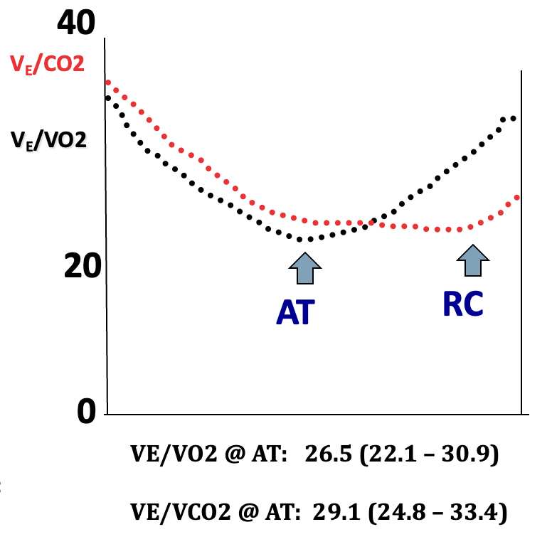
Ventilatory Equivalents Oxygen & Carbon Dioxide
How many L of air we need to breath to exchange 1 L of gas : V_{E}/VO_{2,} V_{E}/VCO₂
Abnormally High:
Hyperventilation
Increase dead Space
Lower values on Exercise indicate better efficiency
Notes:
Elevated VE/VCO2 is a common finding in pulmonary hypertension and other pulmonary vascular diseases, contributing to exercise intolerance

Slide 27
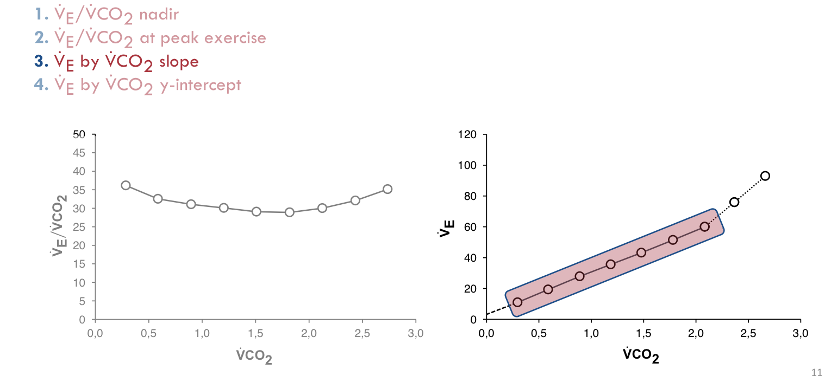
VE/VCO2 : Ventilatory Efficiency
.
.
: Lowest prior to respiratory compensation point, High in Cardio-respiratory disease
: In poor exercise tolerance - nadir & peak are similar ? unable to exercise after AT
: Most robust indicators of V efficiency In the absence of altered ventilatory mechanics-COPD
: Elevated increase in VE for a given VCO2, Useful for patients terminating CPET early
RCC
Notes:
Considerations of ΤሶVE ሶ VCO2 nadir
• Can overestimate ventilatory
inefficiency in patients with very short
CPET
• Lack of data points
• ΤሶVE ሶ VCO2 nadir: Lowest
ΤሶVE ሶ VCO2prior to respiratory
compensation point
VE ሶ VCO2 at peak exercise is high
to account for metabolic acidosis
• Individuals with poor exercise
tolerance the nadir and peak
values are similar
• Consider patients unable to exercise
beyond anaerobic threshold
• Generally considered a poorer
marker of ventilatory efficiency & decreases as COPD severity increases

Slide 28
VE / VCO₂ : Ventilatory Efficiency
.
.
Poor Exercise Tolerance
Peak point
In poor exercise tolerance - nadir & peak are similar ? unable to exercise after AT
Lowest prior to respiratory compensation point, High in Cardio-respiratory disease
Nadir Point
↓ Cardio-Respiratory Disease
Notes:
Considerations of ΤሶVE ሶ VCO2 nadir
• Can overestimate ventilatory
inefficiency in patients with very short
CPET
• Lack of data points
• ΤሶVE ሶ VCO2 nadir: Lowest
ΤሶVE ሶ VCO2prior to respiratory
compensation point
VE ሶ VCO2 at peak exercise is high
to account for metabolic acidosis
• Individuals with poor exercise
tolerance the nadir and peak
values are similar
• Consider patients unable to exercise
beyond anaerobic threshold
• Generally considered a poorer
marker of ventilatory efficiency & decreases as COPD severity increases

Slide 29
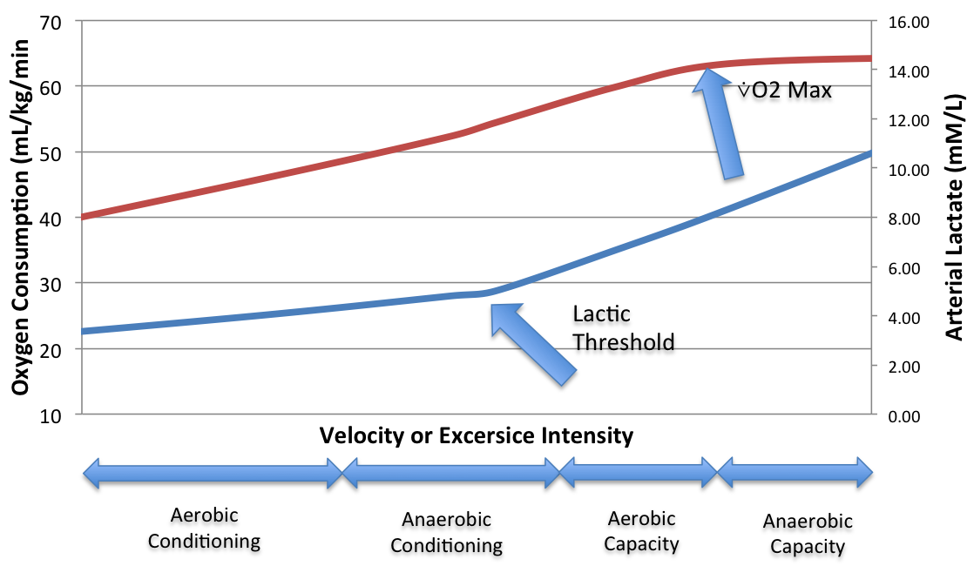
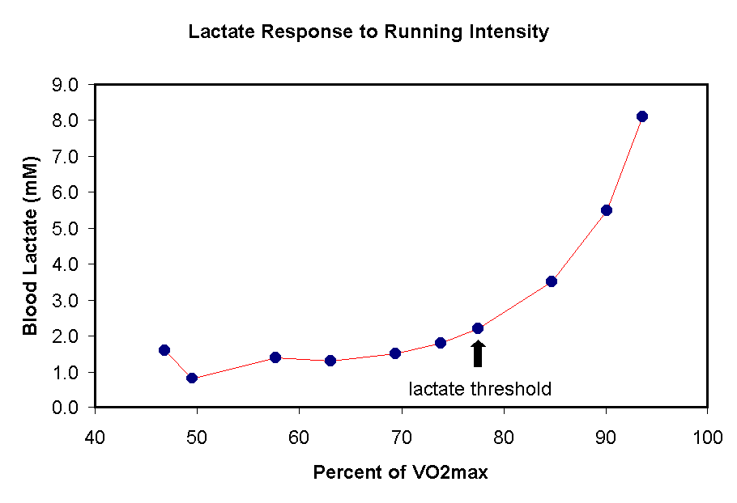
Concept of Anaerobic Threshold & Lactate Threshold
Point at which there is switch from aerobic metabolism to anaerobic metabolism due to blood flow limitation to exercising muscles
Arterial Lactate measurements

Slide 30
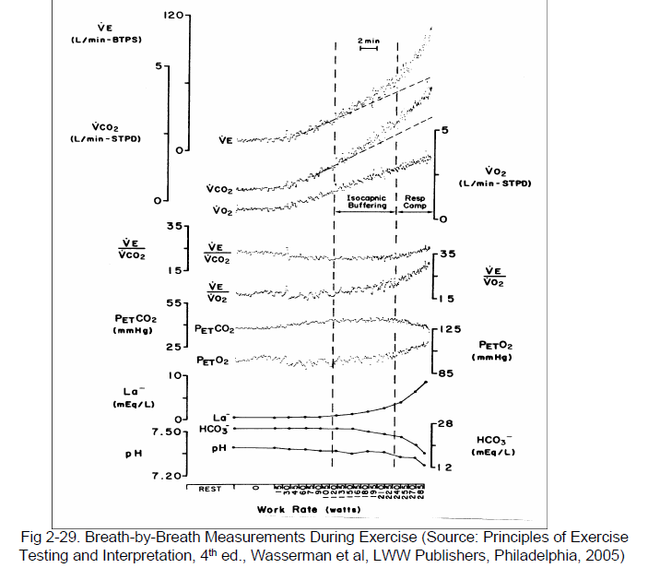
Physiological Responses at AT
LT
LT & AT are used interchangeably in Exercise Test
Rise of VE slope
Rise of VCO2 slope
Rise of VO2 slope

Slide 31
Anaerobic Threshold
Normally – 50-85% and 40% is the generally accepted LLN used clinically
Not Identifiable
COPD
DCMP on B blocker
Elderly
Obese

Slide 32
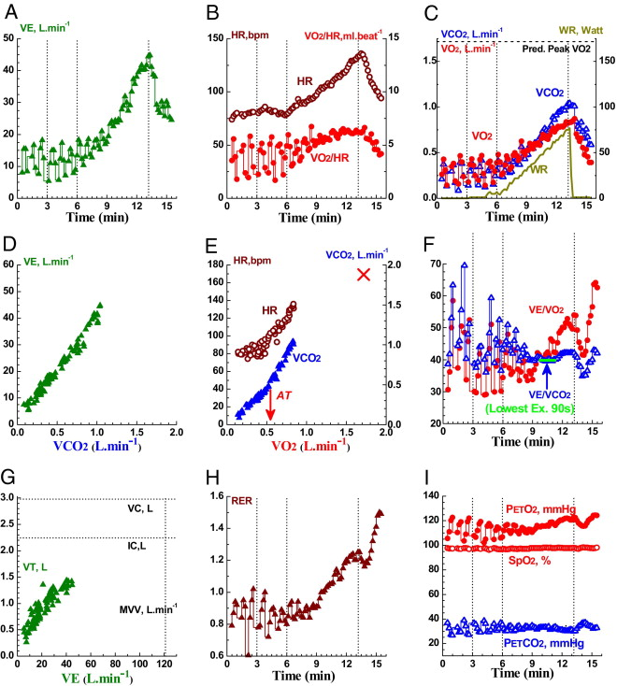
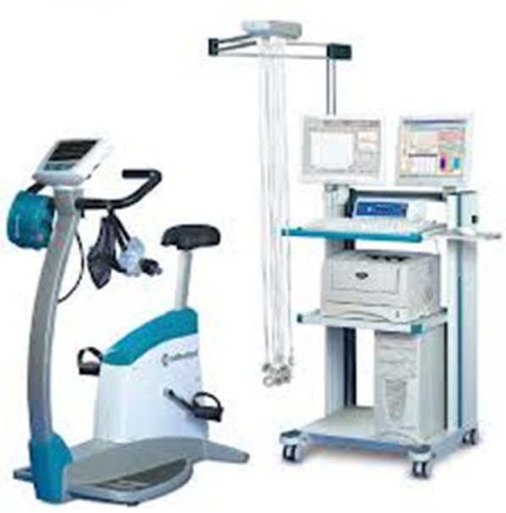
Wasserman 9-Panel Plot

Slide 33
Interpret CPET Results: Putting it all together
How much exercise in W patient could perform ?
Can subject achieve normal VO₂ ( > 85%)or not ?
Is there a cardiovascular limitation?
Is there a premature metabolic acidosis - Low AT
Low O2 pulse at termination of exercise
Large HR reserve
Long HRR time
Is there a ventilatory (mechanics) limitation?
Low BR < 15%
DHI with EFL
Does pulmonary gas exchange contribute to exercise limitation?
Fall in Oxygen saturation > 4%
Is it poor conditioning / muscular limitation ?

Slide 34
Contraindications to CPET
Acute MI
Unstable angina
Unstable arrhythmia
Acute endocarditis, myocarditis, pericarditis
Syncope
Severe, symptomatic AS
Uncontrolled CHF
Acute PE, DVT
Respiratory failure
SpO₂ <88% on RA
Acute significant non-cardiopulmonary disorder that may affect or be adversely affected by exercise
Notes:
Orthopedic, infection, cataract

Slide 35
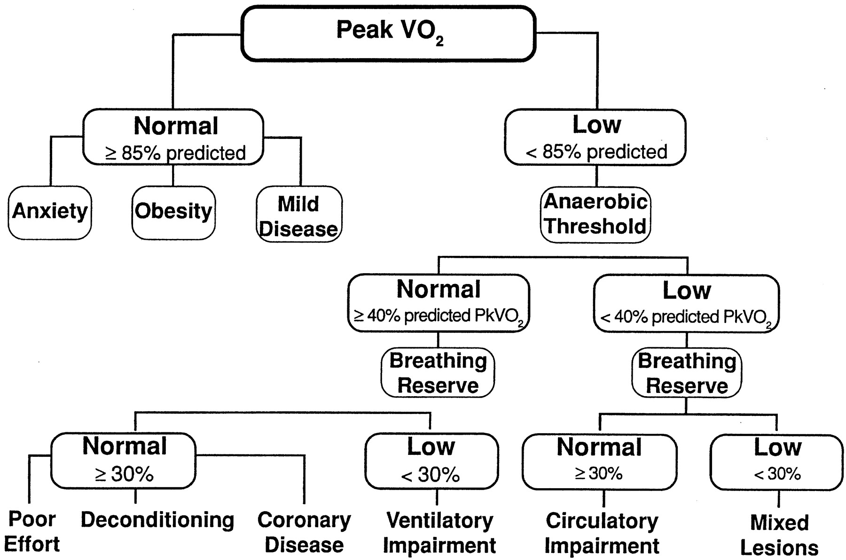

Algorithm to Interpret CPET Report
Figure 2. Flow chart for the differential diagnosis of exertional dyspnea and fatigue.
Copyright © American Heart Association
Milani R V et al. Circulation 2004;110:e27-e31
Notes:
Figure 2. Flow chart for the differential diagnosis of exertional dyspnea and fatigue. Used with permission from Wasserman et al.2

Slide 36
Reduced Vo₂ peak : Patterns for Causes
CPET Variable | COPD | ILD | PVD | Obesity | Heart Failure | Deconditioning
LT / AT | Indeterminate/ Low / normal | Normal / Low | Reduced | Reduced / normal | Reduced | Reduced
VE Reserve | Reduced or Zero | Reduced or normal | Normal | Normal | Normal | Normal
HRR | Normal / increased | Normal / increased | Normal | Normal | Reduced / Normal | Normal
O₂ Pulse | Reduced | Reduced | Reduced | Normal | Reduced | Reduced
Oxygen saturation (sPo2) | + /- | ++ | ++ | Nil | Nil | Nil
End Tidal CO2 Late in Exercise | Increase or Stable | Decrease | Decrease | Decrease | Decrease | Increase or Stable
Stopping Test | Dyspnea | Dyspnea | Leg Fatigue | Fatigue | Leg Fatigue | Dyspnea, Fatigue,

Slide 38













Arriving : Octane PACS -25 15, 16 & 17 August 2025
Prof. Shirmila Withana
Prof. Dave Singh
Prof. Colm McCabe
Prof. Athol U Wells
Prof P Haldar
Prof. Omar Usmani
Prof Rakesh Panchal
Prof. Konstantina Kontogianni
Prof. Marlies Weisenbeek
Prof. Anthony De Soyza

Slide 39
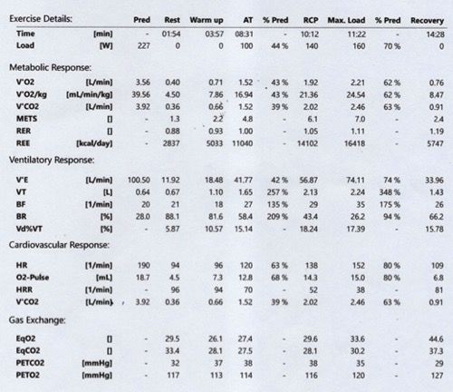
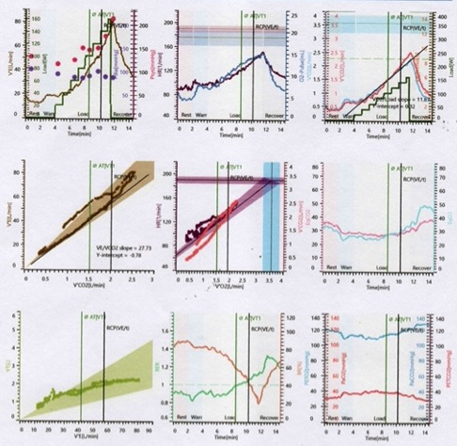
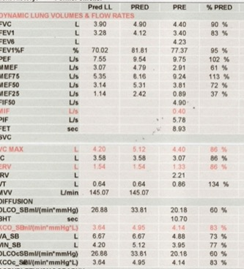
Case : 30 Years, Male with SOB
No desaturation on CPET
Notes:
Exercise Capacity is moderately reduced due to neuromuscular weakness Post Covid

Slide 40
Case
Notes:
≥ 2 mm (0.2 mV) in men or 1.5 mm (0.15 mV) in women in leads V2-V3 and/or of ≥ 1 mm (0.1 mV) in other contiguous chest leads or the ...

Slide 41
Case
No desaturation on CPET

Slide 42
Case

Slide 43
Case

