Slide 1

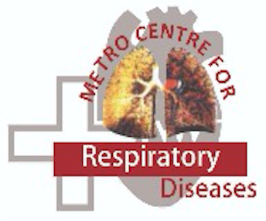
Bronchial Asthma ICP – API 2025
Deepak Talwar
MD, DTCD, DNB, DM ( Pulmonary & Critical Medicine ) FISDA, FCCP ( USA ), FNCCP
Director & Chair
Pulmonary, Sleep, Allergy & Critical Care Medicine
Metro Group of Hospitals, INDIA

Slide 2
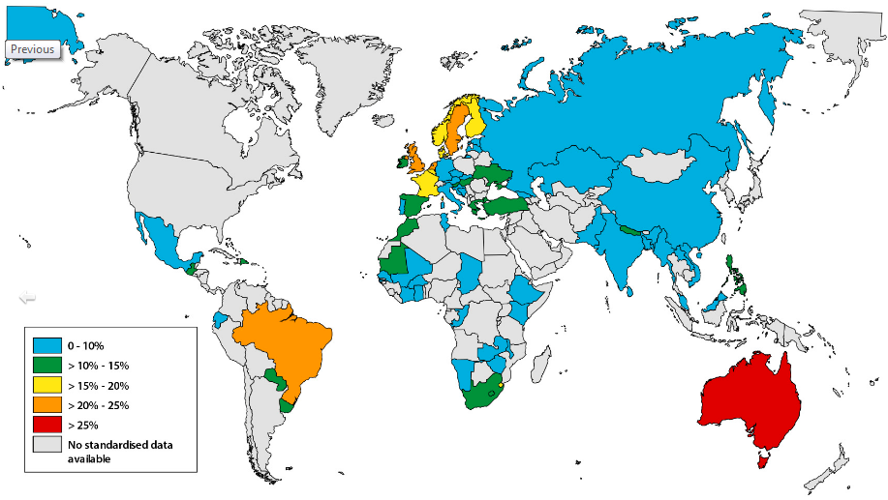
Burden of Asthma : Problem !
Prevalence of asthma worldwide
Asthma affects 339 million people worldwide
1 in 10 asthma patients globally live in India
> 20% of total deaths in asthma from India
Fletcher JM et al. Primary Care Respiratory Medicine (2020) 30:29 ; https://doi.org/10.1038/s41533-020-0184-0

Slide 3
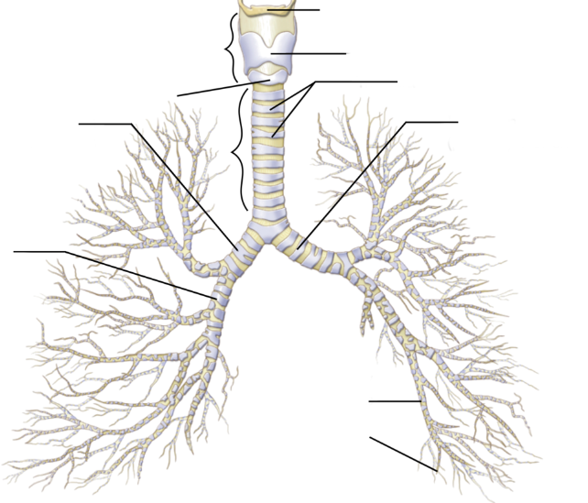
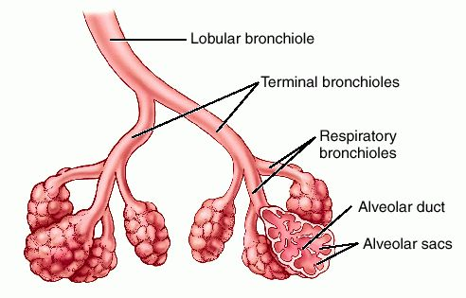
Respiratory System – Where Asthma Attacks ?
Predominantly affect large airways
Larynx
Thyroid
Primary bronchi (Rt)
Trachea
Primary bronchi (Lt)
Secondary bronchi
Tertiary
bronchi
bronchioles
Large airways
Small airways
3

Slide 4
Defining Asthma
Asthma is a heterogeneous disease, usually characterized by chronic airway inflammation.
It is defined by the history of respiratory symptoms such as wheeze, shortness of breath, chest tightness and cough that vary over time and in intensity, together with variable expiratory airflow limitation.
GINA 2024

Slide 5

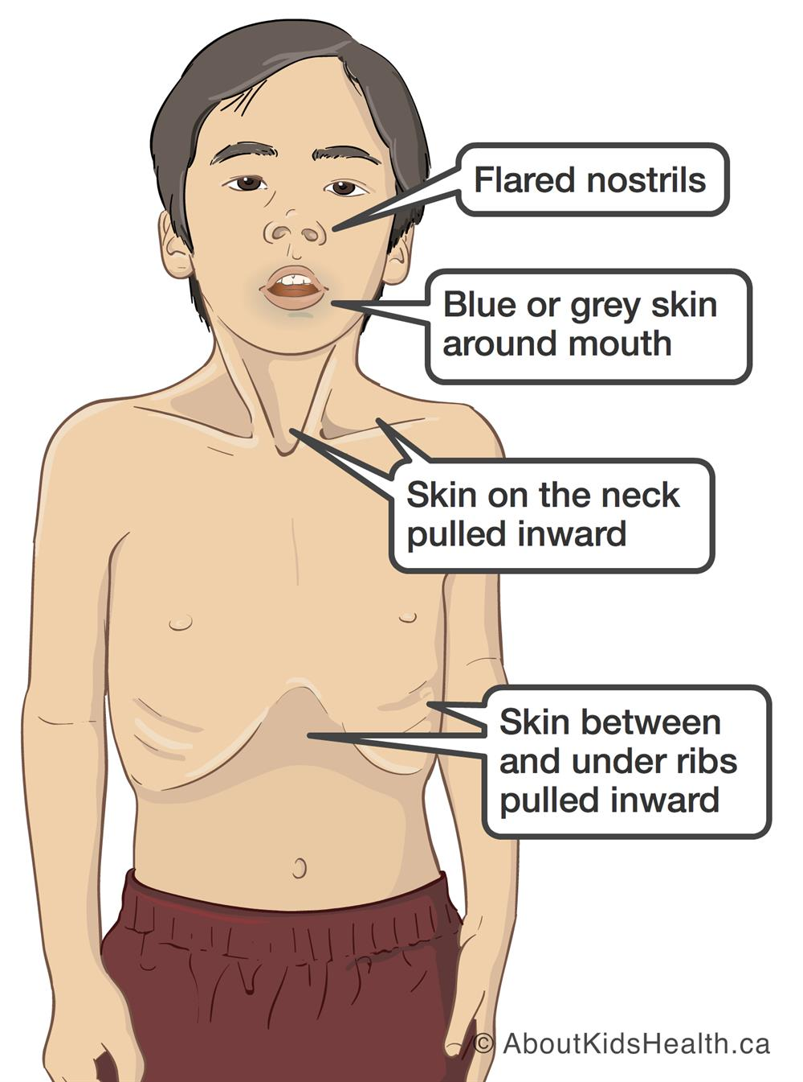

Spot Red Flag Symptoms In Asthma :

Slide 6
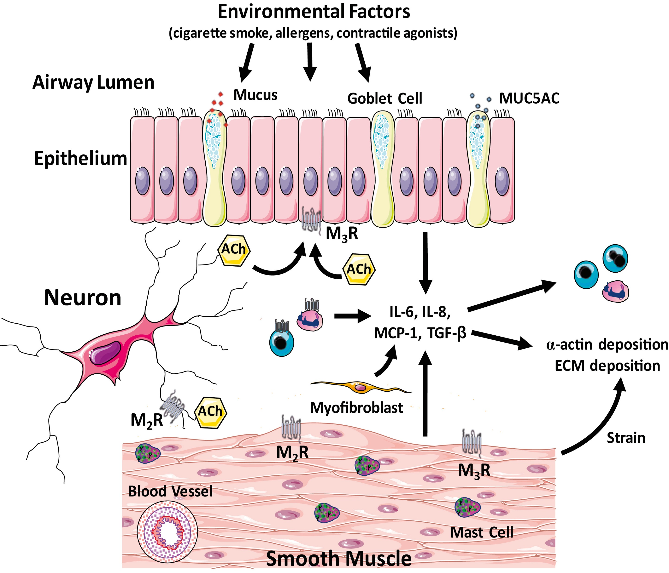
Asthma : Patho-physiology – Chronic Inflammation
Tliba O et al JACI 2018

Slide 7
Defining Variability in Asthma : Key to Diagnosis
Respiratory Symptoms variability : Historically defined
Wheeze, SOB, Cough or Chest tightness: mostly >1 symptom
Variable over time and intensity
Mostly or worse in night or at wakening
Triggered by exercise, laughing or allergen / cold air exposure
Viral infections : precipitate of worsen symptoms
Lung Function variability : Spirometry based
Obstruction : Once FEV1 is low and FEV1 /FVC ration < LLN
Reversibility : ↑ FEV₁ / FVC > 12% and 200 ml or in children 12% after bronchodilator or @ 4 weeks of ICS therapy
More variation and more reversibility and on repeated testing – more confident diagnosis
Reversibility may be absent during exacerbation / viral infection
> 10% improvement ( ERS 2022)

Slide 8
Diagnostic Flow Chart For Asthma
Patient with respiratory symptoms
Patient in distress OR
Other diagnosis unlikely
Are Symptoms & Clinical Findings Typical of Asthma
Work Up for Alternative Diagnosis
Perform Spirometry with Reversibility
Repeat Testing later
Empiric ICS+ SABA
Review Response
Spirometry @ 1-3 months
Fulfils Criteria for BA
Bronchoprovocation
Trial with Asthma Treatment
Treat as Asthma
Treat for Alternative Diagnosis

Slide 9
Diagnosis of Asthma in Resource limited Settings
GINA recommends confirmation of asthma diagnosis with lung function testing, whenever possible, before commencing long-term treatment
Spirometry-based testing if available
Peak expiratory flow (PEF)
>20% increase in PEF, 15 minutes after 2 puffs of salbutamol = asthma likely (WHO-PEN)
Improvement of symptoms and PEF after 4 weeks ICS treatment
Access to affordable diagnostic equipment and skills training needs to be substantially scaled up in low- and middle-income countries

Slide 10
Differential Diagnosis in Asthma
Symptoms | Differential Diagnosis
Sneezing, itching, blocked nose, throat-clearing | Chronic upper airway cough syndrome
Cough, sputum, SOB on exertion, smoking or noxious exposure | COPD
Sudden onset of symptoms, unilateral wheeze | Inhaled foreign body
Recurrent infections, productive cough | Bronchiectasis
Dyspnea with exertion, nocturnal symptoms, ankle edema | Cardiac failure
Cardiac murmurs | Congenital heart disease
Excessive cough and mucus production, gastrointestinal symptoms | Cystic fibrosis

Slide 11
Allergy Tests in Asthma :
To confirm presence of atopy : But only increases the probability that a patient with respiratory symptoms has allergic asthma, but this is not specific for asthma nor is it present in all asthma phenotypes
SPT with common environmental allergens is simple, rapid to perform, inexpensive and has a high sensitivity
Measurement of sIgE is no more reliable than skin tests and is more expensive, for uncooperative patients or with skin disease
Presence of a positive skin test or positive sIgE, does not mean that the allergen is causing symptoms – must be confirmed by the patient’s history

Slide 12
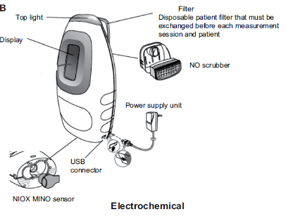
Role of FeNO in Asthma
Modestly associated with levels of sputum and blood eosinophils
Not to rule in or rule out a diagnosis of asthma
While FeNO is higher in T 2 asthma, also elevated in non-asthma conditions (e.g. eosinophilic bronchitis, atopy, allergic rhinitis, eczema)
Not elevated in T2 low asthma (e.g. neutrophilic asthma)
FeNO is lower in smokers
May be increased or decreased during viral respiratory infections

Slide 13
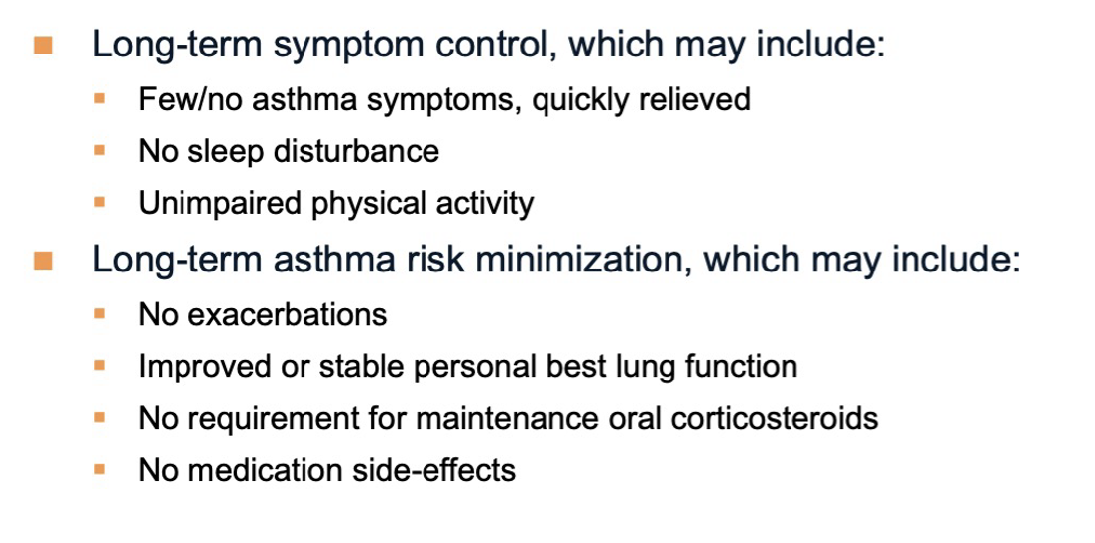
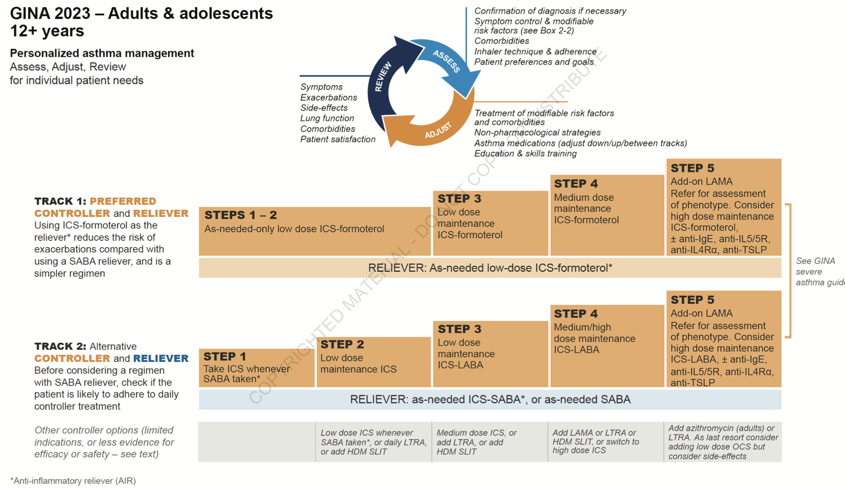
Treatment

Slide 14
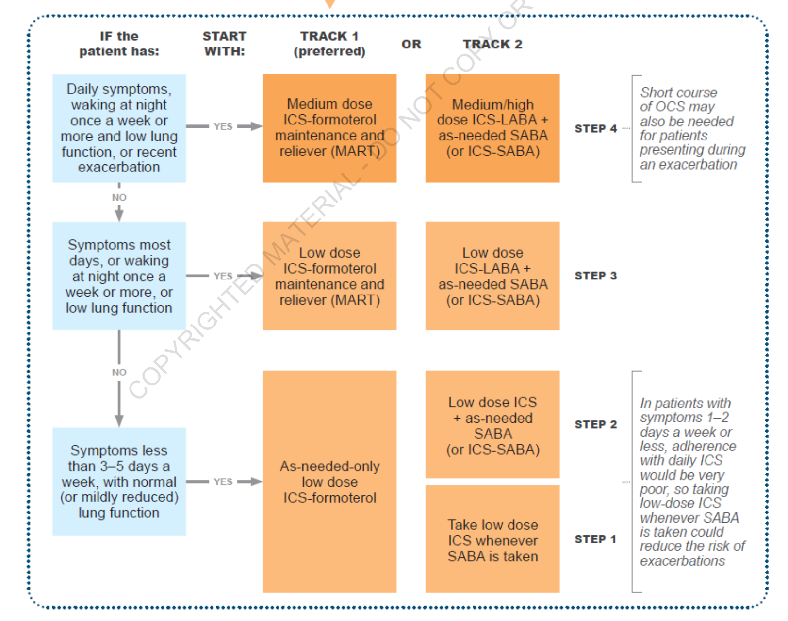
Treatment

Slide 15
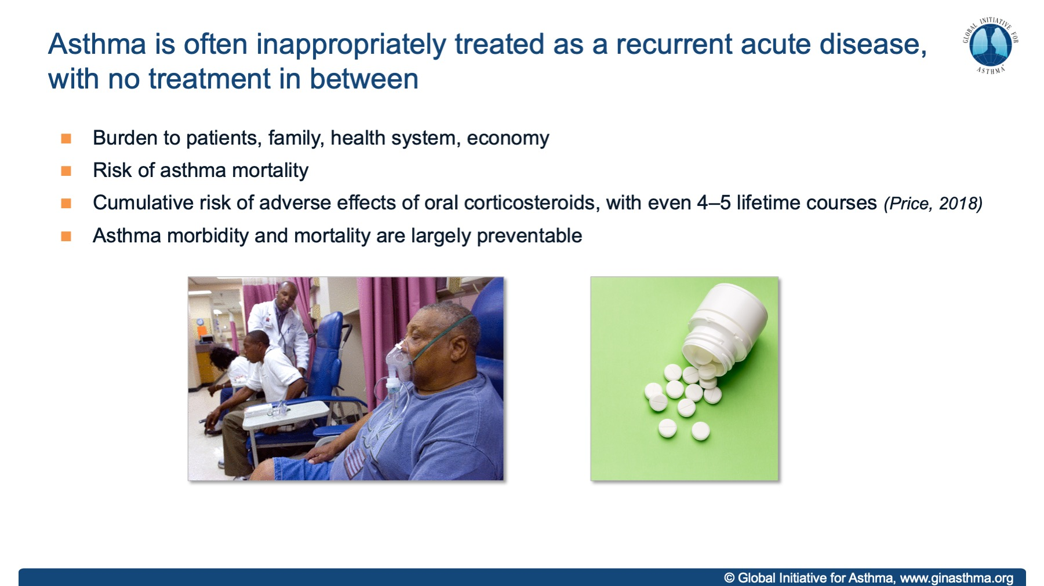
Notes:
Rather than chronic and preventative care

Slide 16

Assessments: Asthma Control Symptom Control
Symptom Control :
1.Daytime
2 Nocturnal
3 Activity
4 SABA* use (2 /week)
About Past 4 weeks
Every Visit
Direct Questioning
Tools :
ACT or ACQ
Well Controlled, Partially Controlled Uncontrolled
* Not for patients on AIR

Slide 17
Future Risk for Exacerbations
Past exacerbation in last 1 year
Poor adherence
Incorrect technique
Chronic sinusitis
Smoking
Medication: High SABA & Low ICS use
Others: Pregnancy, Food allergy and multimorbidity
Exposures : Allergen / Pollution / Smoke
Psychosocial : Poor support
Type 2 Inflammation: ↑AEC & FeNO
Severe Exacerbation : Intubated or ICU
Low FEV₁ is
a strong predictor of Exacerbations

Slide 18
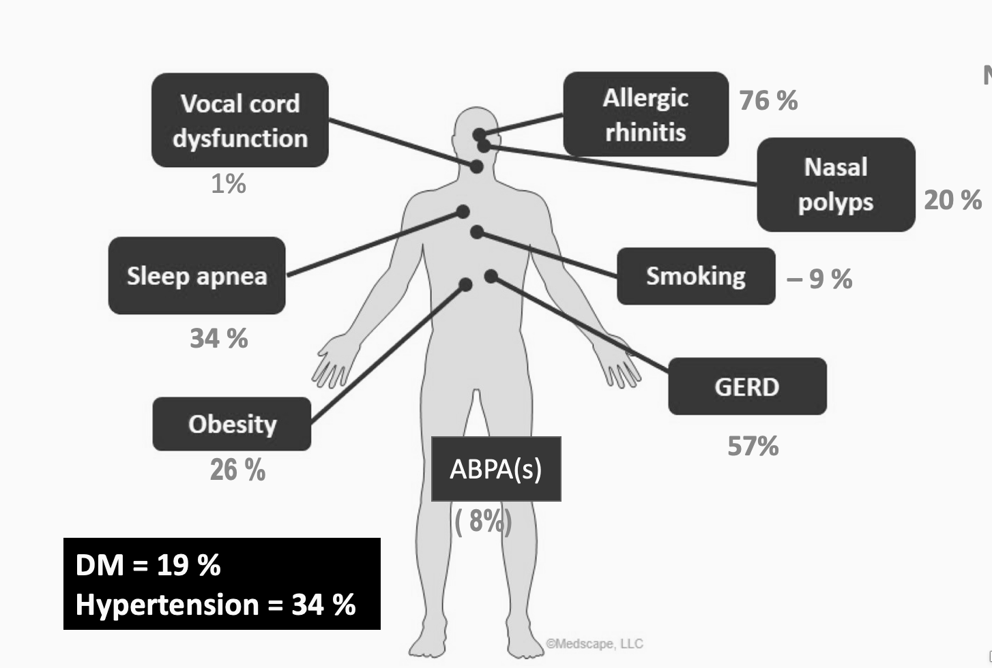
Assessments: Multimorbidities
Pulmonary :
Rhinitis
Rhinosinusitis
Extra-Pulmonary :
Obesity
GERD
OSA
Anxiety / Depression
Talwar D, Lung India 2022;39:393-400.

Slide 19
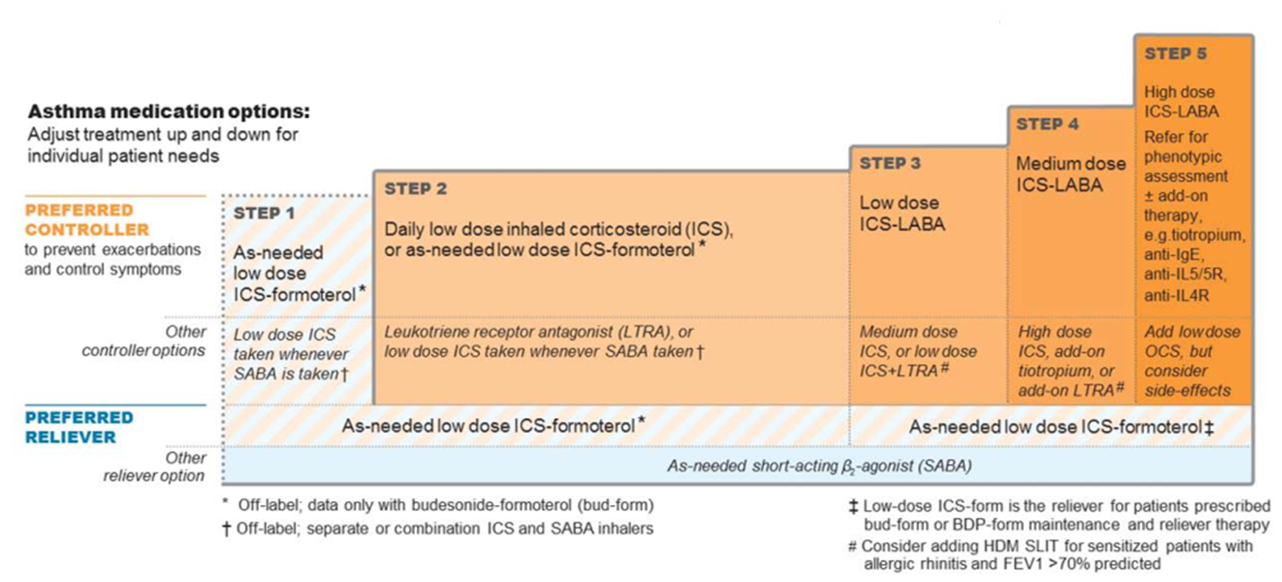
Treatment

Slide 20
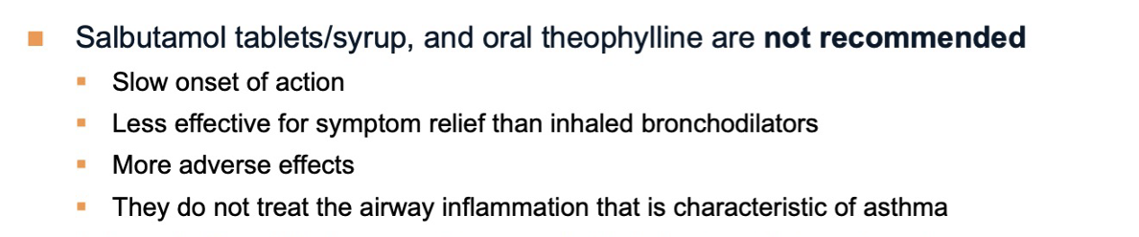
Oral bronchodilators not Recommended

Slide 21
Defining Doses of ICS for Asthma Treatment
Inhaled corticosteroid | Total daily dose (mcg)
 | Low | Medium | High
Beclometasone dipropionate (CFC) | 200–500 | >500–1000 | >1000
Beclomethasone dipropionate (HFA) | 100–200 | >200–400 | >400
Budesonide (DPI) | 200–400 | >400–800 | >800
Ciclesonide (HFA) Fluticasone furoate (DPI) | 80–160 100 | >160–320 n.a | >320 200
Fluticasone propionate (DPI) | 100–250 | >250–500 | >500
Mometasone furoate | 110–220 | >220–440 | >440
Triamcinolone acetonide | 400–1000 | >1000–2000 | >2000

Slide 22
Step 1 – Different Approach
For safety, GINA no longer recommends SABA-only treatment for Step 1
This decision was based on evidence that SABA-only treatment increases the risk of severe exacerbations, and that adding any ICS significantly reduces the risk
GINA now recommends that all adults and adolescents with asthma should receive symptom-driven or regular low dose ICS-containing controller treatment, to reduce the risk of serious exacerbations
This is a population-level risk reduction strategy, e.g. statins, anti-hypertensives
Evidence
Indirect evidence from SYGMA 1 of large reduction in severe exacerbations vs SABA-only treatment in patients eligible for Step 2 therapy (O’Byrne, NEJMed 2018)
Values and preferences
High importance given to reducing exacerbations
High importance given to avoiding conflicting messages about goals of asthma treatment between Step 1 and Step 2
High importance given to poor adherence with regular ICS in patients with infrequent symptoms, which would expose them to risks of SABA-only treatment

Slide 23
Step 2 – 2 ‘Preferred’ Controller Options
As-needed low dose ICS-formoterol (off-label; all evidence with budesonide-formoterol)
Evidence
Direct evidence from two large studies of non-inferiority for severe exacerbations vs daily low dose ICS + as-needed SABA (O’Byrne, NEJMed 2018, Bateman, NEJMed 2018)
Direct evidence from one large study of 64% reduction in severe exacerbations vs SABA-only treatment (O’Byrne, NEJMed 2018)
Symptoms reduced; one study showed reduced exercise-induced bronchoconstriction
Values and preferences
High importance was given to preventing severe exacerbations, avoiding need for daily ICS in patients with mild or infrequent symptoms, and safety of as-needed ICS-formoterol in maintenance and reliever therapy, with no new safety signals
Lower importance given to small non-cumulative differences in symptom control (ACQ-5 difference 0.15 vs MCID 0.5) and lung function compared with daily ICS
Makes use of normal patient behavior (seeking symptom relief) to deliver controller

Slide 24
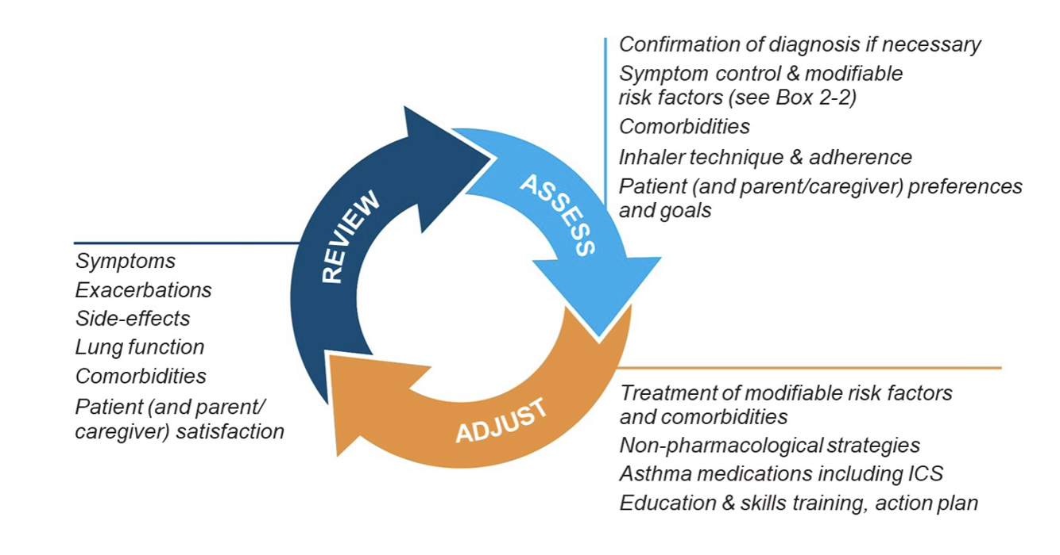
Asthma Treatment is NOT SET & FORGET

Slide 25
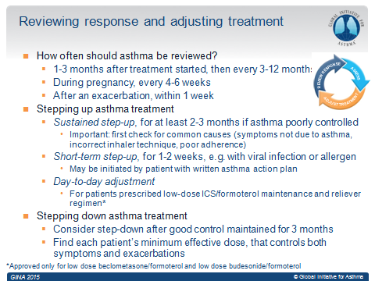
Assessing Response & Adjusting Treatment

Slide 26
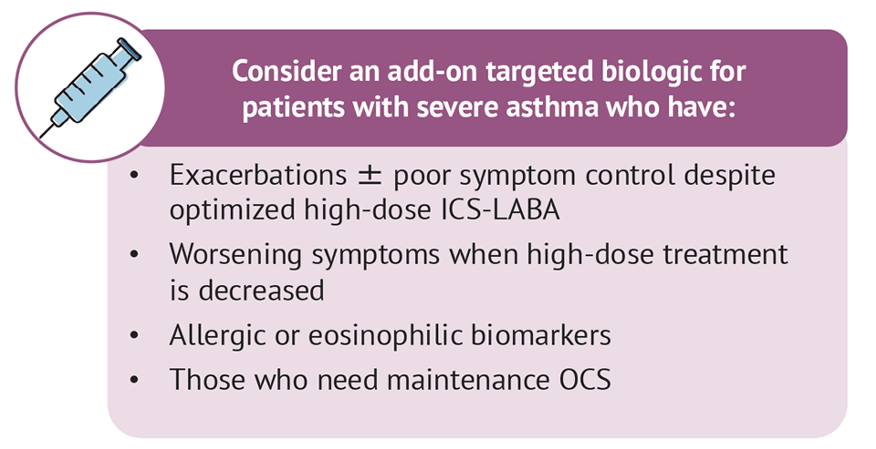
When To Consider Biologicals in Asthma ?
GINA Step 5 Asthma: Severe Asthma
Expansive !

Slide 27
Patients with Severe Asthma Suitable for Biologicals
Type 2 Severe Asthma : Atopic / Eosinophilic Phenotype
Type 2 Inflammation
Age of onset of asthma: Childhood / Early adulthood
Allergic comorbidities : Atopic dermatitis, AR, CSwNP, ABPA, EGA
Oral steroids responsive
GINA 2023

Slide 28
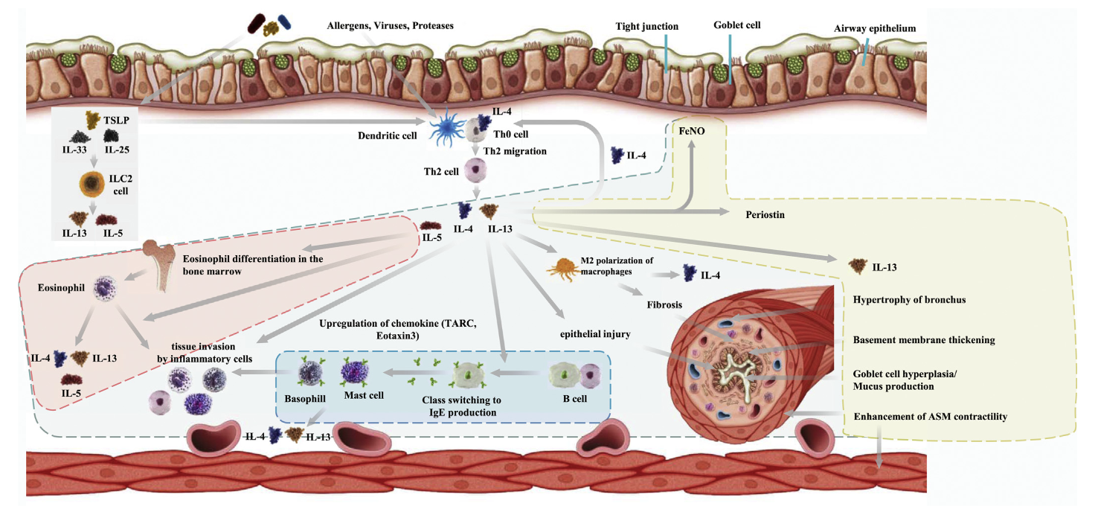
Choosing Appropriate Biologicals - Drivers
4. Anti – TSLP Tezepelumab
2. Anti – IL-5 Mepo/Benralizumab
3. Anti – IL-4R/13
Dupilumab
Anti – IgE
Omalizumab
K. Matsunaga et al. / Allergology International 69 (2020) 187e196

Slide 29
Choosing Biologicals in SA : Match Expectations with Research
SA Outcomes | Omalizumab | Mepolizumab | Benralizumab
Reduction in Exacerbations | 25% reduction | ~ 50 % | 40 -70 %
Reduction in maintenance dose of OCS | 50% dose reduction in those at 15 mg/day baseline | 50% dose reduction 2- 6 months | 50 - 80%
FEV₁ | 2.1% | 100 ml | 100 -160 ml @ 4 weeks
QoL | SGRQ Asthma diaries | ACQ5 + 0.4 SGRQ +7 points | ACQ < 0.5 SGRQ +8.1 points
Real World Data | Reduction in AE in 42% vs 63 % & 28% vs 48% @ baseline | Reduction in AE ~ 50% Reduction in mOCS ~ 50% | All improved with 70% exacerbation free @2years
Comorbidities | CRwNP Chronic Idiopathic Urticaria | EGPA ( 300 mg/ month ) CRSwNP | WIP

Slide 30
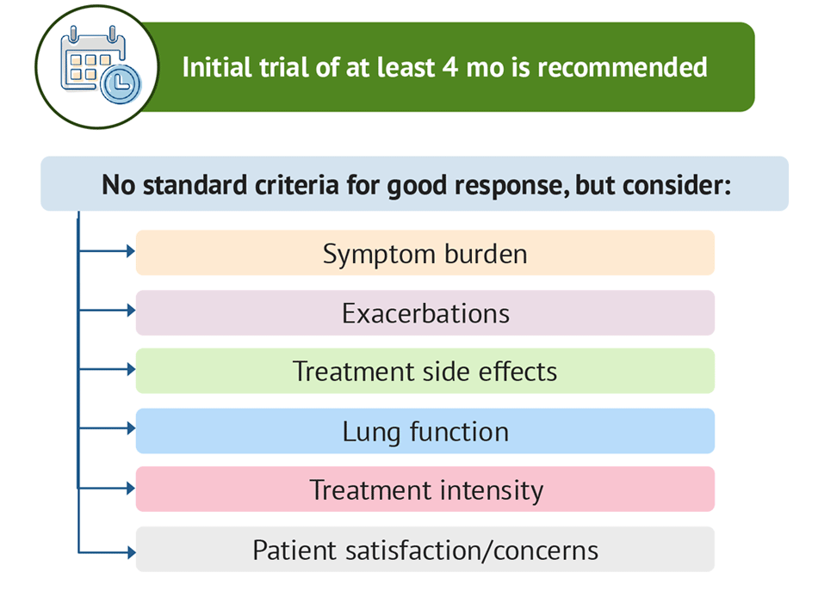

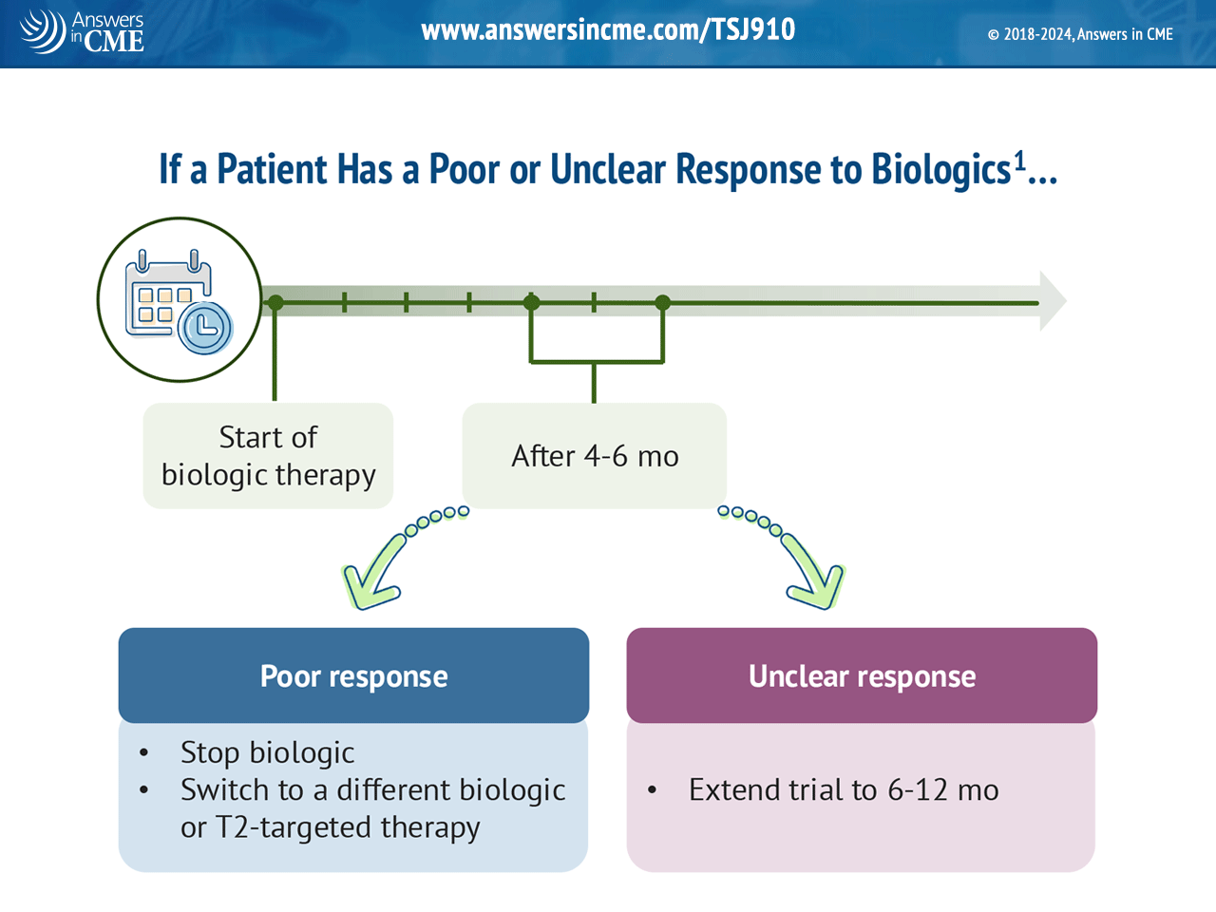
Assessing Effectiveness of Biologicals : FU@ 6 months
Good /Response
Initial Trial for 4 months Minimum
Continue

Slide 31
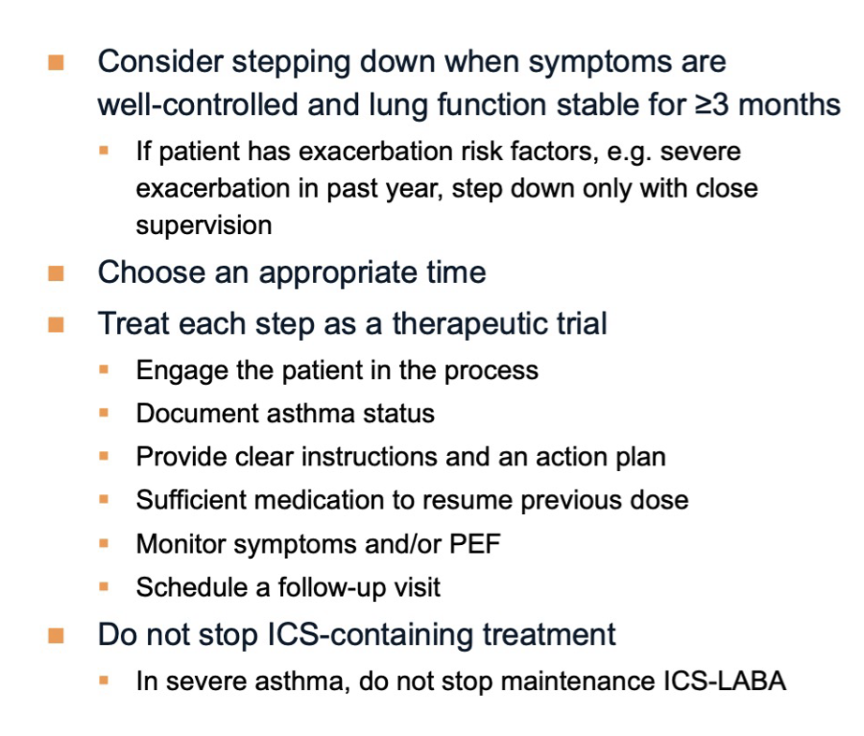
Stepping Down Treatment in Asthma
GINA 2024

Slide 32
Take Home Messages
Asthma is a chronic inflammatory airway disease.
Diagnostic approach simple: Medical history-variability in PFT’s.
Consider BHR where diagnosis remains controversial.
Biomarkers and particular FeNO reach applicability, validity and utility in different aspects.
ICS the cornerstone of treatment.
As needed treatment for step 1&2. More closer to patients needs.
Phenotypes and endotypes drive our treatment decision strategies.
Severe asthma a continuous challenge.
Biologics for T2 related process…but limited treatments exist for the T2 low.
Continuously Assess, Adjust & Review asthma cases on FU @ 1-3 months

Slide 33
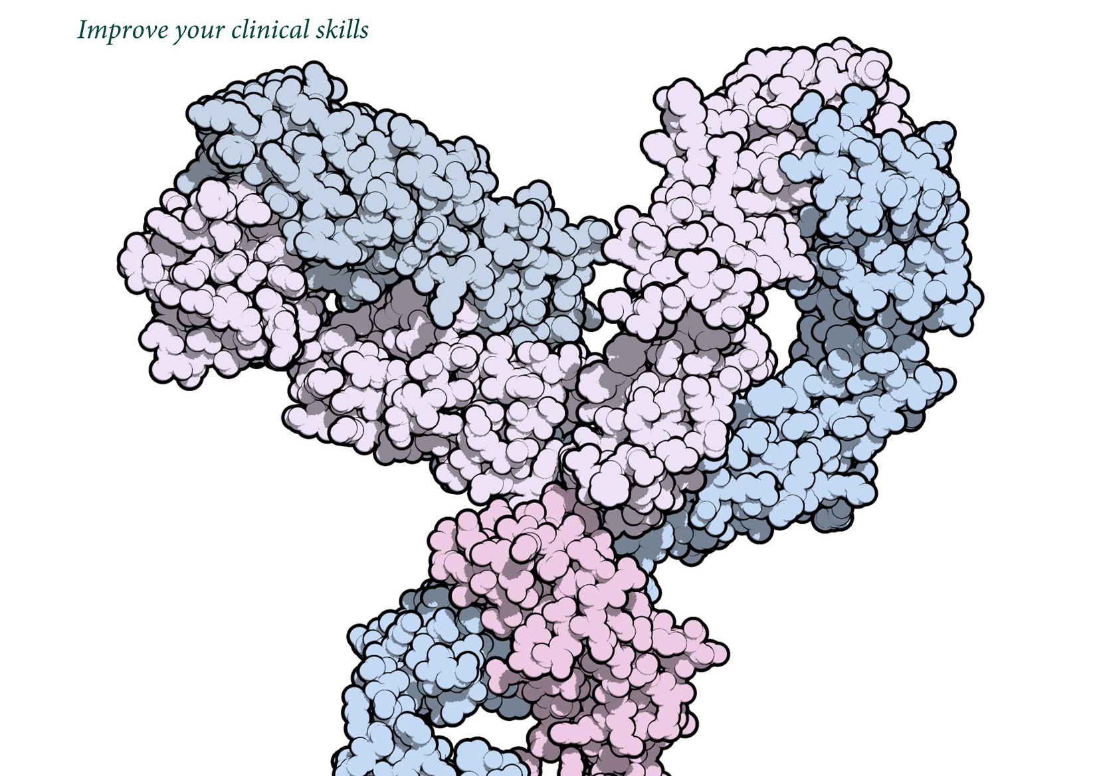
Thank You
Deepak Talwar
Director & Chair, Metro Centre for Respiratory Diseases
INDIA

