Slide 1
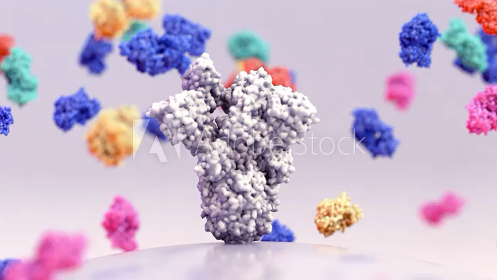

Biologicals Breakthrough in Asthma & COPD
Deepak Talwar
Director & Chair, Metro Centre for Respiratory Diseases
Metro Hospitals & Institute, NOIDA, INDIA

Slide 2
Biologicals : Targeted Therapies
0 %
35 %
10 %
100 %
Anti – IL-5 Mepolizumab
Benralizumab
Anti – IgE Omalizumab
Anti – IL-4/13
Dupliumab
Murine
Chimeric
Humanized
Fully Human
(-omab)
(-ximab)
(-zumab)
(-umab)
1. Anti – IgE Monoclonal Ab
Notes:
Ibrutimumab

Slide 3
4 Biologicals for Airway Diseases
Anti – TSLP Tezepelumab
Anti – IL-5 Mepolizumab
Benralizumab
Anti – IL-4R/13
Dupilumab
Anti – IL-4R/13
Dupilumab
Anti – IgE
Omalizumab
Eur Respir Rev 2025; 34: 240088

Slide 4
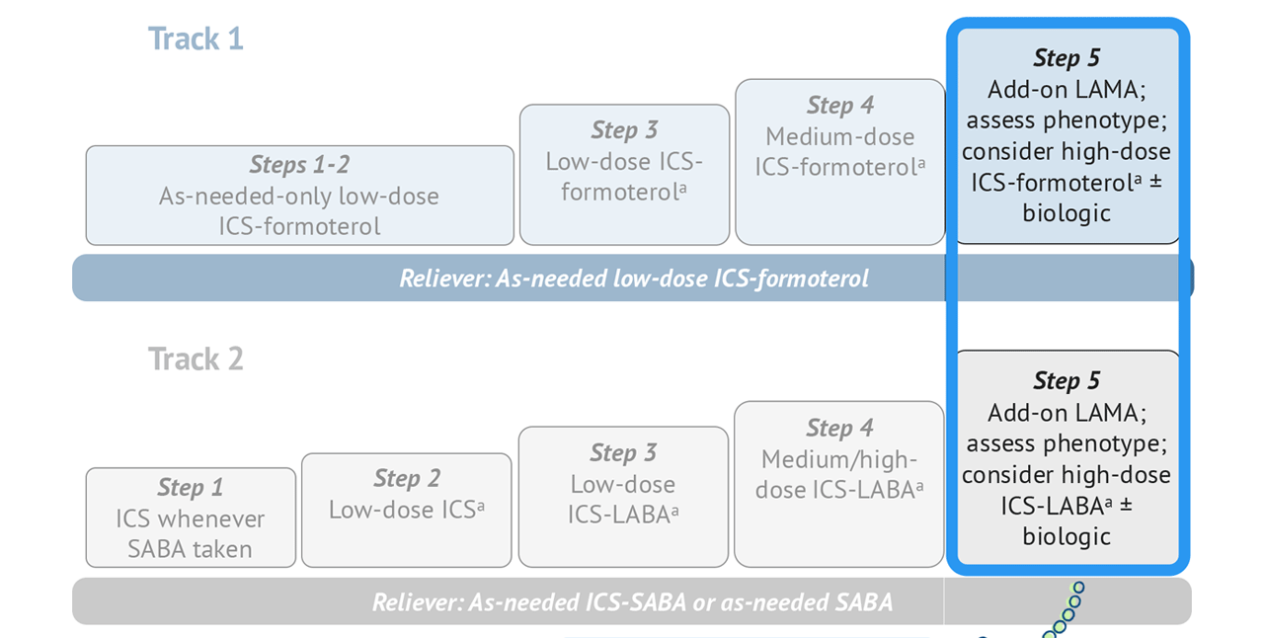
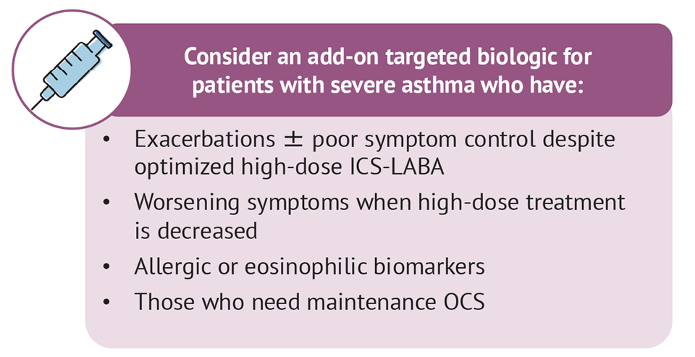
Biologicals in Asthma : When to Use ?
Step 5
Low Dose OCS
LAMA
High Dose ICS
LABA
Montelukast
Other Options
Azithromycin
GINA 2024

Slide 5



Remember : All Uncontrolled Asthma is NOT Severe Asthma
Severe Asthma
GINA Step 5
90%
Difficult To Treat Asthma
Comorbidities
50%
Exposures & Triggers
20%
Adherence & Technique
Retrospective label
25%
Diagnosis
Uncontrolled Asthma
World Allergy Organization Journal 2013, 6(Suppl 1):P3

Slide 6
Which Severe Asthma Patients
Type 2 Inflammation
Type 2 Severe Asthma : Atopic / Eosinophilic Phenotype
Type 2 Inflammation
Age of onset of asthma: Childhood / Early adulthood
Allergic comorbidities : Atopic dermatitis, AR, CSwNP, ABPA, EGA
Oral steroids responsive
GINA 2023

Slide 7
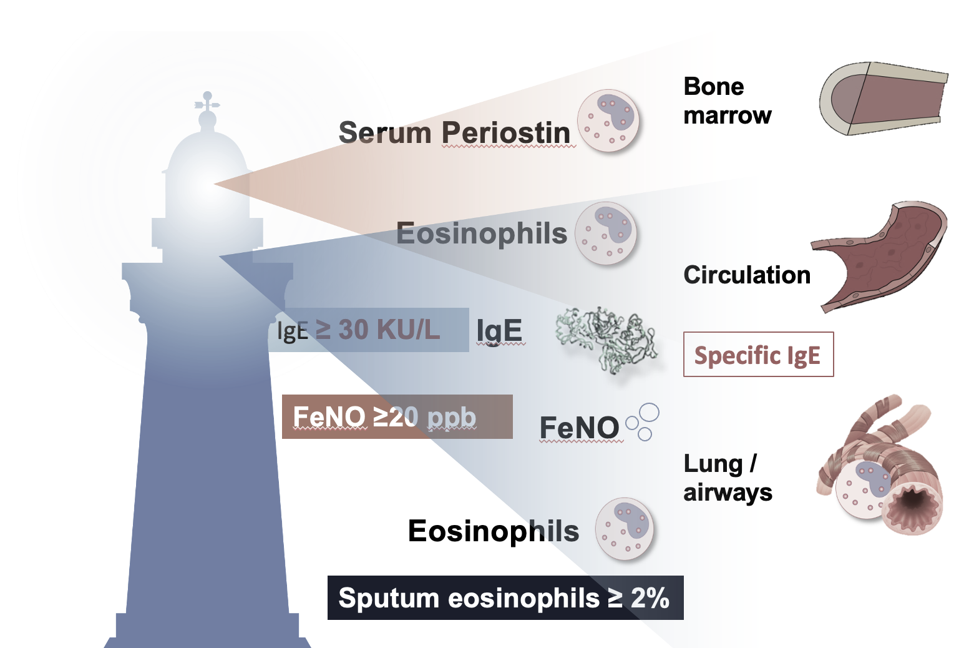
Identify T 2 High Asthma- Biomarkers !
Type 2 Inflammation*
Blood Eosinophils : > 300 * cells/uL
FeNO*: >20 ppb
Sputum Eosinophils : > 2%
* Depends on dose of OCS & ICS
Scheerens et al. Clin Exp Allergy 2014; 44:38–46; Sidhu et al. Proc Natl Acad Sci USA 2010; 107:14170–14175; Suresh et al. Am J Respir Cell Mol Biol 2007; 37:97-104

Slide 8
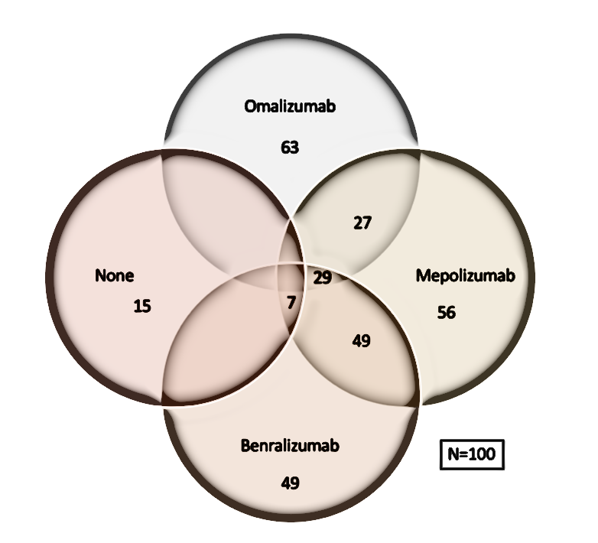
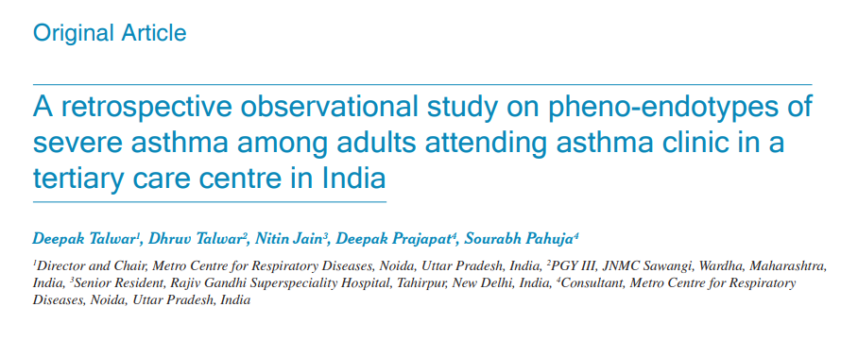
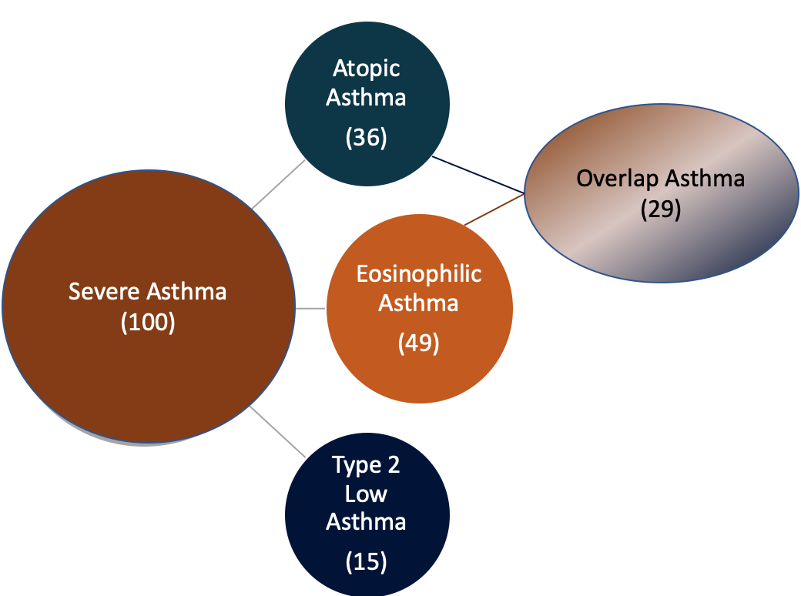
Type 2 Severe Asthma India ~ 85 % & Biologicals Eligible ~ 91%
Single center, retrospective , observational study:
100 Adult severe asthmatics from SA Clinic
Measurements :
Total/ Specific IgE
AEC
Skin prick tests
History of allergy,
~ 50% of our Severe Asthmatics were eligible for both group of biologicals
~ 30% of Severe Asthma patients were in the Overlap Group
T₂ Low asthma is only 15% at AEC cut off of 300 & 9% at @ AEC -150
Lung India 2022;39:393-400.

Slide 9
Mepolizumab vs Benralizumab : Both Anti-IL5 Mabs
https://doi.org/10.1183/16000617.0088-2024

Slide 10
Remember : Match Expectations with Research
SA Outcomes | Omalizumab | Mepolizumab | Benralizumab
Reduction in Exacerbations | 25% reduction | ~ 50 % | 40 -70 %
Reduction in maintenance OCS | 50% dose reduction in those at 15 mg/day baseline | 50% dose reduction 2- 6 months↓ | 50 - 80%
FEV₁ | 2.1% | 100 ml | 100 -160 ml @ 4 weeks
QoL | SGRQ Asthma diaries | ACQ5 + 0.4 SGRQ +7 points | ACQ < 0.5 SGRQ +8.1 points
Real World Data | Reduction in AE in 42% vs 63 % & 28% vs 48% @ baseline | Reduction in AE ~ 50% Reduction in mOCS ~ 50% | All improved with 70% exacerbation free @2years
Predictors for Response CRwNP | Childhood onset,, AEC >300, FeNo > 19.5, S Periostin >50 ng/ml, ↓FEV₁ | Low mOCS, Later onset SA, ↓ BMI, AEC, ↑ Sputum Eos /AE | AEC, FEV₁<65%, mOCS, ‘f’ Exacerbations, AR

Slide 11
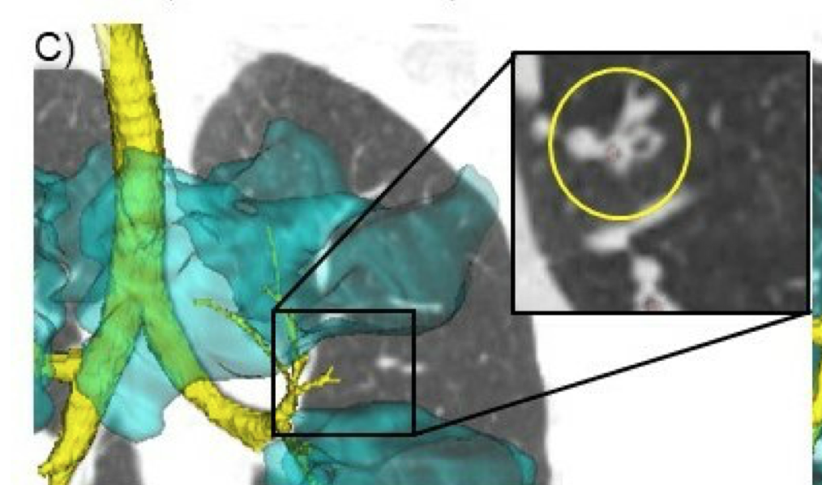
Choosing Biologicals in SA - 2025 !
Omalizumab
Mepolizumab
Benralizumab
Childhood Onset asthma
Comorbidities :
Allergic rhinitis
Chronic idiopathic urticaria
Food Allergy
CRSwNP
Late Onset asthma
Comorbidities :
Chronic Sinusitis with NP
EGPA
HES
Adult / Late Onset asthma
Comorbidities :
Nasal Polyposis
Airway Mucus
HES / CEP
NO safety signal has come up with antibodies directed against IL-5 after up to 5 years administration for mepolizumab and > 2 years for Benralizumab
Notes:
Higher serum IgE and BEC
and a shorter disease duration were associated with a slower response, necessitating a prolonged treatment
SoMOSA open-label studies, however, found omalizumab
to be effective independent of traditionally used biomarkers

Slide 12
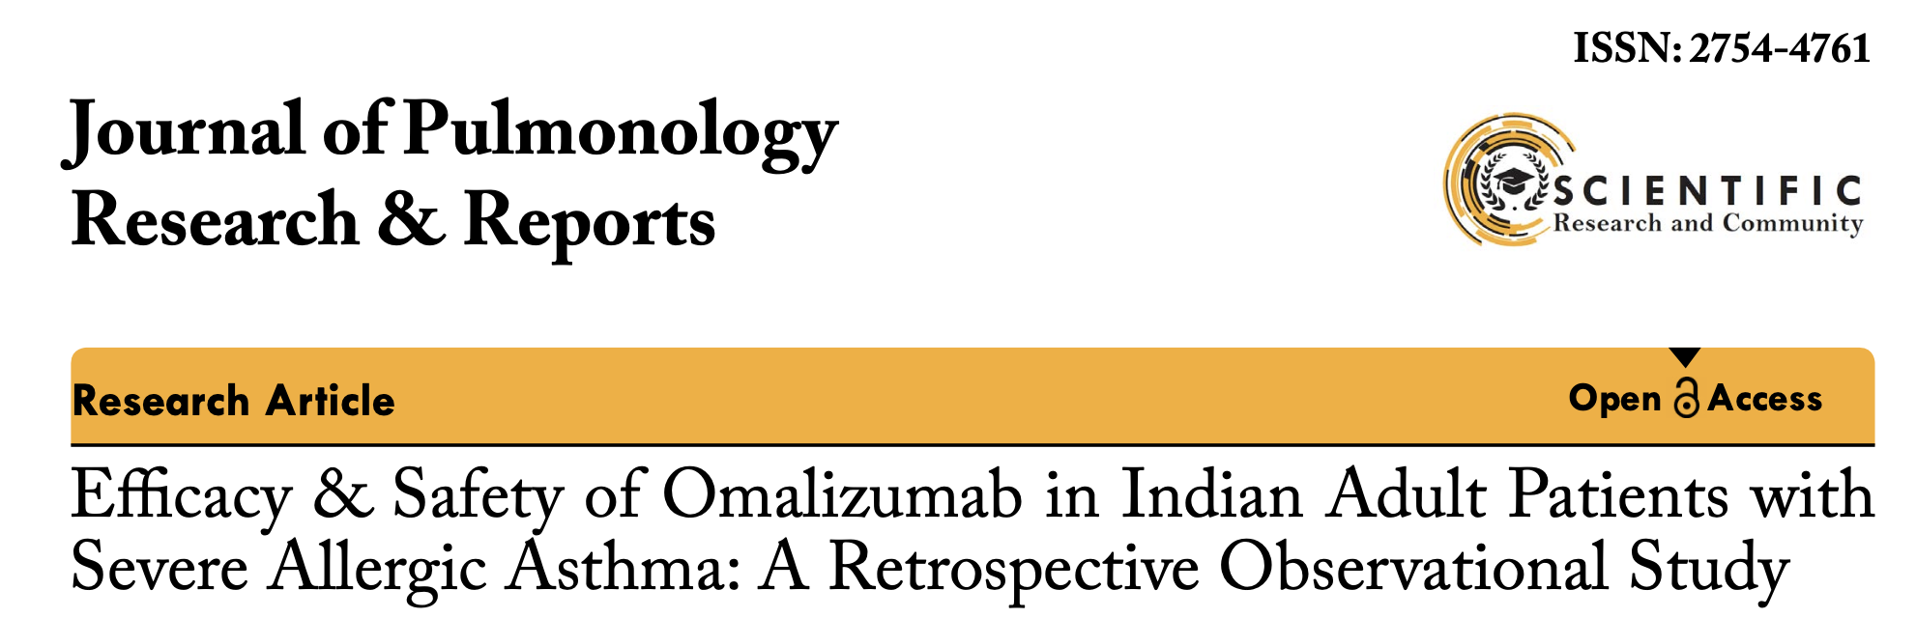
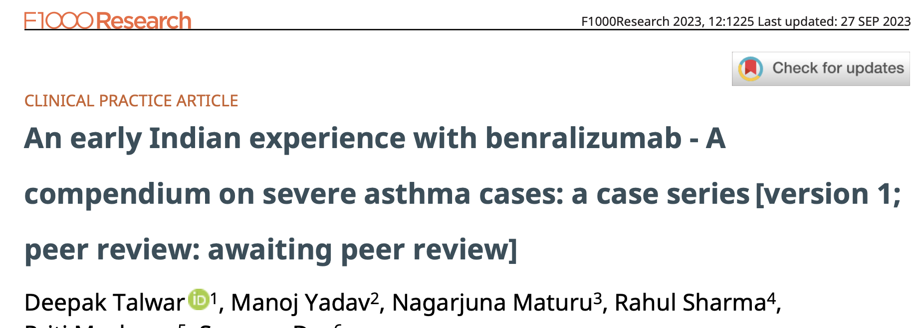
Biologicals in Severe Asthma– Indian Experience
Arjun Khanna1*, Deepak Talwar2, Linija K Nair3
Deepak Talwar * 1, Manoj Yadav2, Nagarjuna Maturu3
Conclusions:
Omalizumab led to improved asthma control, lung function, and QoL and allowed a reduction in the dosage of medications for asthma. The improvement was observed irrespective of age and biomarker levels.
Conclusions:
In all cases, management with Benralizumab resulted in optimal clinical and functional improvement, a decline in systemic steroid use, and improved QoL.
J Pulmonol Res Rep, 5(2): 4-6 2023
Published: April 28, 2023
F1000 Research 2023, 12:1225 Last updated: 27 SEP 2023

Slide 13
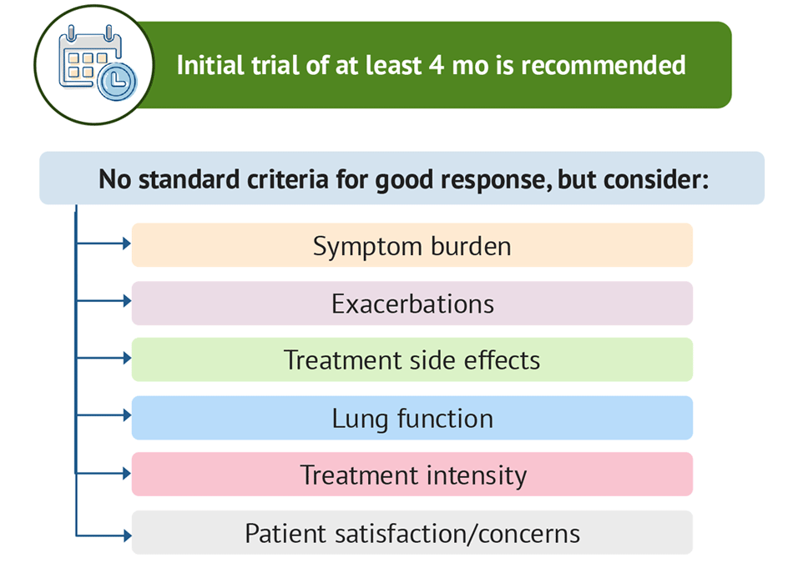

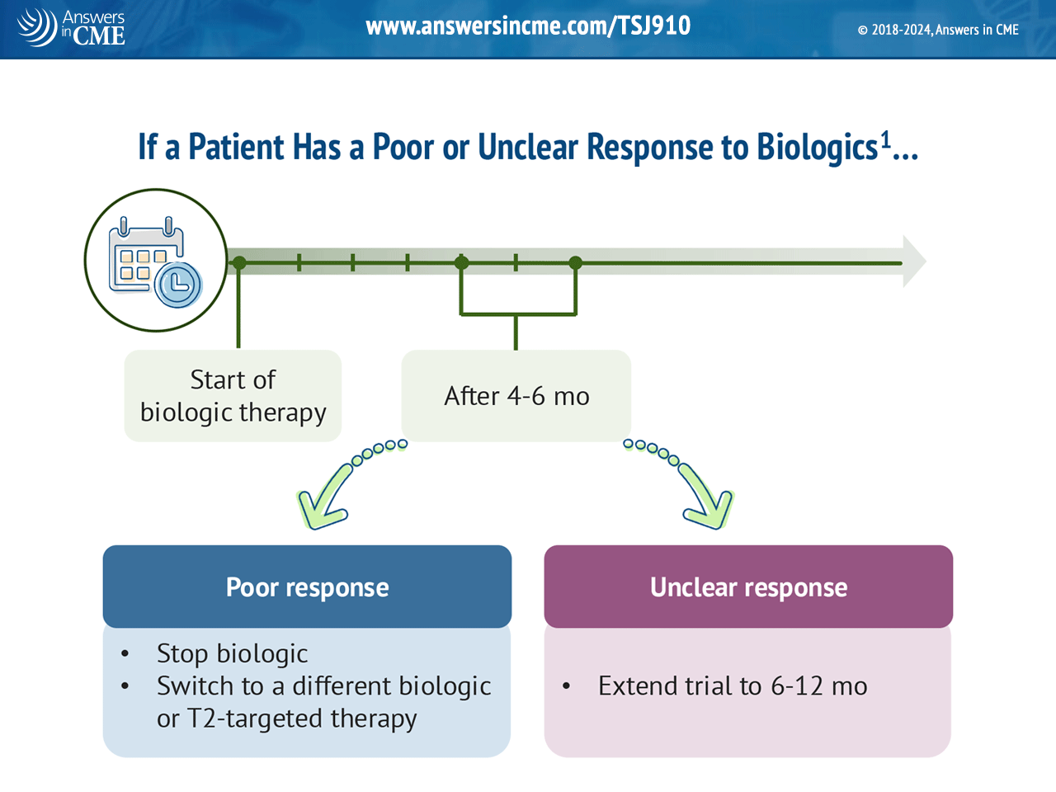
Assessing Effectiveness of Biologicals : FU@ 6 months
Good /Response
Initial Trial for 4 months Minimum
Continue

Slide 14
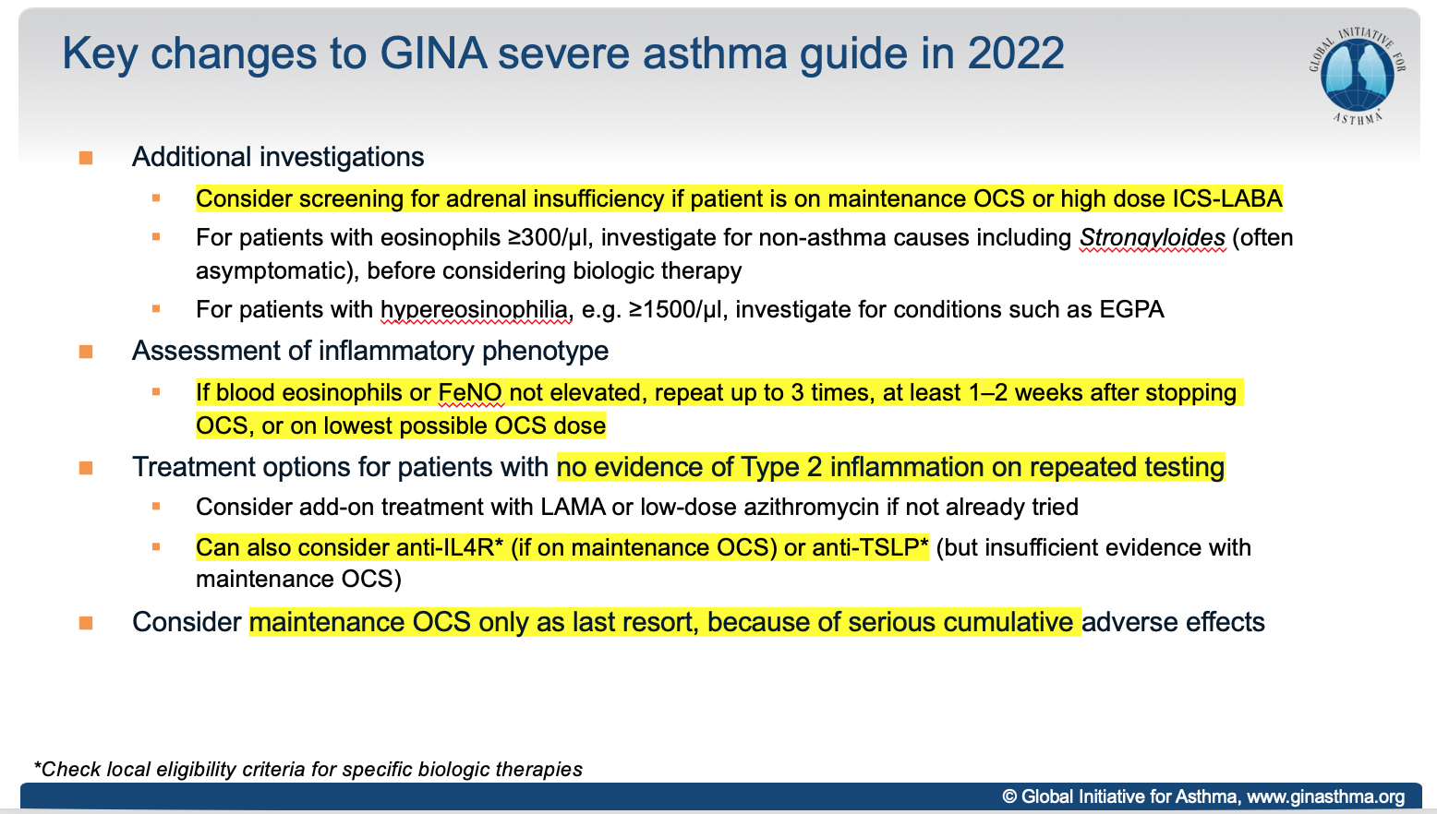
How to Treat Non-Type 2 SA - GINA 2024 !
On Maintenance OCS
Not on Maintenance OCS
Dupulimab
Consider
Tezepelumab
Check AEC - 3 times
At least 1-2 weeks after stopping OCS
Lowest possible dose of OCS
GINA 2024

Slide 15
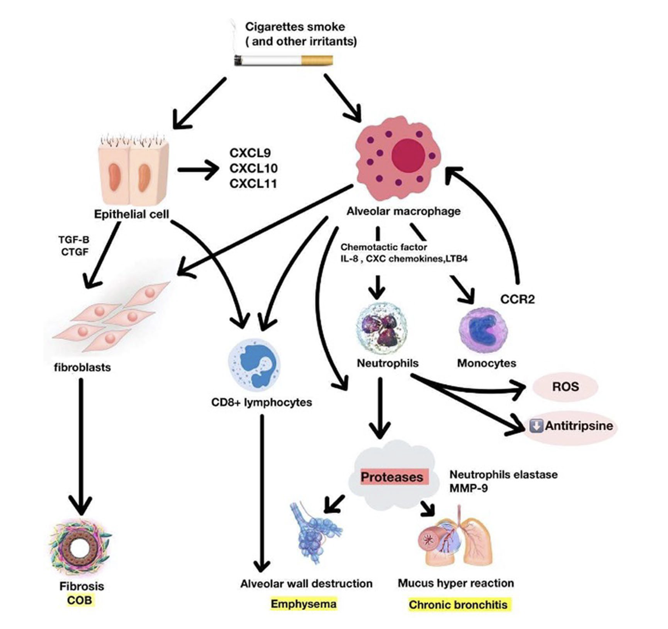
COPD
COPD ‘Different Biological Pathways’
Fibrosis
Destruction
Mucus
Bronchiolitis
Emphysema
Bronchitis
Notes:
3 types of lineage
Master of orchestra
Show stoppers 2
crowd
Front liners 2 cells

Slide 16
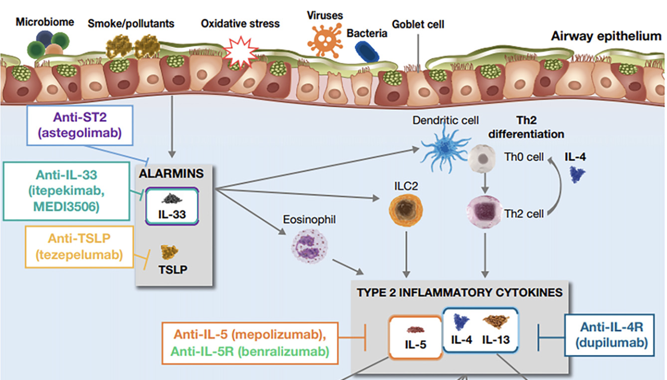
20- 40% COPD ~ Type 2 Inflammation
Am J Respir Crit Care Med : 208 ; 4, 395–405,2023

Slide 17
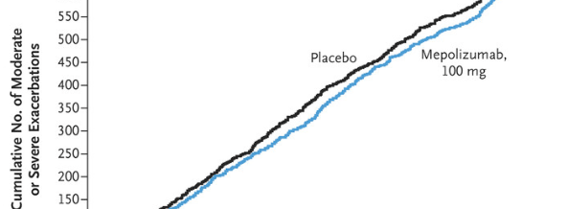

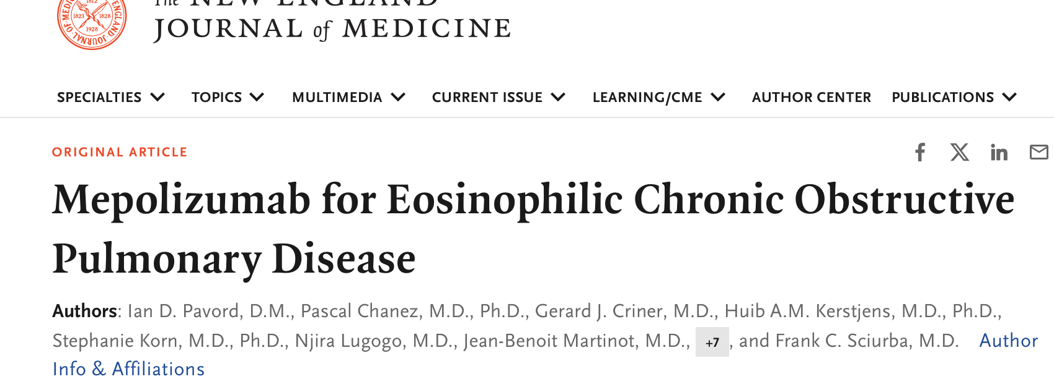
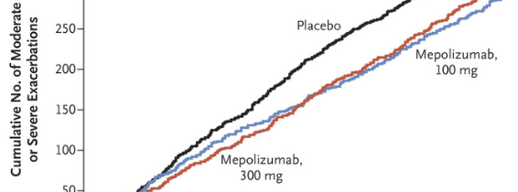
Biologicals in COPD : Anti IL-5 -Mepolizumab
METREX
METREX & METREO
14-20% reduction
3 More Ongoing Trials
SUMMER
MATINEE
&
COPD-HELP
METREO
Notes:
There was a significant increase in odds for individual patient FEV1 response greater than 20% from baseline with high dose oral steroid treatment compared to placebo, OR 2.71; 95% CI 1.84 to 4.01 (9 studies) . It would be necessary to treat 7 patients (95% CI 5 to 12) with oral corticosteroids to achieve one extra case of increasing FEV1 by more than 20%, with a placebo group risk of 0.13. All differences in health-related quality of life were less than the minimum clinically important difference. There were small statistically significant advantages for functional capacity and respiratory symptom of wheeze with oral steroid treatment but no significant difference in risk of withdrawal from study due to an exacerbation or rate of serious exacerbations over 2 years with low dose oral steroid treatment. There was an increased risk of adverse effects, including increased blood glucose, adrenal suppression and reduced serum osteocalcin.

Slide 18
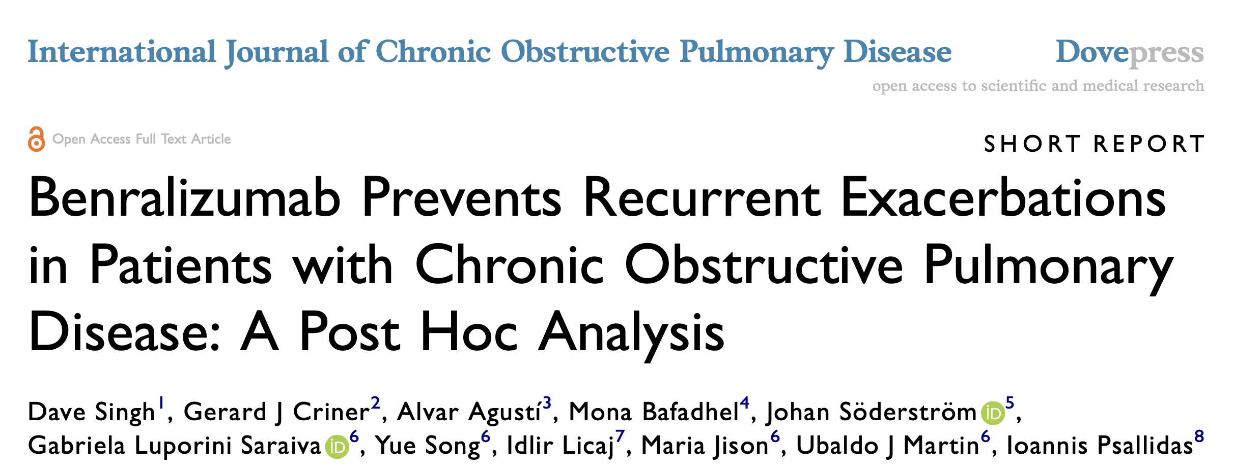
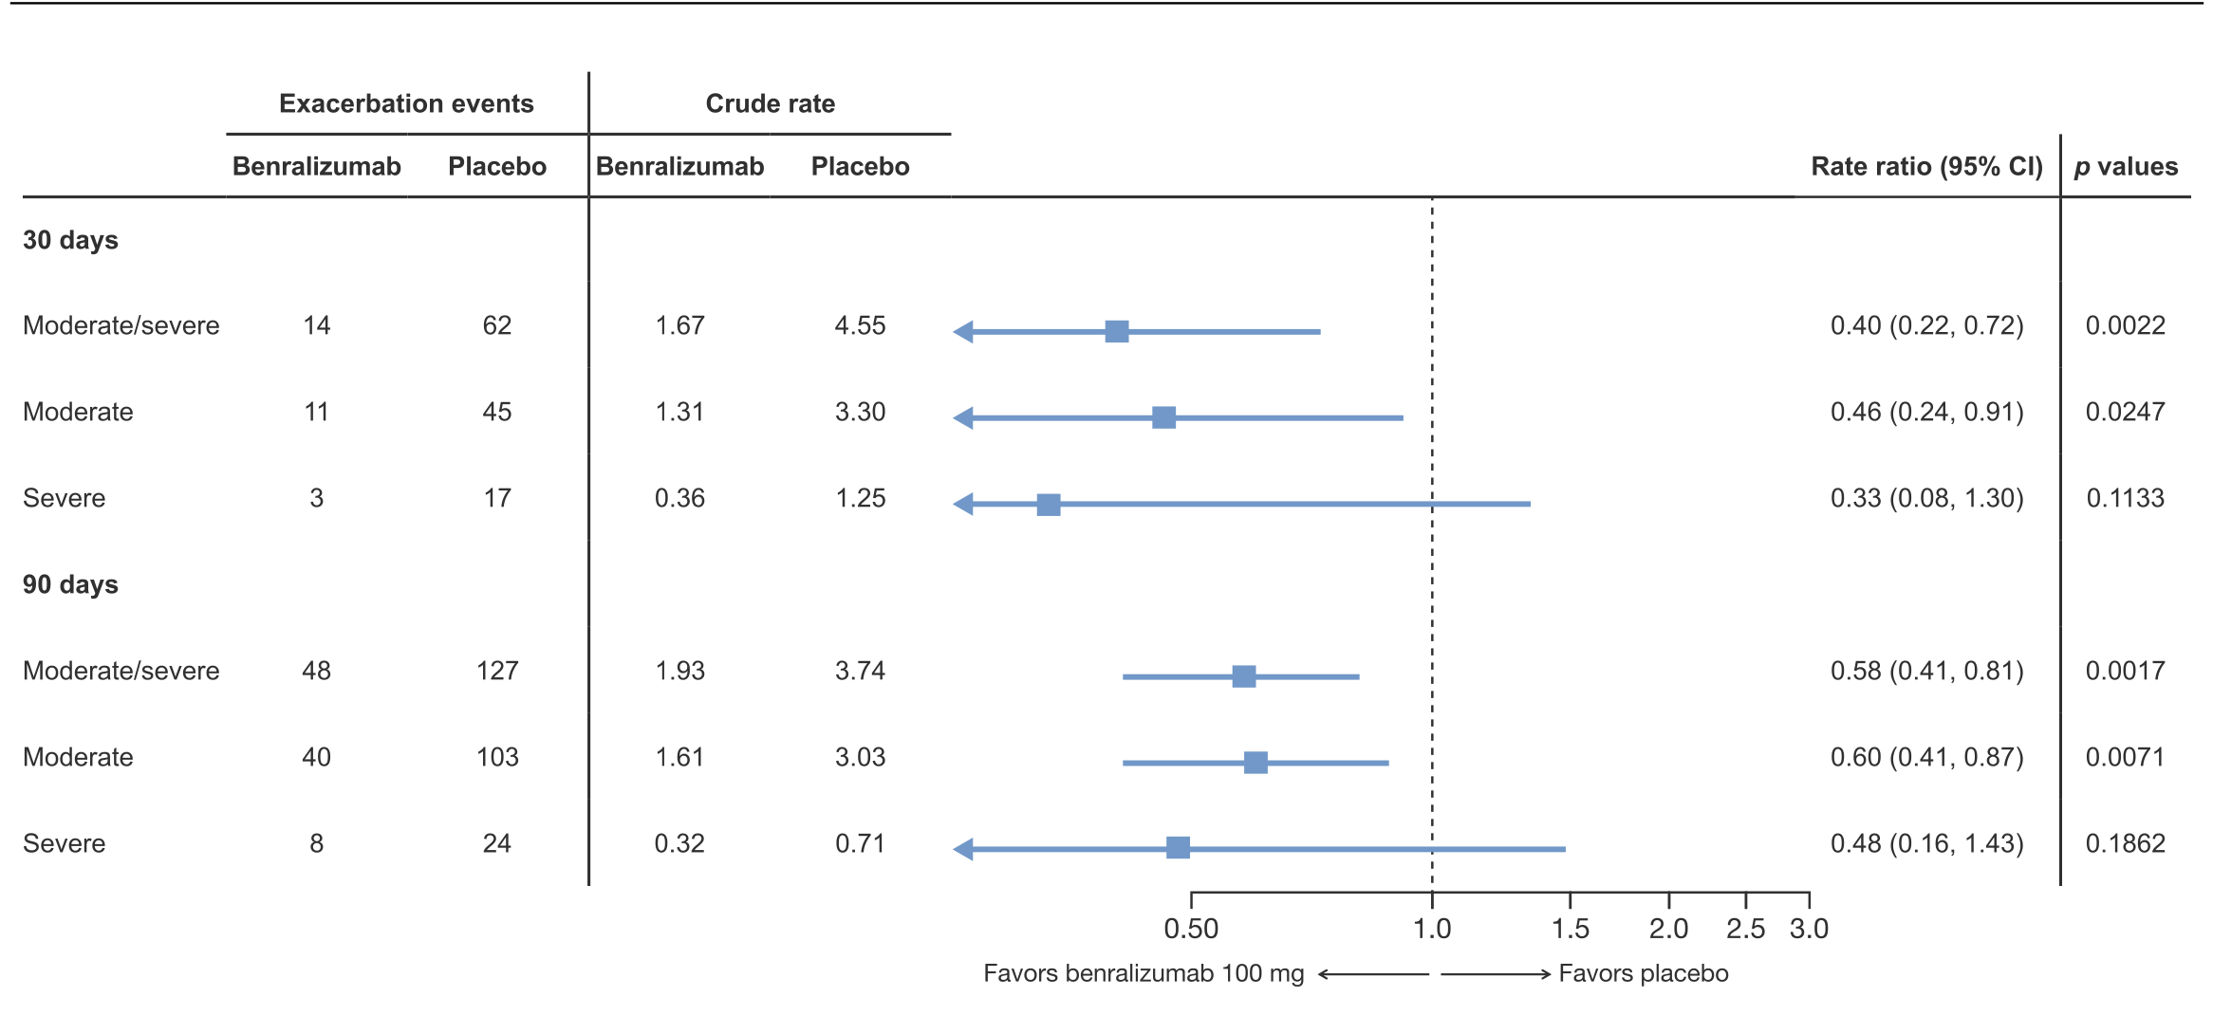
Benralizumab: Anti IL - 5r Blocking Monoclonal antibody
Exploratory post hoc analysis of the GALATHEA and TERRANOVA trials
Subgroup of COPD with:
> 3 exacerbations on Triple therapy
Baseline AEC > 300
Benralizumab ( 100 mg/month) reduces risk of exacerbations @ 30- and 90-days post exacerbation ( vulnerable period )
RESOLUTE - recruiting
International Journal of Chronic Obstructive Pulmonary Disease 2023:18

Slide 19

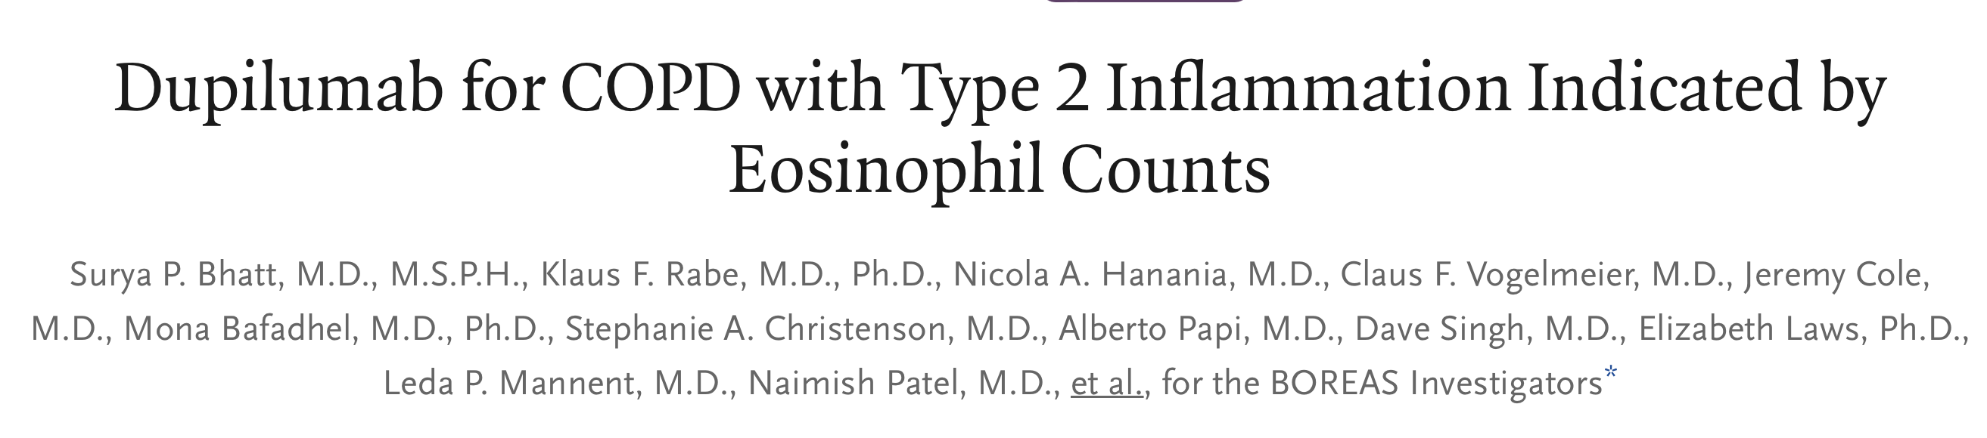
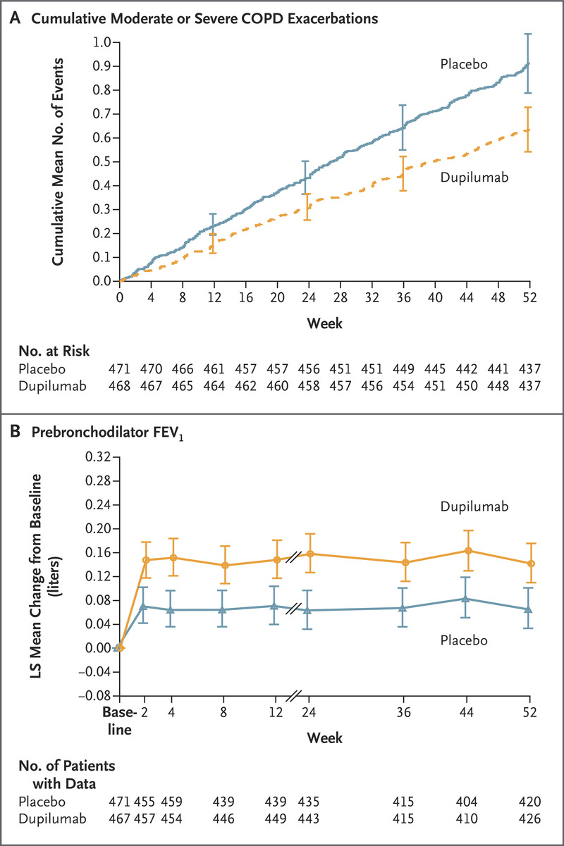
Phase 3, double-blind, randomized trial
COPD who had a blood eosinophil count of at least 300 per uml and an elevated exacerbation risk despite use of standard triple therapy
Dupilumab (300 mg) or placebo subcutaneously once every 2 weeks
COPD with T2 inflammation ( AEC > 300 ) had fewer exacerbations, better lung function and QoL, and less severe respiratory symptoms
30% reduction in exacerbations
160 ml FEV₁
Notes:
A total of 939 patients underwent randomization: 468 to the dupilumab group and 471 to the placebo group
The annualized rate of moderate or severe exacerbations was 0.78 (95% confidence interval [CI], 0.64 to 0.93) with dupilumab and 1.10 (95% CI, 0.93 to 1.30) with placebo (rate ratio, 0.70; 95% CI, 0.58 to 0.86; P<0.001). The prebronchodilator FEV₁ increased from baseline to week 12 by a least-squares (LS) mean of 160 ml (95% CI, 126 to 195) with dupilumab and 77 ml (95% CI, 42 to 112) with placebo (LS mean difference, 83 ml; 95% CI, 42 to 125; P<0.001), a difference that was sustained through week 52. At week 52, the SGRQ score had improved by an LS mean of −9.7 (95% CI, −11.3 to −8.1) with dupilumab and −6.4 (95% CI, −8.0 to −4.8) with placebo (LS mean difference, −3.4; 95% CI, −5.5 to −1.3; P=0.002).

Slide 20
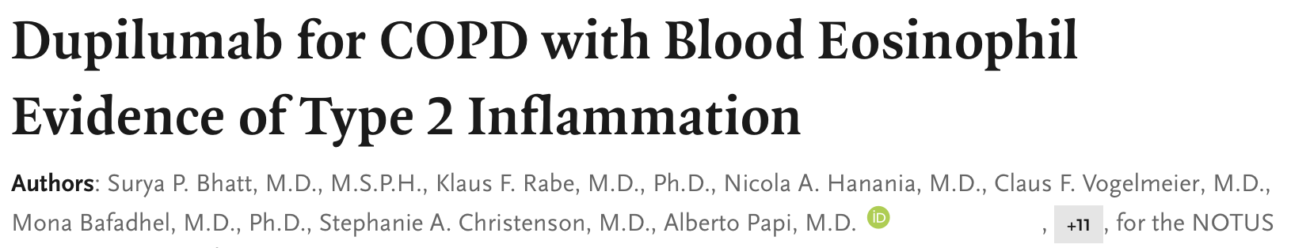
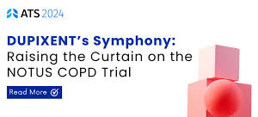
NOTUS, Dupilumab reduced exacerbations by a magnitude never seen before with an investigational biologic in a phase 3 COPD clinical study
No Effect of
Age
Sex
Smoking
FEV1
Emphysema
Exacerbations
34% reduction in exacerbations
139 ml FEV₁
↑ Symptoms
↑ SGRQ
Notes:
A total of 939 patients underwent randomization: 468 to the dupilumab group and 471 to the placebo group
The annualized rate of moderate or severe exacerbations was 0.78 (95% confidence interval [CI], 0.64 to 0.93) with dupilumab and 1.10 (95% CI, 0.93 to 1.30) with placebo (rate ratio, 0.70; 95% CI, 0.58 to 0.86; P<0.001). The prebronchodilator FEV₁ increased from baseline to week 12 by a least-squares (LS) mean of 160 ml (95% CI, 126 to 195) with dupilumab and 77 ml (95% CI, 42 to 112) with placebo (LS mean difference, 83 ml; 95% CI, 42 to 125; P<0.001), a difference that was sustained through week 52. At week 52, the SGRQ score had improved by an LS mean of −9.7 (95% CI, −11.3 to −8.1) with dupilumab and −6.4 (95% CI, −8.0 to −4.8) with placebo (LS mean difference, −3.4; 95% CI, −5.5 to −1.3; P=0.002).

Slide 21


Biologicals in COPD: Finally Wait is Over
Published July 19, 2023 N Engl J Med 2023;389:274-275 D
Published May 20, 2024 DOI: 10.1056/NEJMoa2401304
COPD with type 2 inflammation ( AEC > 300 ) on dupilumab had fewer exacerbations, better lung function and QoL, and less severe respiratory symptoms than those who received placebo
No Signal for Safety

Slide 22
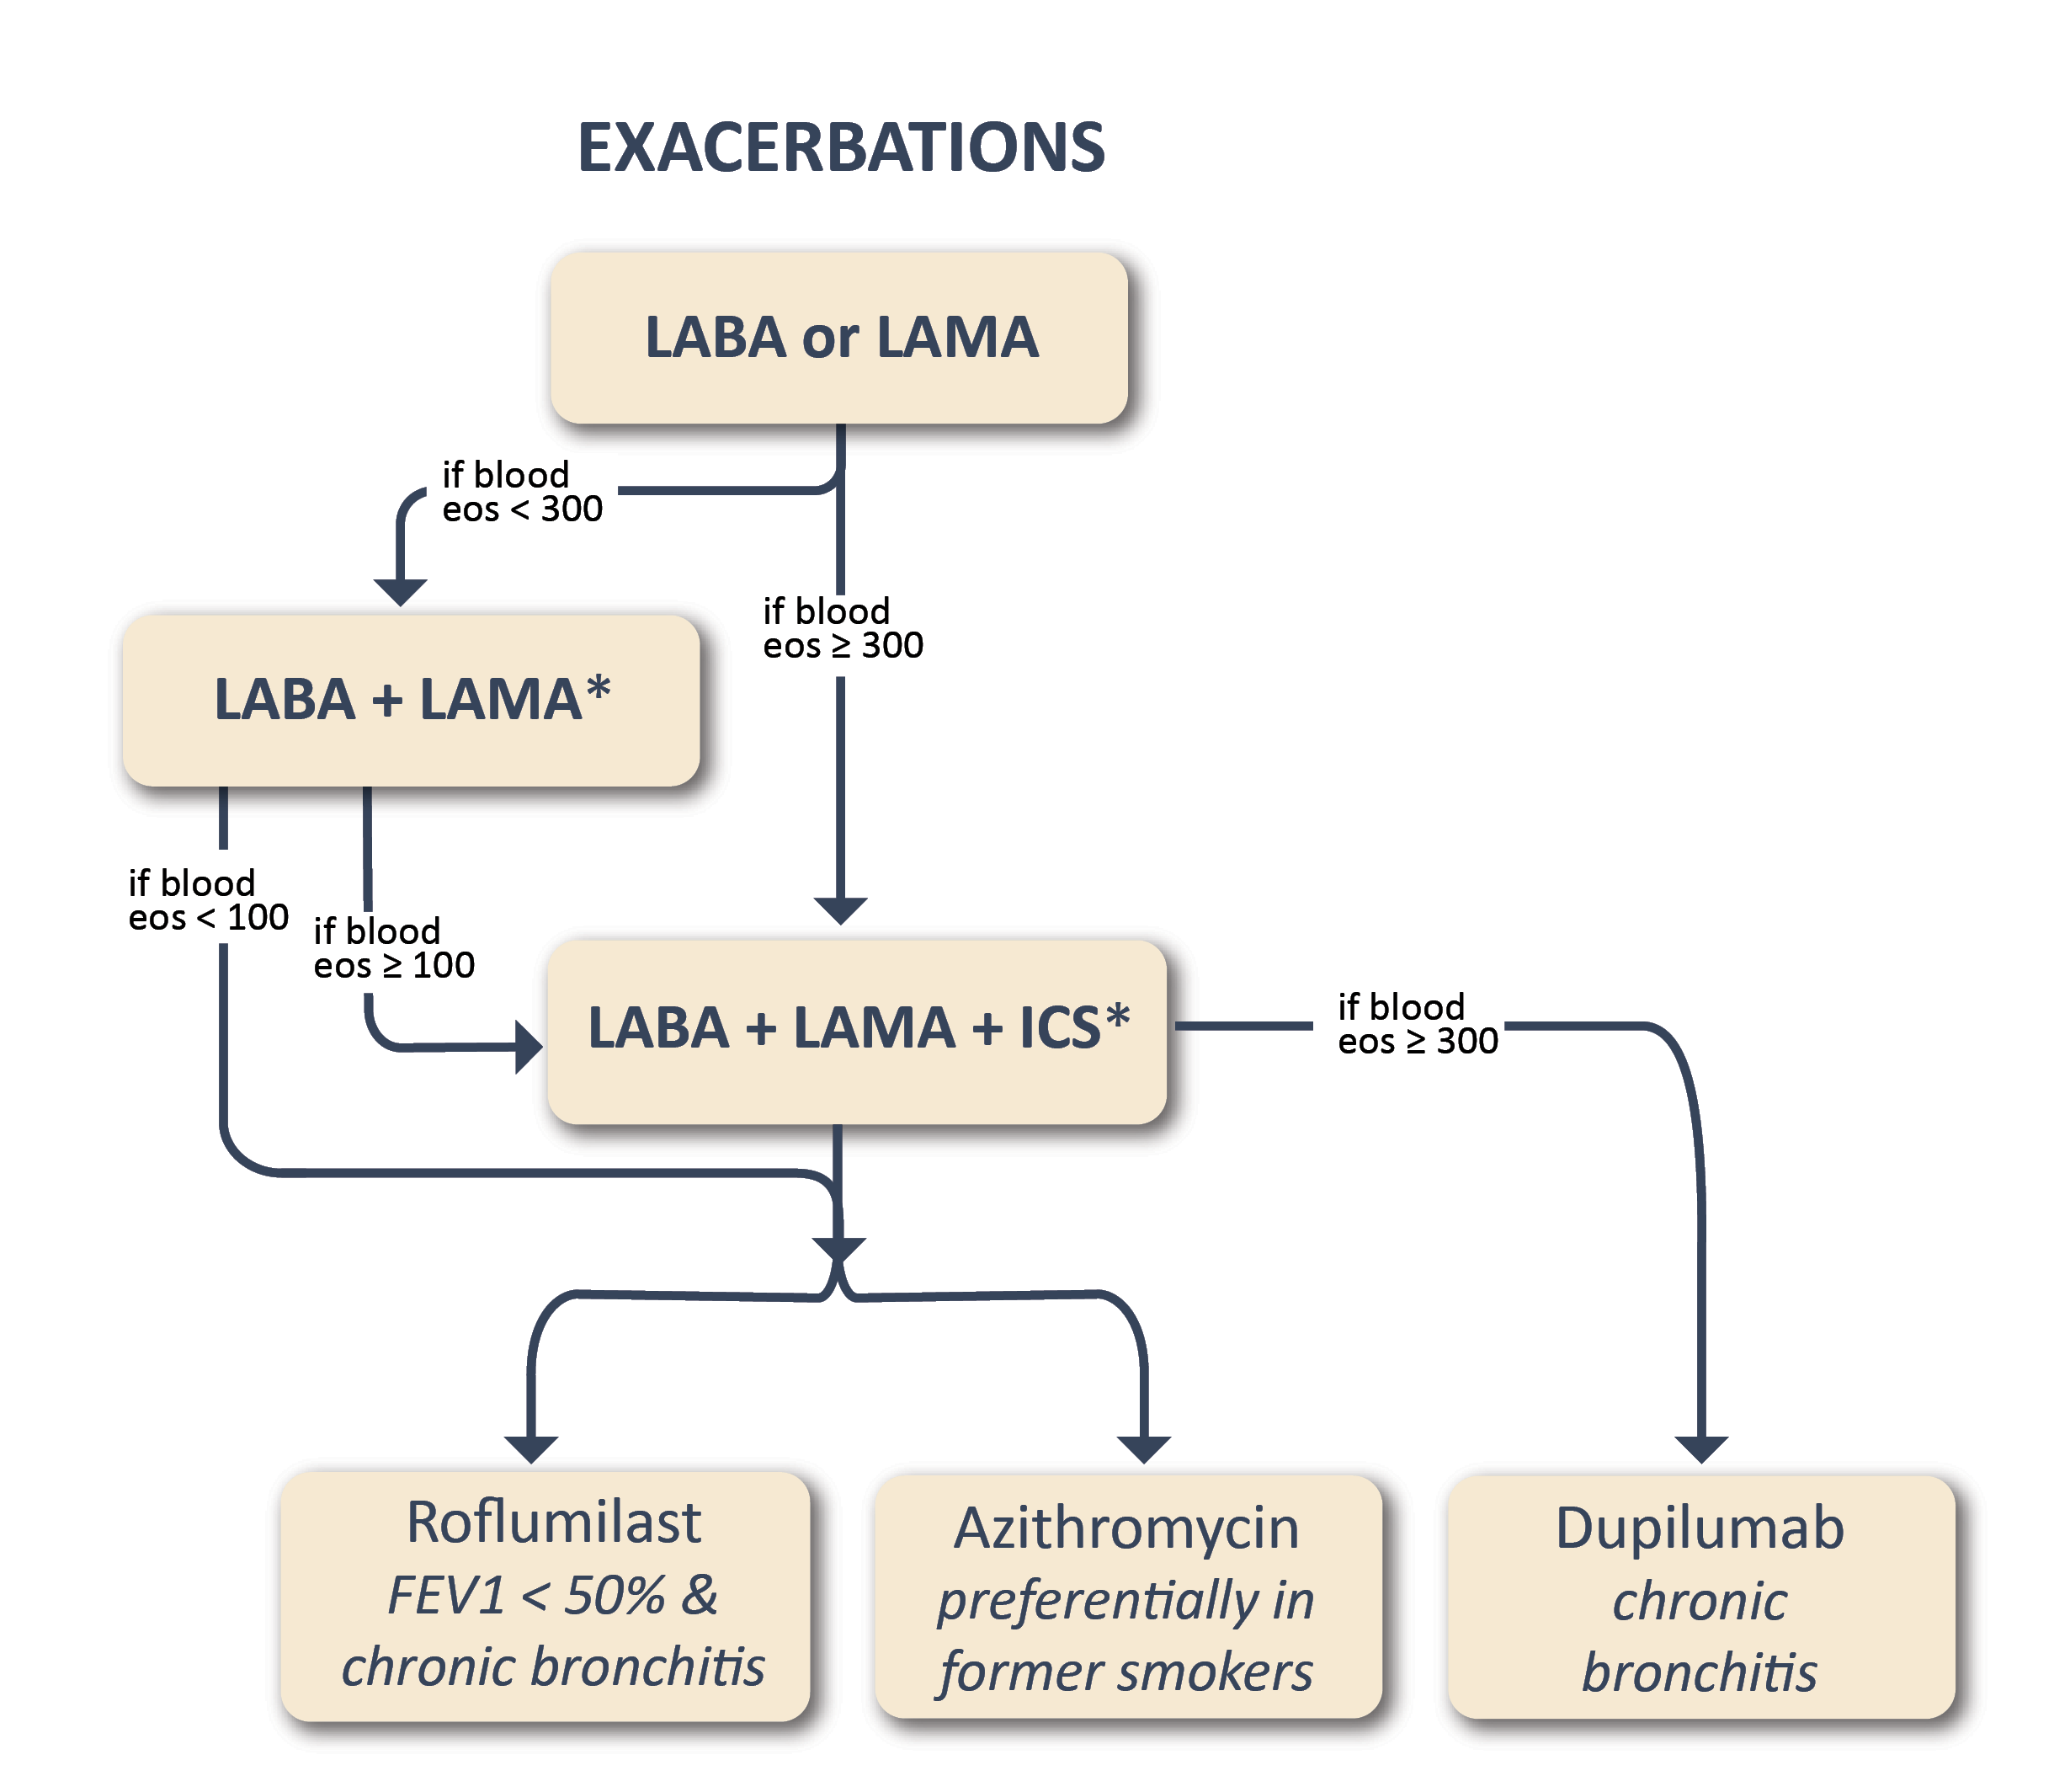
Biologicals in COPD : Why & When ?
~ 67% exacerbate on SITT
~ 50% exacerbated despite add on Roflumilast/ Macrolides
Type 2 inflammation in COPD:
↑ Future risk of exacerbations in ‘f’ exacerbators
Some with both COPD & Asthma (ACO)
~ 40% exacerbations in COPD are eosinophilic
GOLD 2025
Treatable trait : Eosinophilic COPD
European Journal of Internal Medicine 2024.05.011

Slide 23
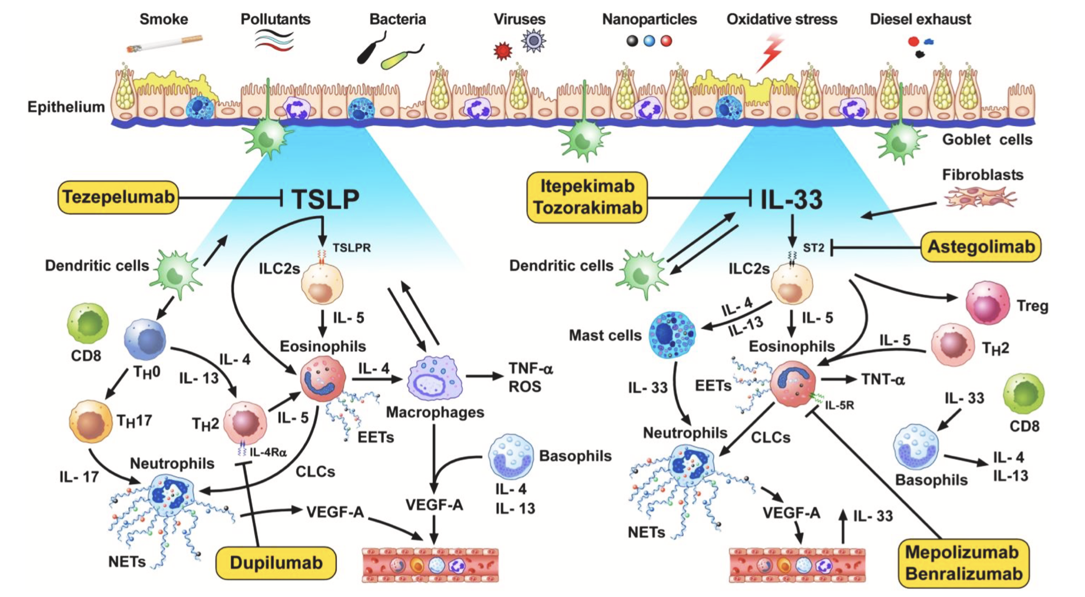
Pandora Box !
Tezepelumab
Itepekimab
Astegolimab
Dupulimab
Mepolizumab
Benralizumab

Slide 24
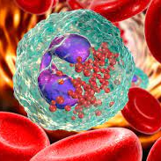
Treatable Trait in Airway Disease : Precision Medicine
Treat to Target in OAD’s
Asthma or COPD
Type 2 Inflammation
On Triple therapy
Poor disease control
Improve disease outcomes

Slide 25






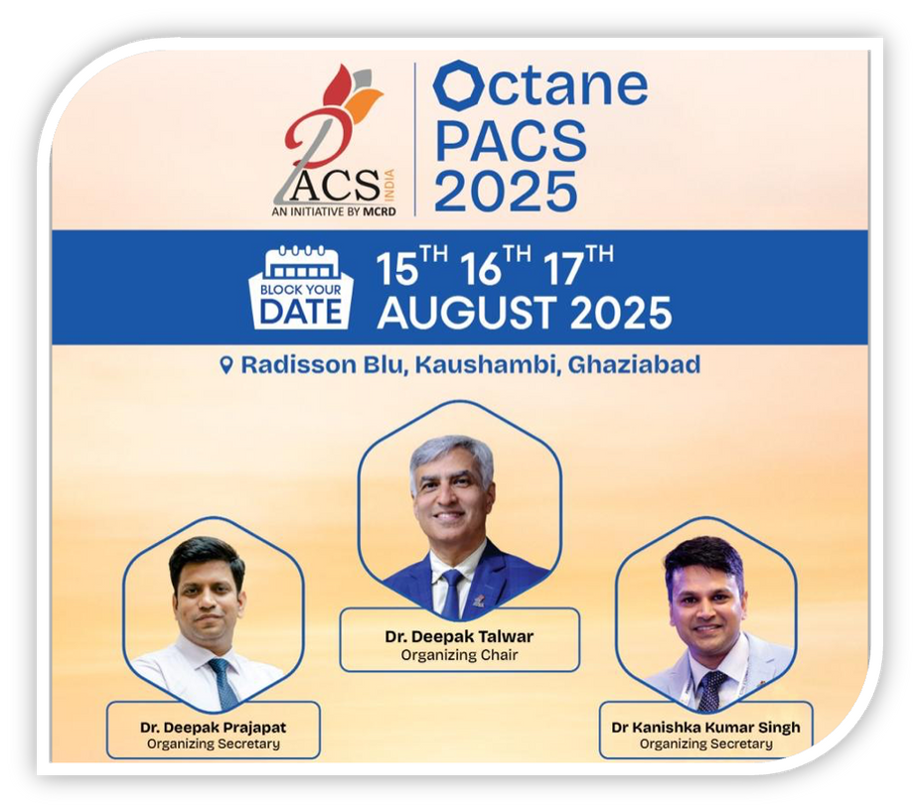
Dr Deepak Talwar
Director & Chair MCRD
Dr Deepak Prajapat
Senior Consultant
Dr Kanishka Kumar Singh
Senior Consultant
Thank You
Dr Rahul Khera
Consultant

