Slide 1


Assessing & Monitoring Asthma & its Phenotypes
Deepak Talwar
MD, DTCD, DNB, DM ( Pulmonary & Critical Medicine ) FISDA, FCCP ( USA ), FNCCP
Director & Chair
Pulmonary, Sleep, Allergy & Critical Care Medicine
Metro Group of Hospitals, INDIA

Slide 2
Assessment of Asthma
Discordant Asthma control Assessment by patient vs physician
Asthma Control
Symptoms
Future Risk
Treatment Issues
Current
Goals & attitudes
Multimorbidity
Pulmonary
Extra Pulmonary
50% asthmatics continue to be Uncontrolled & at risk for future exacerbations
GINA 23
Notes:
Controlled asthma in 10%

Slide 3


Assessments: Asthma Control Symptom Control
Symptom Control :
1.Daytime
2 Nocturnal
3 Activity
4 SABA* use (2 /week)
About Past 4 weeks
Every Visit
Direct Questioning
Tools :
Simple : GINA / PACS
Categorical : Research
Numerical : ACT / ACQ
Before Exercise SABA X
0 %
Well Controlled, Partially Controlled Uncontrolled
* Not for patients on AIR

Slide 4
Assessments: Asthma Control Future Risk
Risk for Poor Outcomes
1.Exacerbations
2.Persistent Airflow Obstruction
3. Medication side effects
Symptoms alone are not sufficient to assess asthma:
Poor perceivers
Non respiratory causes of Sx
Sx controlled by sham treatments
Anxiety / Depression

Slide 5
Assessments: Asthma Control Future Risk : Exacerbations
Risk for Poor Outcomes
1.Exacerbations : future Risk
2.Persistent Airflow Obstruction
3. Medication side effects
Past exacerbation in last 1 year
Poor adherence
Incorrect technique
Chronic sinusitis
Smoking
Low FEV₁ is
a strong predictor of Exacerbations

Slide 6
Risk for Exacerbations: Others
Medication: High SABA & Low ICS use
Others: Pregnancy, Food allergy and multimorbidity
Exposures : Allergen / Pollution / Smoke
Psychosocial : Poor support
Type 2 Inflammation: ↑AEC & FeNO
Severe Exacerbation : Intubated or ICU

Slide 7
Assessments: Asthma Control Future Risk :PAO
Risk for Poor Outcomes
1.Exacerbations
2.Persistent Airflow Obstruction
3. Medication side effects
Fast decline in lung functions
Low birth weight / pre term
Smoking / Noxious inhalational agents
Chronic Mucus Hypersecretion
Asthma exacerbation in patient not on ICS

Slide 8
Assessments: Asthma Control Future Risk : Medication Side-Effects
Risk for Poor Outcomes
1.Exacerbations
2.Persistent Airflow Obstruction
3.Medication side effects
Local : ( incorrect technique )
Oral Thrush / Dysphonia
Systemic : ( higher doses / more potent ICS )
Easy bruising
Osteoporosis / fragility #
Cataracts / Glaucoma
Adrenal suppression
P450i combined with asthma therapy increase toxicity :
Short term : CVS effects of LABA’s
Long term : Adrenal Suppression

Slide 9
Assessments: Treatment Issues
Current Treatment :
1.GINA Step
2 Adherence / Technique
3 Asthma Action Plan
4 Attitudes & Goals : Label/ Treatment
Well Controlled, Partially Controlled Uncontrolled

Slide 10
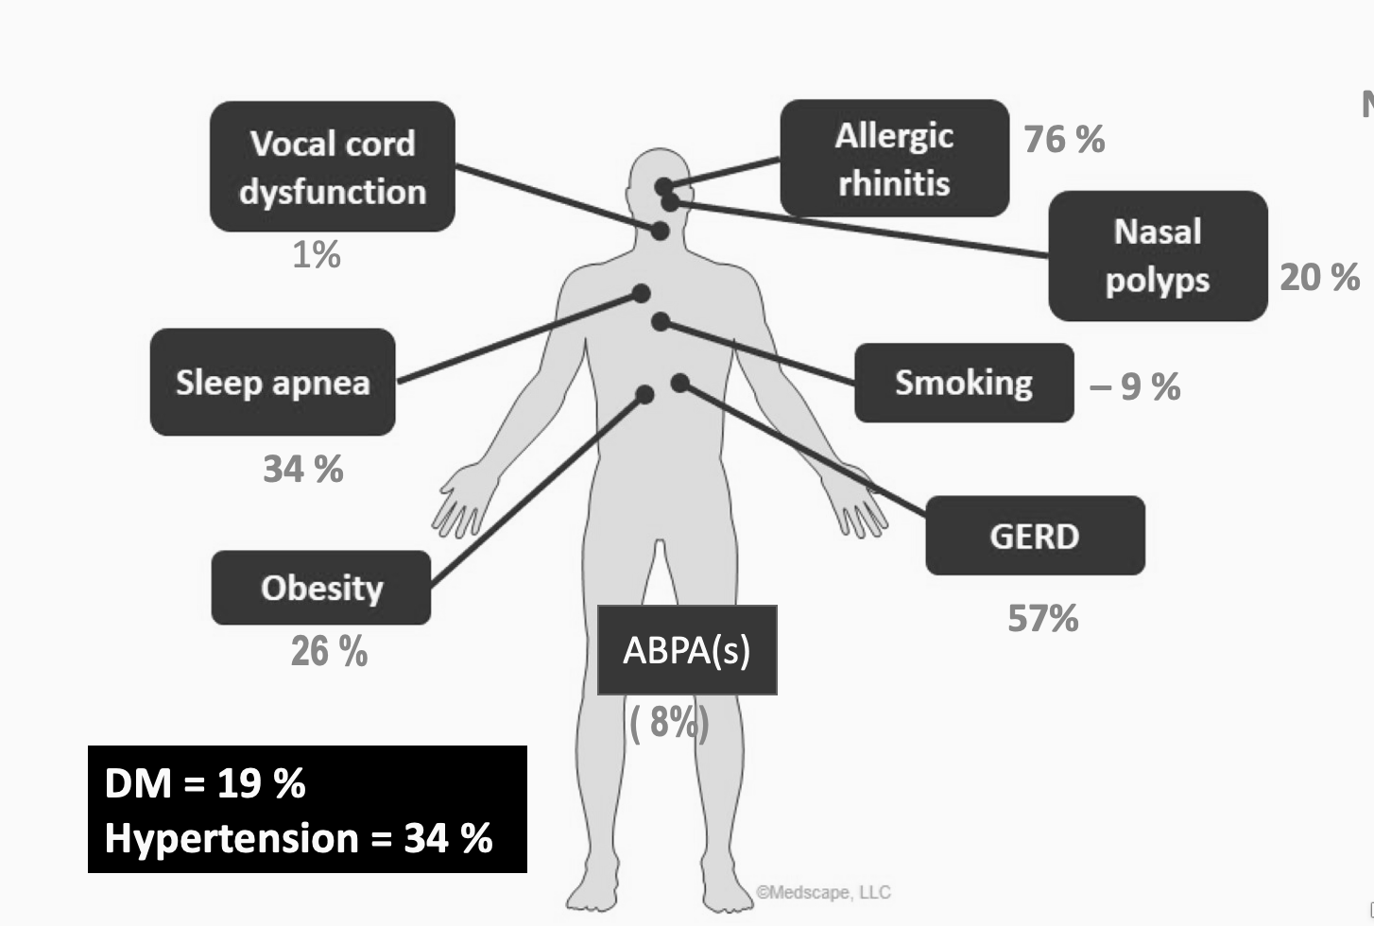
Assessments: Multimorbidity
Pulmonary :
Rhinitis
Rhinosinusitis
Extra-Pulmonary :
Obesity
GERD
OSA
Anxiety / Depression
99% SA patient’s had at least 1 comorbidity
Talwar D, Lung India 2022;39:393-400.

Slide 11
Role of Lung Functions in Assessment
Lung functions do not strongly correlate with asthma control
At Diagnosis or Start of treatment
3-6 months after ICS treatment
1-2 Yearly ( more frequent in at risk for AE / decline at lung functions
No need to hold medications prior to repeat PFT’s & do both pre & post
Mark personal best for future reference

Slide 12
Interpretation of PFT on Treatment in Asthma
Low FEV₁ (< 60% predicted )
At risk for exacerbations
Rapid lung function decline
Near Normal FEV₁
SOB: Cardiac / Deconditioning
Cough : PNDS / GERD
Reversibility in FEV₁
Compliance
Uncontrolled asthma
10% improvement or decline in FEV₁ is considered threshold MID for better or worsening asthma

Slide 13
Asthma Severity :
Severe Asthma*
Retrospective*
Uncontrolled despite optimized High dose ICS+LABA
Require high dose ICS+LABA to prevent it getting uncontrolled
OR
* Several months

Slide 14

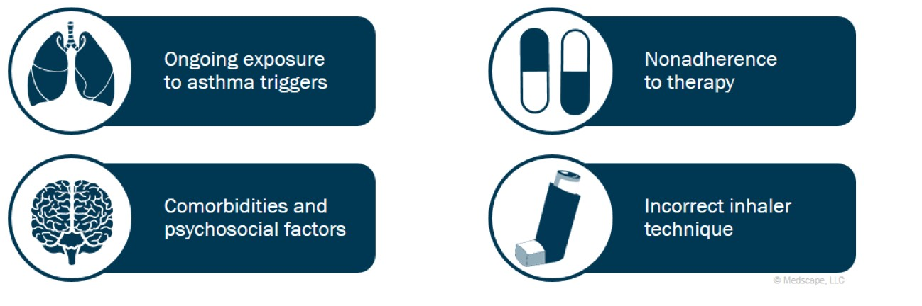
Difficult Asthma # SA
Confirm Diagnosis of Asthma
1/4th
5 Steps
.✓ ^{1/3rd}
1/2
.✓ ^{1/3rd}
.✓ ^{1/3rd}
Respiratory Medicine, vol. 106, no. 2, pp. 205–214, 2012.

Slide 15
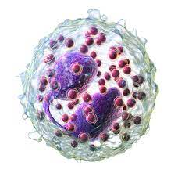
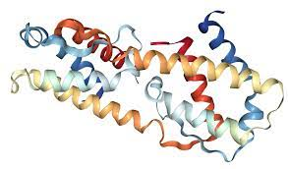
Pheno-Endotyping in SA
Choose best fit biological
Eligibility Criteria for Biologicals
Pheno-Endotyping
Observable Feature vs Pathobiological mechanism
Notes:
Grouping on the base of observable characteristics

Slide 16
Phenotypes Severe Asthma
Allergic Asthma
Late Onset Eosinophilic Asthma
Very Late Onset
Obesity Associated Asthma
Smooth Muscle Mediated Pauci-granulocytic Asthma
Aspirin Exacerbated Asthma
Exercise Induced Asthma
Smoking Related Neutrophilic Asthma
Childhood Onset
Adult Onset

Slide 17

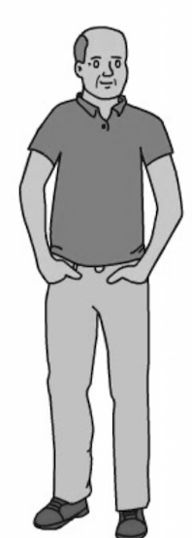
GINA 2019 Identifying Patients and Selecting Treatment
Type 2 Severe Asthma Phenotype
Type 2 Inflammation
Age of onset of asthma: Childhood vs Adulthood vs late onset
Allergic comorbidities : Atopic dermatitis, allergic rhinitis, Nasal polyposis, Chronic sinusitis, ABPA, EGA
Oral steroids responsive
>1 of following Criteria on high dose ICS ( before OCS)*:
Blood Eosinophils > 150 /uL
FeNO > 20 ppb
Sputum Eosinophils > 2%
*At presentation or any time in last 1 year or during FU

Slide 18
Type 2 Severe Asthma
IgE Mediated Atopic SA
Eosinophilic SA
Usually early age onset asthma
Sx related to allergen exposure
Allergic comorbidities ( AR/AD)
Skin prick test + for Aeroallergens
Specific and total IgE raised
Late onset asthma
No clinically relevant atopy /allergy
+ Nasal Polyposis
 Symptoms ,  Exacerbations
Eosinophilia in Blood ( + sputum)
Both are Responsive to Oral Steroids

Slide 19
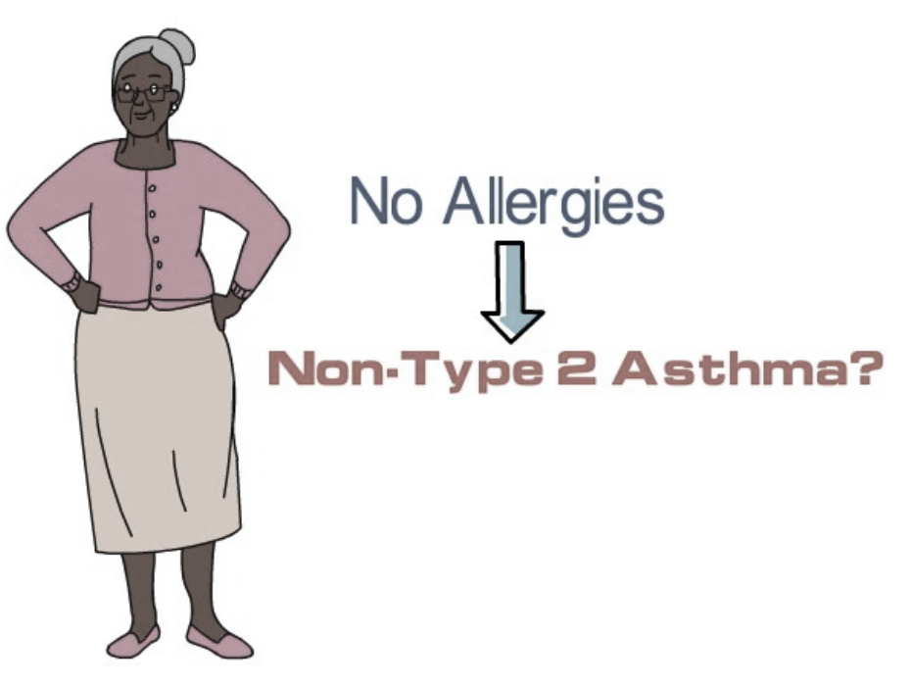
GINA 2019 Identifying Patients and Selecting Treatment
Non Type 2 Severe Asthma Phenotype
Non Type 2 Inflammation
Age of onset of asthma: Very late
Non Allergic comorbidities : Obesity, Smoking
Smooth muscle mediated
Paucigranulocytic
Not oral steroids responsive
Not Responsive to Oral Steroids

Slide 20

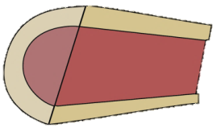

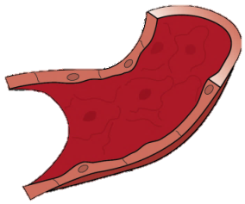
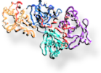

Biomarkers in SA
Bone marrow
Research Tool
Serum Periostin
IL-5
Eosinophils
IL-13
Circulation
IgE
Specific IgE
IgE ≥ 30 KU/L
FeNO ≥20 ppb
FeNO
Breath
Eosinophils
Lung /
airways
Blood eosinophils ≥300/μl,
Sputum eosinophils ≥ 2%
Hershey. J Allergy Clin Immunol 2003; 111:677–690; Menzies-Gow et al. J Allergy Clin Immunol 2003; 111:714–719; Scheerens et al. Clin Exp Allergy 2014; 44:38–46; Sidhu et al. Proc Natl Acad Sci USA 2010; 107:14170–14175; Suresh et al. Am J Respir Cell Mol Biol 2007; 37:97-104
Notes:
Heaney 2 min
Type 2 is most prevalent form of asthma → is defined via effector cytokines → are linked to key BM → which in turn can be used to define the high and low phenotype!

Slide 21
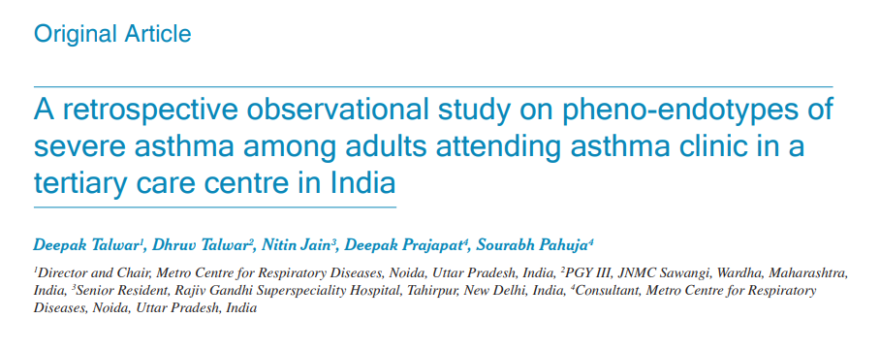
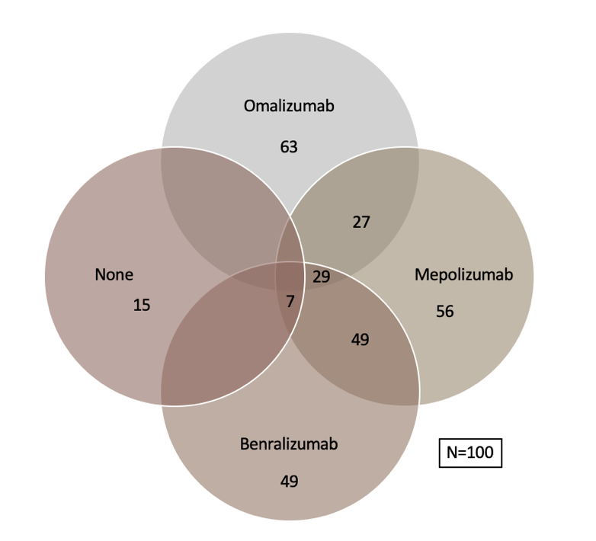
Severe Asthma Pheno-Endotypes in India :
Atopic Asthma
(36)
Eosinophilic Asthma
(49)
Type 2 Low Asthma
(15)
Overlap Asthma
(29)
Severe Asthma
(100)
~ 85 % Eligible for Biologicals
~ 50% SA eligible for both group of biologicals

Slide 22
Take Home :
Asthma treatment aims at reductions of symptoms as well as future risk for poor outcomes(Exacerbations, FAO & Medication side effects)
Assessments include multimorbidity's & expectations / attitudes
Spirometry has pluripotent role in asthma diagnosis & management
Severity assessment is retrospective : Severe vs Non Severe
Phenotyping recommended in asthmatics on Step 4/5 treatments
T2 high ( allergic & eosinophilic) vs T2 low are main phenotypes for targeted therapeutics ( Biologicals )

Slide 23


Thanks
MDT in SA

