Slide 1
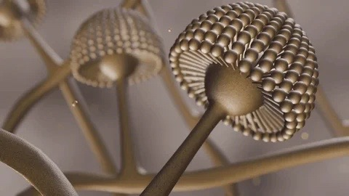


CG- CS Raipur- 2025
ABPA : State of Art 2025
Deepak Talwar
Director & Chair, Metro Centre for Respiratory Diseases
Metro Hospitals & Institute
NOIDA, INDIA

Slide 2
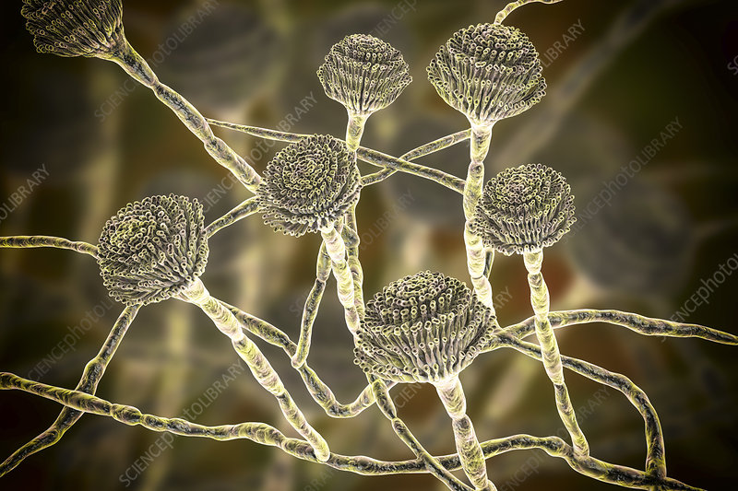
Allergic Broncho-Pulmonary Aspergillosis
1952
Dr. K.F.W. Hinson
2013
ISHAM
2024
ISHAM - AWG
1977
Rosenberg Peterson

Slide 3
ABPA
Aspergillus colonize airways
IgE mediated hypersensitivity disease
4% of asthmatics have ABPA
38% asthmatics ~ Aspergillus sensitization
Present as ‘Difficult to Treat Asthma’
India has 2X burden of ABPA vs World
1/5th gets tuberculsis treatment - misdiagnosis
Agarwal R, et al. Chest 2007; 132(4): 1183-90 Agarwal R, et al. Respir Med 2010; 104(2): 204-10

Slide 4
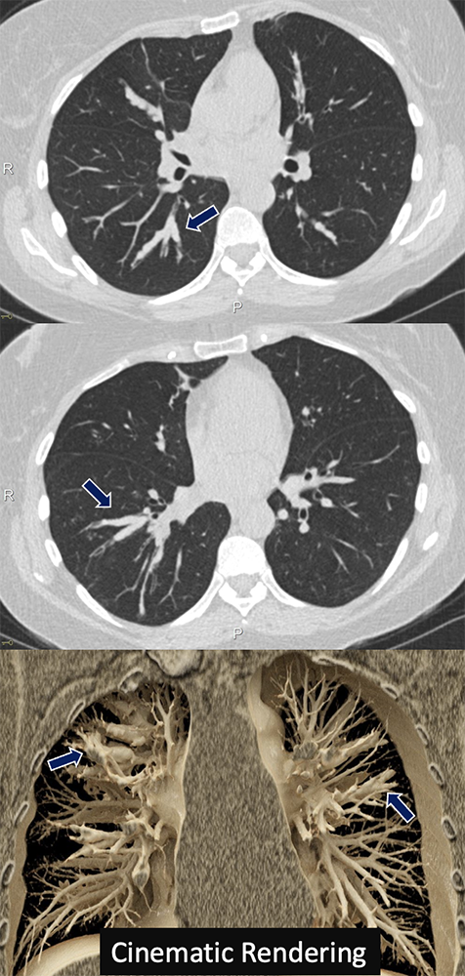
Underlying Conditions :
Asthma
Cystic Fibrosis
⇲ COPD
⇲ Bronchiectasis
Agarwal R: Revised ISHAM-ABPA. Eur Respir J 2024;63:2400061.

Slide 5
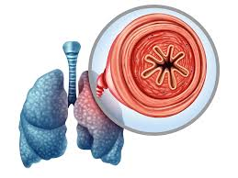
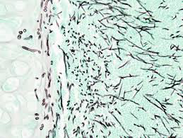
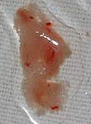
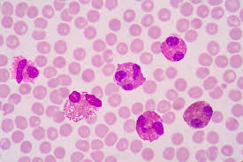
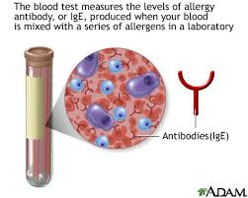
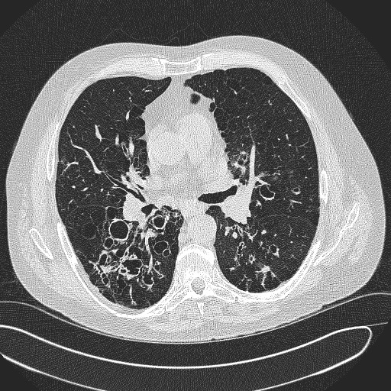
DI AGNOS I S
Predisposing Condition
Asthma / CF/COPD/ Bronchiectasis
Biochemical
Radiological
Clinical
Hemoptysis
Aspergillus Hyphae
AEC > 500
HAM
Total IgE > 500
Bronchiectasis
Aspergillus Specific IgE > 0.35
Aspergillus Specific IgG > 27
2024 ISHAM-AWG guidelines

Slide 6
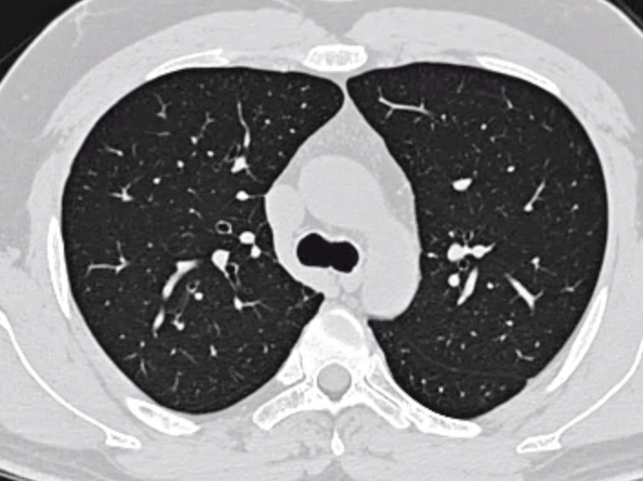
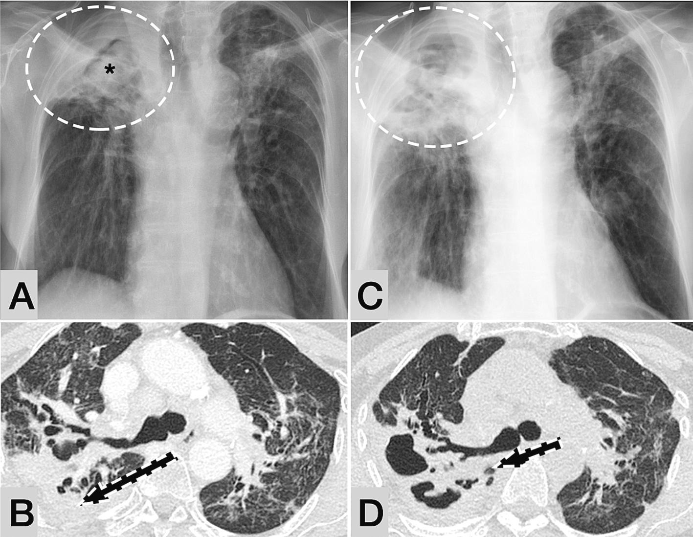
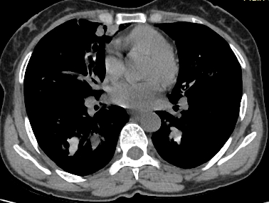
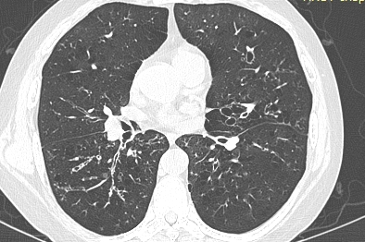
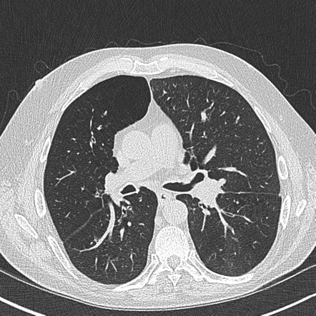
Algorithm For ABPA Diagnosis
Asthma
Cystic Fibrosis
COPD
Bronchiectasis
Aspergillus IgE > 0.35 / SPT + to Aspergillus
ABPA -S
ABPA -CPF
Total IgE > 500 IU/ml
AEC> 500cells/uL
Aspergillus IgG > 27 mgA/L
HRCT Chest
ABPA -B
ABPA - HAM
ABPA - MP
2024 ISHAM-AWG guidelines

Slide 7
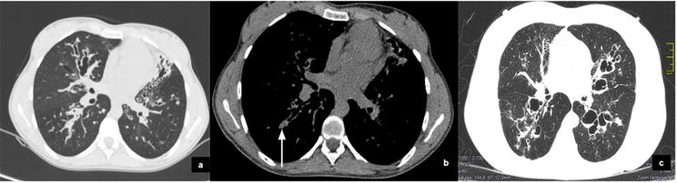
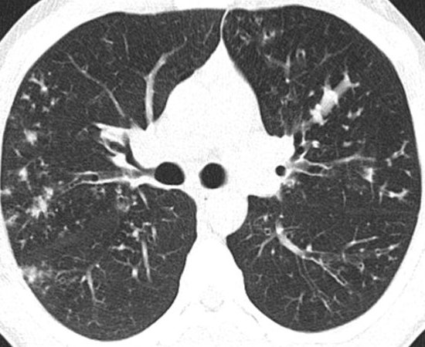
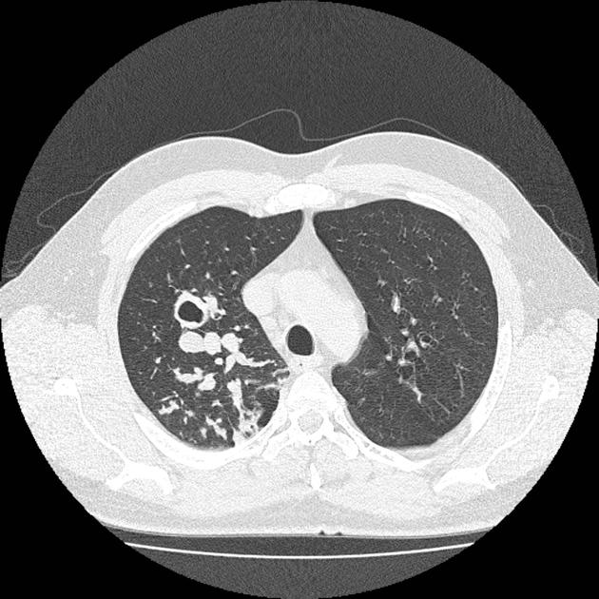
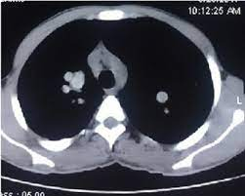
Algorithm For ABPM Diagnosis
Asthma
Cystic Fibrosis
COPD
Bronchiectasis
Compatible Clinical Picture
OR
Elevated Serum Fungus Specific IgE HIGH
Total IgE > 500 IU/ml
Any 2 of 3
AEC> 500cells/u
Fungus specific IgG HIGH
2 Sputum OR 1 BAL Fungus Culture +ve
ABPM -B
ABPM - MP
HRCT Chest
ABPM
ABPM - HAM
2024 ISHAM-AWG guidelines
Notes:
Or Fleeting opacities on CXR

Slide 8

Clinico-Radiological Stages of ABPA : Acute ABPA
Newly Diagnosed
Exacerbation in Previously Diagnosed ABPA
Clinical worsening > 2 weeks
Radiological worsening
Increase in S IgE total by > 50% over last IgE in clinical stable state
R/O other causes of worsening: AE of Associated Condition:
Asthma
Bronchiectasis
48 hours of worsening Sx of Asthma or Bronchiectasis, w/o immunological or radiological worsening of ABPA
2024 ISHAM-AWG guidelines

Slide 9
Clinico-Radiological Stages of ABPA : Response
Symptoms
> 50% in Visual Analogue Scale
Immunological
Decrease in IgE Total >20%
Imaging
> 50% reduction in radiological opacities
Improvement @
8 weeks
2024 ISHAM-AWG guidelines
Notes:
CXR or CT scan of the chest should be
repeated after 4-8 weeks of therapy to document clearing of infiltrates

Slide 10
Clinico-Radiological Stages of ABPA : Remission
Remission
On / Off Treatment
Sustained ( >6 months)
Clinical
Symptoms
Radiological
CXR
Off OCS
Oral steroids
No ↑ IgE > 50%*
Over Stability value
On
Antifungals
or
Biologicals
2024 ISHAM-AWG guidelines

Slide 11
Clinico-Radiological Stages of ABPA : Treatment Dependent
> 2 consecutive ABPA exacerbations, within 3 months of stopping OCS
Worsening respiratory symptoms
Worsening imaging
Rise in serum total IgE by 50% within 4 weeks of tapering OCS on 2 separate occasions
AND
OR
+
2024 ISHAM-AWG guidelines
Notes:
Multiple asthmatic exacerbations in ABPA patient suggest that corticosteroid therapy should be used,
usually at a dose of ≥10 mg/day of prednisolone, although with the aim of using the minimal dose that will stabilise the patient.

Slide 12
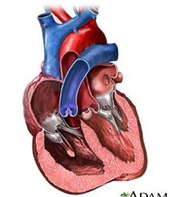
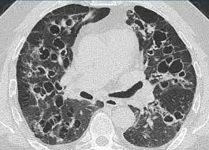
Advanced ABPA
• Extensive bronchiectasis (≥10 segments) due to ABPA on imaging
AND
Cor pulmonale
Type 2 Respiratory Failure
OR
2024 ISHAM-AWG guidelines

Slide 13
Treatment of ABPA : Principles
Anti-inflammatory
Hypersensitivity to Aspergillus
Anti-fungal
Airway Aspergillus Load
Standard of Care
Underlying Disease
2024 ISHAM-AWG guidelines

Slide 14
ABPA Treatment
Glucocorticoids are the most effective agents in ABPA
Antifungal triazoles (itraconazole, voriconazole) are good alternative agents
Prednisolone-Antifungal (itraconazole) combination recommended by IDSA
Combination therapy also for those with high-risk of recurrent exacerbations*
*
First exacerbation of ABPA (to maintain remission)
Glucocorticoid-dependent ABPA
Alternative therapy in acute-stage ABPA
2024 ISHAM-AWG guidelines
Notes:
itraconazole: 200 mg orally three times daily for 3 days and then 200 bid
voriconazole: 400 mg orally twice daily on day 1, followed by 200 mg twice daily
posaconazole: 300 mg orally (delayed- release) twice daily on day 1, followed by 300 mg once daily

Slide 15

Steroids in ABPA : 1st Line Therapy
Dose : 0.5mg/kg/day – 2 weeks, decrease dose by 5 mg every 2 weeks till maintenance dose 10 mg /day for ~ 6 months
Relapses -13.5–45% and can become OCS-dependent
Steroid induced side effects : Total OCS dose dependent
Agarwal R, et al. Clin Chest Med 2022; 43(1): 99-125

Slide 16
Azoles in ABPA : Add on 1st Line or 2nd Line Therapy
Delayed Response
As1st line when OCS can't, be used *
* Poorly controlled DM or Severe OCS related side effects threatening life or organ or chronic infections
Drug interactions
Hepatotoxicity
Bioavailability
Issues
Adding Azoles to OCS – Adrenal suppression
2nd line
or as combined therapy
Itraconazole : need monitoring of serum drug levels
Voriconazole : less affected bioavailability
Posaconazole : used in resistance to other azoles
Agarwal R, et al. Clin Chest Med 2022; 43(1): 99-125
Notes:
concomitant use of systemic corticosteroids and azole antifungals; both
agents can cause adrenal suppression in their own right due to metabolism through CYP450.
azoles can increase the serum concentration of cystic fibrosis transmembrane conductance regulator
modulators, which is important for drug monitoring in CF patients.

Slide 17
Goals of Treatment & Drugs in ABPA
Goals For Treatment | Acute ABPA Newly Diagnosed | ABPA in Remission Improvement for > 6 months without OCS | Treatment Dependent ABPA ; Exacerbation or worsening after tapering OCS | Advanced ABPA Extensive Brx or Respiratory Failure
Relief of Symptoms | ✓ # ^ | ✓ | ✓#^ | ✓
Prevent Bronchiectasis | ✓#^ | ^ | ^
Reduce Adverse Effects | ✓^ |  | ✓^ | ✓^
Prevent Reoccurrences | ✓#^ | ✓^ | ✓#^
✓ Biologicals # Steroids ^ Antifungals

Slide 18

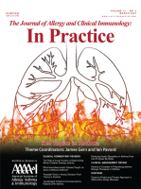
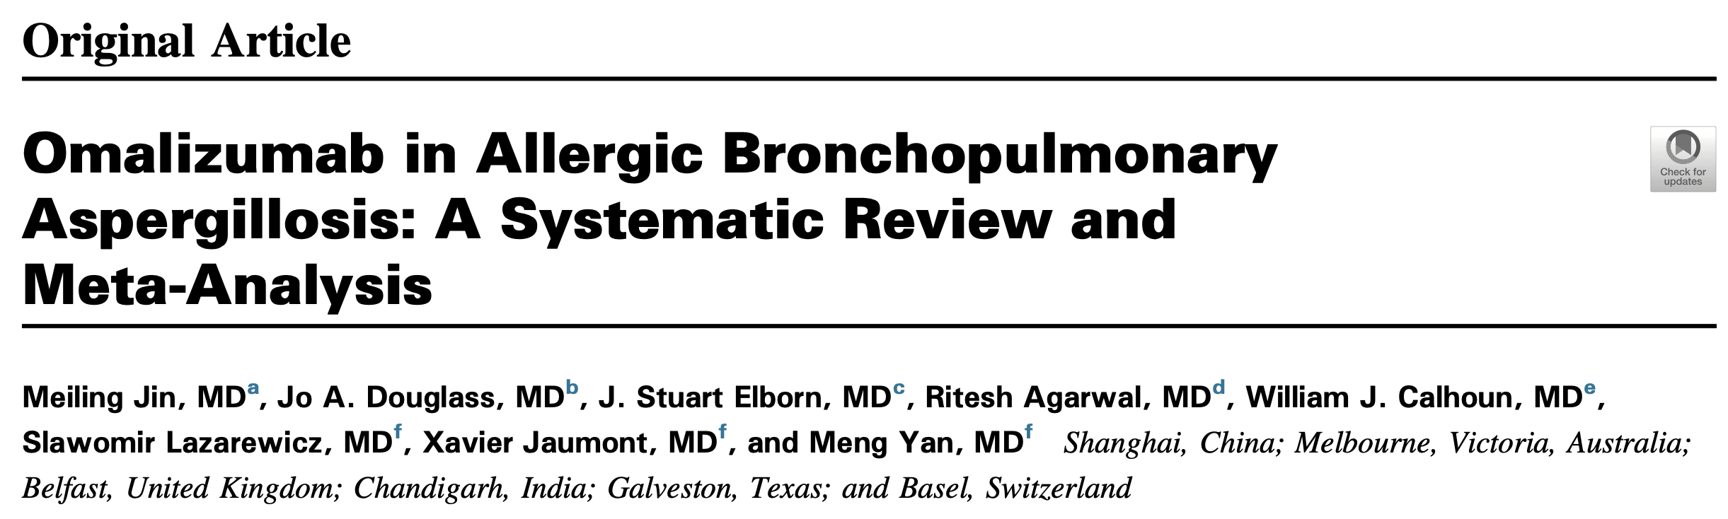
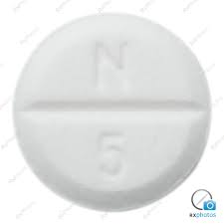
Biologicals in ABPA : Omalizumab
2.09 % less Exacerbations
65 % reduction in OCS use
53 % OCS termination
15 % reduction in OCS MG/day
12 % FEV₁ improvement
8 % better asthma control
Average dose 375 mg/ twice a month
Notes:
Baseline clinical data with respect to the stage and duration of ABPA and extent of bronchiectasis (ABPA severity)
were not available for most enrolled patients.
Omalizumab: 150-375 mg subcutaneously every 2-4 weeks, adjust dose according to serum IgE levels and body weight, maximum 150 mg/injection site

Slide 19
Biologicals in ABPA : Anti IL-5 Mabs
Mepolizumab :
Exacerbations
OCS dose
Benralizumab :
May be more effective in ABPA patients with mucus plugging
Reduction in :
Improvement in:
Asthma control
Lung functions
Small studies mostly failed on antifungals or omalizumab
Notes:
mepolizumab: 100 mg subcutaneously every 4 weeks
Evidence from case series suggests that benralizumab, an IL-5 antagonist monoclonal antibody, successfully treats ABPA,
and may be more effective than mepolizumab (another IL-5 antagonist) at clearing bronchial mucus plugs

Slide 20
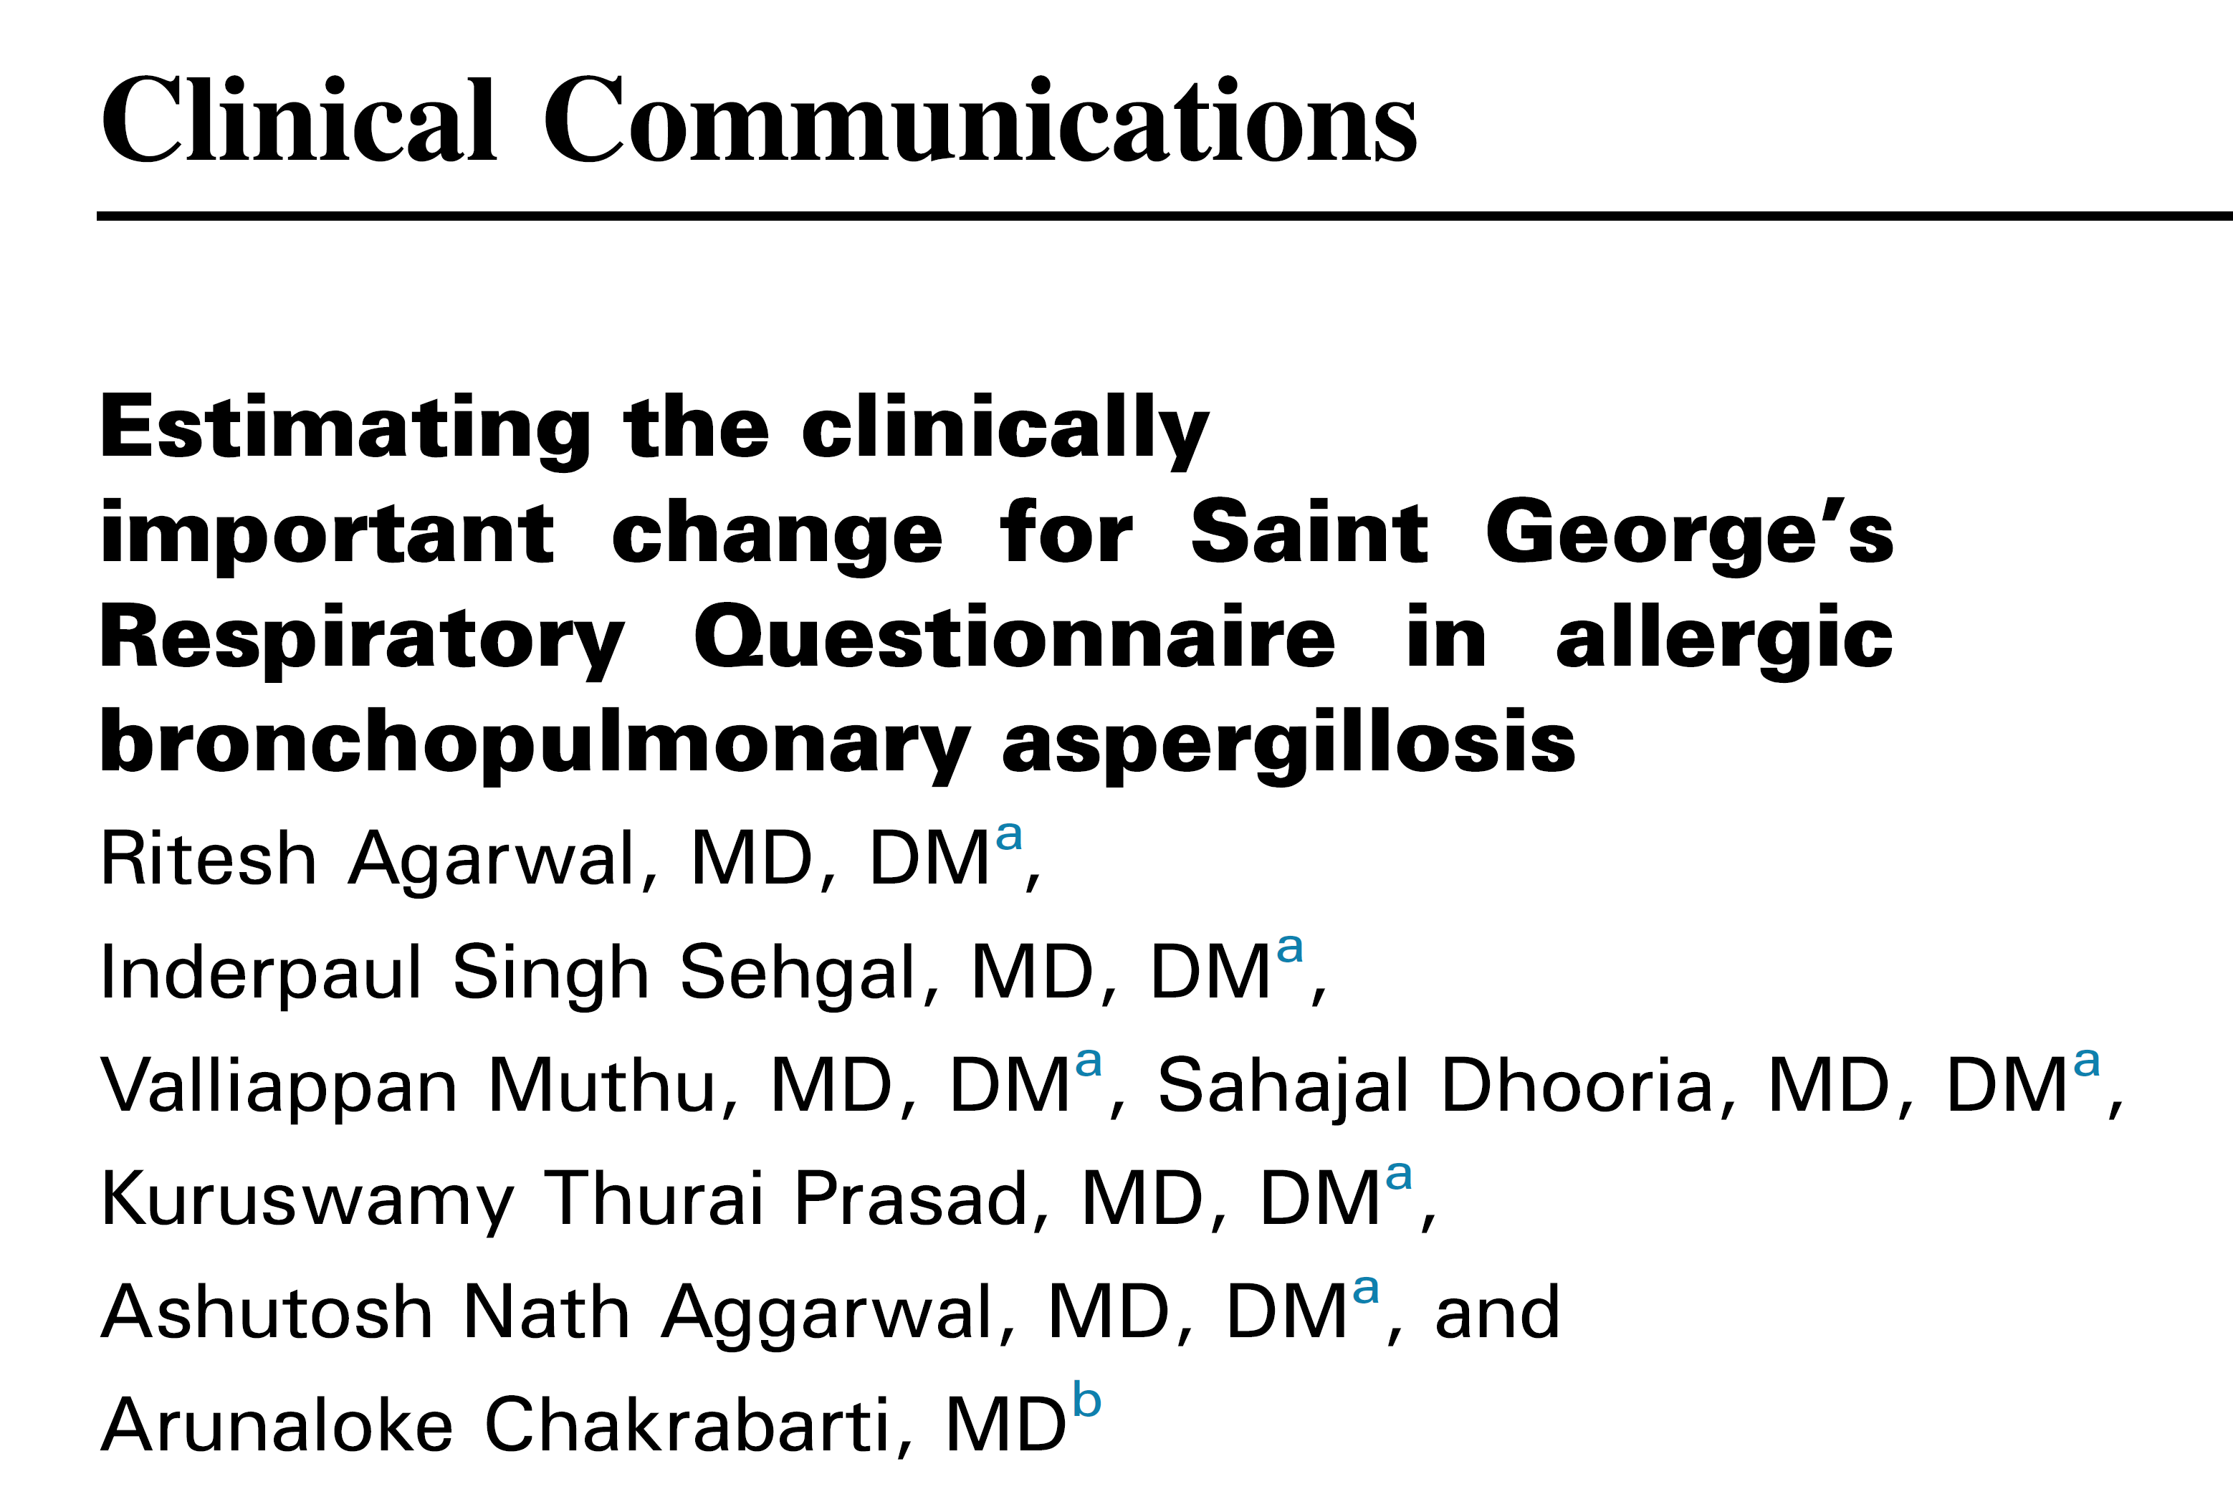
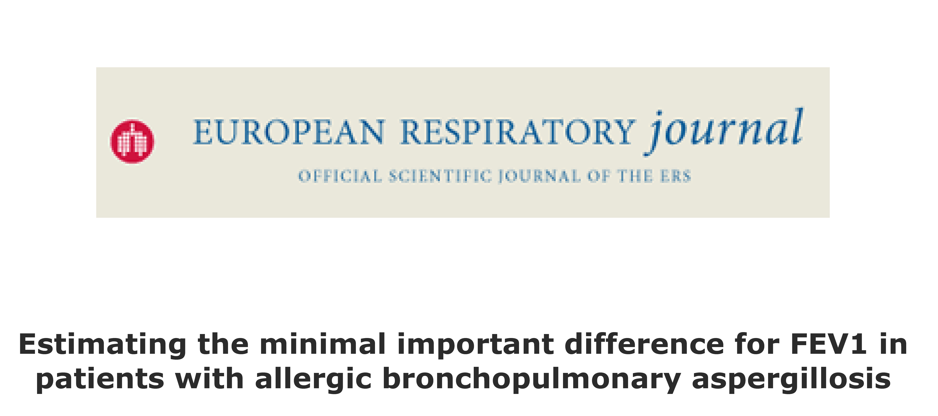
Follow-up and monitoring
Clinical examination, chest radiograph, Total IgE levels (25% (35%)) decline; not specific IgE or IgG) every 8 weeks
Agarwal R, et al. Respir Med 2010; 104(2): 204-10
Agarwal R, et al. Mycoses 2016; 59(1): 1-6
Agarwal R, et al. Mycoses 2017; 60(1): 33-9
Agarwal R, et al. J Allergy Clin Immunol Pract 2022; In press
Agarwal R, et al. Eur Respir J 2022; In press
Notes:
After treatment with prednisolone for either stage 1 (acute) or stage 3 (exacerbation), check total serum IgE every 2 months for 1 year. If the total serum IgE level does not drop by >35% over the first 8 weeks of therapy, confirm that the patient is taking the oral corticosteroid as
instructed, and consider other causes such as infection.[48] If total serum IgE increases by >100% at any stage, evaluation with a chest x-ray is indicated.[
Yearly pulmonary function testing and spirometry is recommended. A decrease in vital capacity of ≥15% may indicate an exacerbation of ABPA

Slide 21
Treatment of ABPA : Summary
2024 ISHAM-AWG & NICE guidelines
OCS
Anti-fungal
Environmental Control
Optimize predisposing Condition
OCS
Anti-fungal
Environmental Control
Optimize predisposing Condition
Biologicals
Anti-fungal
Environmental Control
Optimize predisposing Condition
Acute/ Exacerbation
OCS Dependent
Advanced End Stage
Notes:
Indoor Humidity should be kept below 50% as mould grows in humid environments.
A fumigatus can be seen in particularly high quantities in, for example, dead and decaying organic matter
such as compost, so activities such as gardening can increase exposure.

Slide 22
Conclusions:
ABPA & ABPM are now defined with 4 underlying conditions
Clinical + Serological + Radiological criteria refined
Imaging subtypes ABPA variants
Acute / Exacerbations / Relapse defined as serological vs disease
Treatment dependent needs careful approach – side effects
Advanced ABPA needs management of underlying conditions
Upfront Treatment is dual therapy ( OCS+ Azoles)
Monitoring every 2 months – serology & imaging
Biologicals to use if OCS or antifungals are giving side effects

Slide 23




Foundation for Pulmonary Allergy Critical Care & Sleep Medicine In India
15th 16th, 17th August 2025
Download all Presentations on -
https://pacsfoundation.com/
Inviting Applications for Interventional Pulmonology Fellowship till April 30th 2025

